Slide 1
Raspberry Pi plethysmograph Instructions
Szeged, 2013

Slide 2
Available devices
These methods are not only available on the Raspberry Pi, but also on PC
The same, platform independent software can be used on the Raspberry Pi and PC

Slide 3
Prepare the Raspberry Pi
Install the Raspbian Wheezy hard float build on the Raspberry Pi
Help for the installation: http://javafx.steveonjava.com/javafx-on-raspberry-pi-3-easy-steps/
Install Java and JavaFX
An early access, which is capable for the Raspberry Pi can be found at http://jdk8.java.net/
Help for the installation: http://javafx.steveonjava.com/javafx-on-raspberry-pi-3-easy-steps/

Slide 4
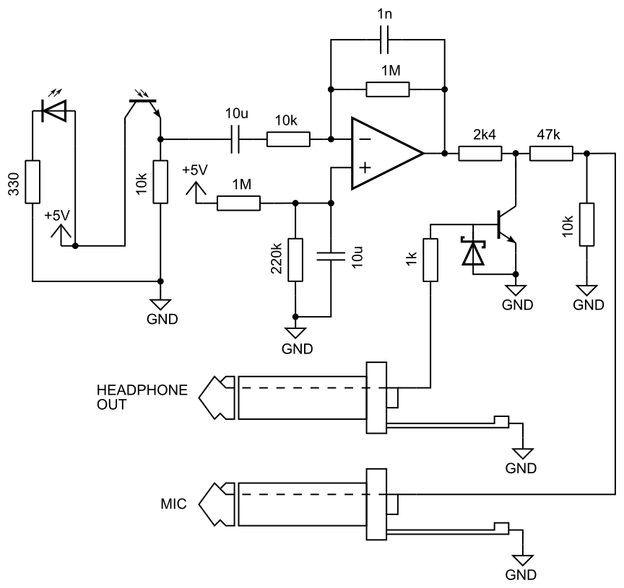
Assembling the measurement circuit Amplitude modulation
Build this circuit on any kind of protoboard

Slide 5
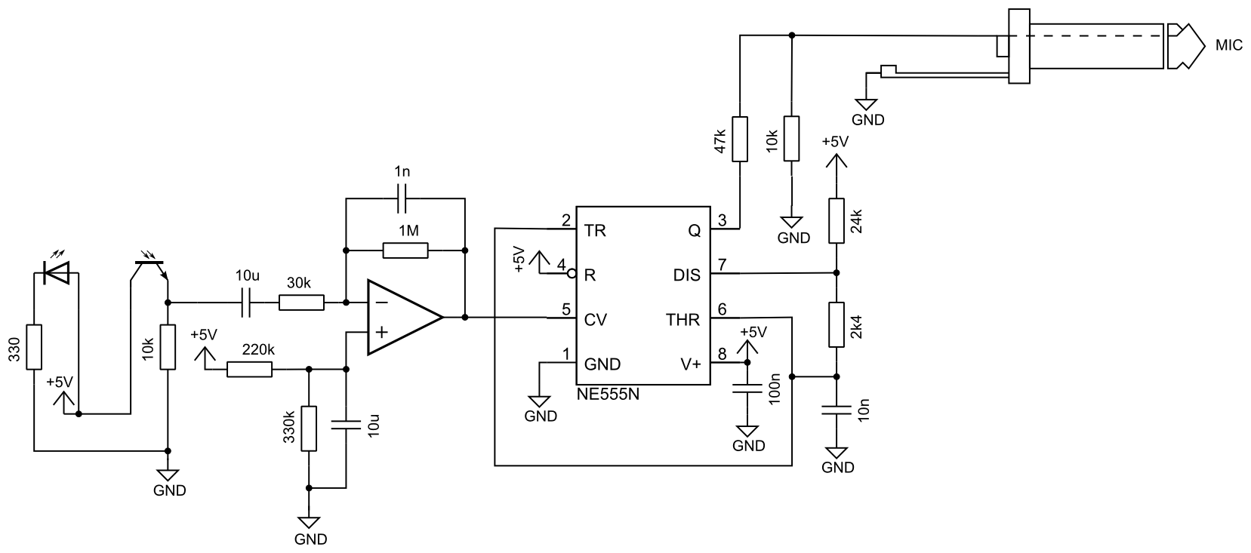
Assembling the measurement circuit Frequency modulation
Build this circuit on any kind of protoboard

Slide 6
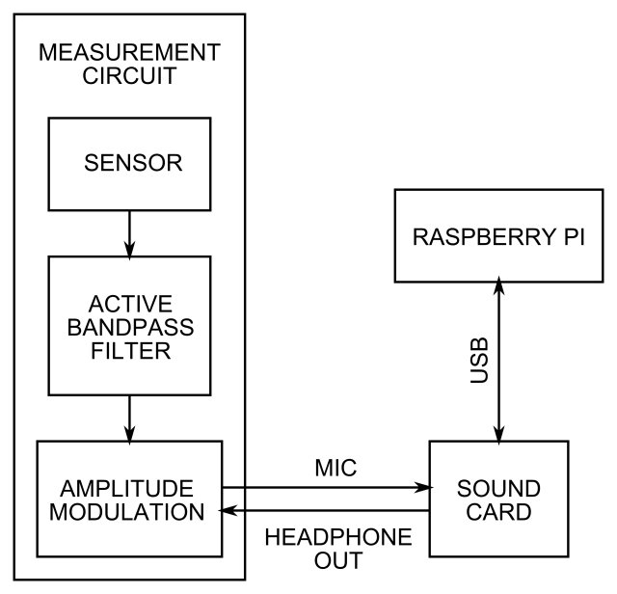
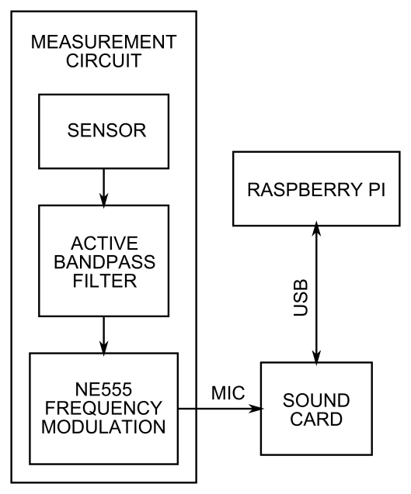
Connecting together
Connect the Raspberry Pi, the external sound card and the measurement circuit
It is not suggested to get the 5 V power supply (the USB B connector on the photos above) from the USB port of the Raspberry Pi
Aplitude modulation block diagram
Frequency modulation block diagram

Slide 7
Download the software
Download the executable jar, the opt.txt and the mixer_select.txt files from …
Place them into the same directory

Slide 8
Options
The options of the program are in the opt.txt file
In the first row the type of modulation can be set, it is AM for amplitude, and FM for frequency modulation
The best value of refresh rate is 1.0 on the Raspberry Pi

Slide 9
Mixer select
The mixer_select.txt file contains only one number, the index of the mixer will be used to play the modulating signal in case of amplitude modulation
It depends on, which speaker port will be used
We used 2 on the Raspberry Pi
On PC the most common value is 1

Slide 10
Run the program
To start the software, write into the terminal:
sudo /opt/jdk1.8.0/bin/java -Djavafx.platform=eglfb -cp /opt/jdk1.8.0/jre/lib/jfxrt.jar:/home/pi/PletPi/PletPi_final.jar PletFX.PletPi
Instead of /home/pi/PletPi write the path of the folder, where the jar file is placed

