Slide 1

EFOP-3.6.2-16-2017-00015
A HU-MATHS-IN – Magyar Ipari és Innovációs Matematikai Szolgáltatási Hálózat tevékenységének elmélyítése
The Hu-Maths-In – Deepening the activities of the Hungarian Industrial and Innovation Mathematics Services Network
Stochastic optimization of the simulated life-cycle of ill cows to provide an advice for farmers when to sell

Slide 2
Sponsor company
Puskin-tej Ltd.:
A private diary farm located in Szegvár
Collaboration contract with the Insitute of Informatics and Faculty of Agriculture of the University of Szeged
Interested in improving the profitability of milk production

Slide 3

Problem field
Milk yield
Economic factors
Mastitis
Reproduction
Productivity
Profitability
Analyse
Decide on selling the cow

Slide 4
First application -Material
We have visited dairy farms and collected other open sources.
We assume that the actual mastitis requires 5 days of healing with a probability of 70%, and 10 days with probability 30%.
An additional interval of 15 days is needed to first profit from the milk production.
To get ill, we have a daily probability of just 0.05% if it will be the first mastitis of the given cow, 0.1% for the second, 0.2% for the third, and 0.4% probability for all the later illnesses.
The daily profit of a cow producing milk is composed of 1500 HUF revenues for the milk, minus 1000 HUF for the keeping costs.
If a cow is in dry period, that means 0 revenue for the milk, and 700 HUF for the keeping.
The medicine against mastitis costs around 200 HUF per day.
The average lactation cycle length is 305 days, then a rest of 115 days is assumed.
In general, we consider to sell the ill cow when it is either the sixth time ill, or it is already 10 years old.

Slide 5
First application - Method
The basis of our technique is to simulate the life of a cow on daily basis.
With a cow of a given age, number of already suffered mastitis illness, and in a given phase of the dairy cycle.
For each day we draw a pseudo random number to decide whether we consider the animal to be ill.
After a proper dry period, the milk production will resume.
The selling price is calculated by the formula: 400 – 25 times the age in years - 37.5 times the number of illnesses (in thousands of HUF).

Slide 6
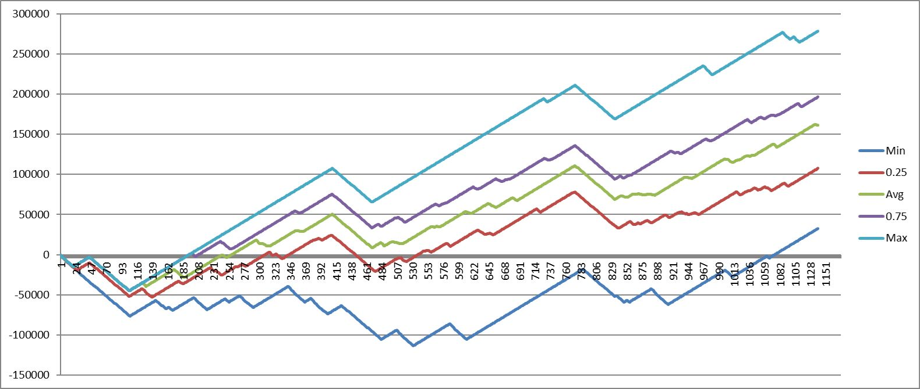
First application - result
Illustration of the profit obtained from a cow in Hungarian Forints from the time (x axis) of the recent illness detection.

Slide 7
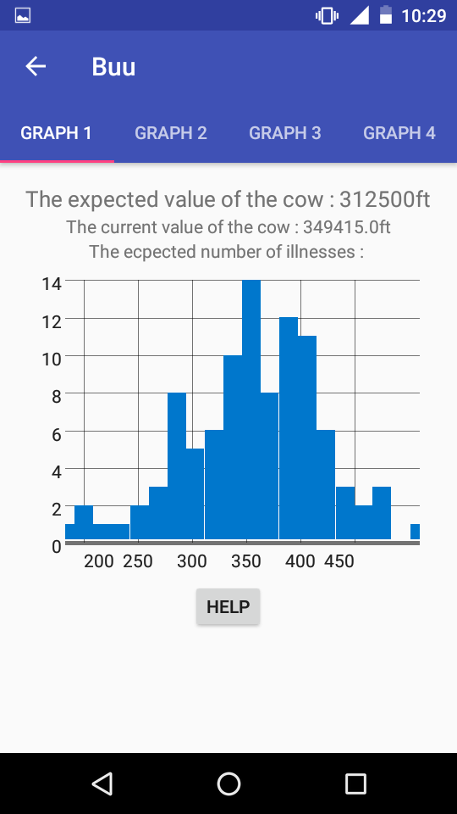
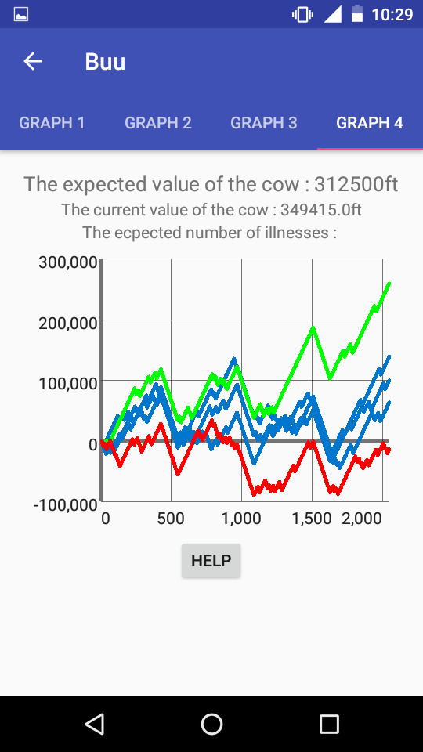
Smart phone application
Portable
Easy to use
Suggestion to apply local data
Visualised data of the the cow’s future price

Slide 8
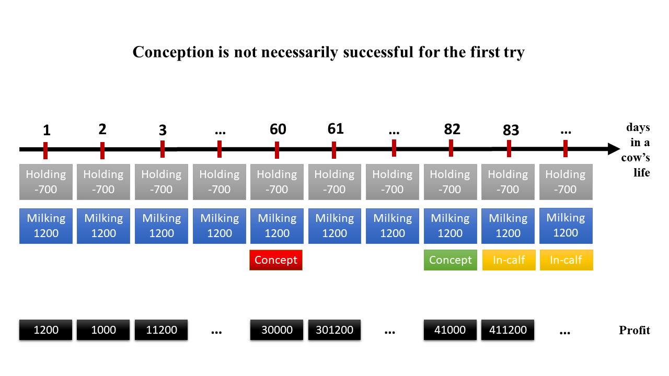
New method

Slide 9
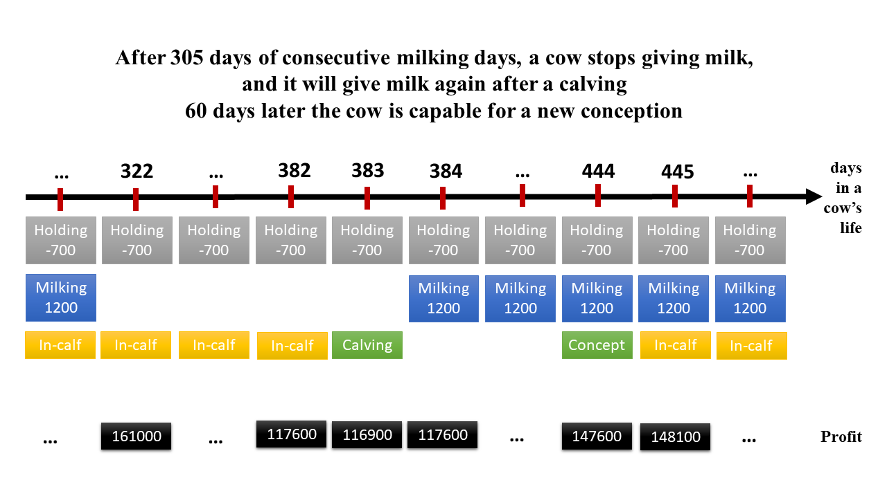
New method

Slide 10
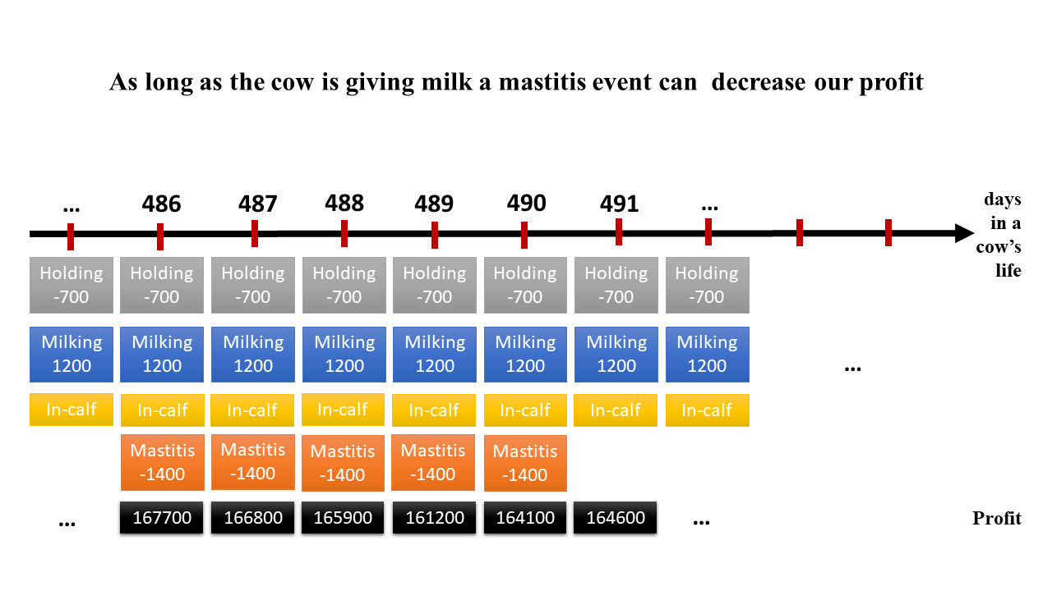
New method

Slide 11

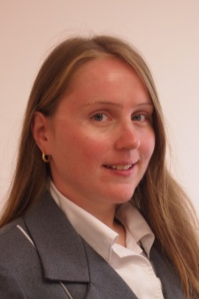
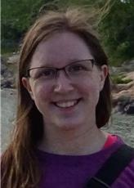


Research Team
Dr. Balázs Bánhelyi
Associate professor
Antal D. Elvira
Young researcher
Abigél Mester
MSc student
Heinc Emilia
BSc student
Garzó Ádám
Agriculture student

Slide 12
Results
Presentations:
BALÁZS BÁNHELYI, ELVIRA D. ANTAL, TIBOR CSENDES, ABIGÉL MESTER, JÓZSEFNÉ MIKÓ, JÓZSEF HORVÁTH:
ECONOMIC MODELLING OF DAIRY FARMS REGARDING MASTITIS
XVIth WELLMANN INTERNATIONAL SCIENTIFIC CONFERENCE Hódmezővásárhely (Hungary) May 9, 2018
ABIGÉL MESTER, EMILIA HEINZ, BALÁZS BÁNHELYI, ELVIRA D. ANTAL, JÓZSEFNÉ MIKÓ, JÓZSEF HORVÁTH, TIBOR CSENDES:
DECISION SUPPORT HEURISTIC FOR DAIRY FARMS
The 11th Conference of PhD Students in Computer Science Szeged (Hungary) June 25-27, 2018
(The extended abstract appeared in conference proceedings.)
BALÁZS BÁNHELYI, JÓZSEFNÉ MIKÓ, JÓZSEF HORVÁTH, TIBOR CSENDES, ABIGÉL MESTER:
DECISION SUPPORT HEURISTIC FOR DAIRY FARMS
The 20th European Conference on Mathematics for Industry Budapest (Hungary) June 18-22, 2018
ABIGÉL MESTER, EMÍLIA HEINZ, BALÁZS BÁNHELYI
DECISION SUPPORT HEURISTIC FOR DAIRY FARMS
The 2. International Students' Conference StudMath-IT Arad (Romanian)
(The conference paper will be appear in conference proceedings.)

Slide 13
Results on Conferences
BALÁZS BÁNHELYI, ELVIRA D. ANTAL, TIBOR CSENDES, ABIGÉL MESTER, JÓZSEFNÉ MIKÓ, JÓZSEF HORVÁTH:
ECONOMIC MODELLING OF DAIRY FARMS REGARDING MASTITIS
XVIth WELLMANN INTERNATIONAL SCIENTIFIC CONFERENCE Hódmezővásárhely (Hungary) May 9, 2018
ABIGÉL MESTER, EMILIA HEINZ, BALÁZS BÁNHELYI, ELVIRA D. ANTAL, JÓZSEFNÉ MIKÓ, JÓZSEF HORVÁTH, TIBOR CSENDES:
DECISION SUPPORT HEURISTIC FOR DAIRY FARMS
The 11th Conference of PhD Students in Computer Science Szeged (Hungary) June 25-27, 2018
BALÁZS BÁNHELYI, JÓZSEFNÉ MIKÓ, JÓZSEF HORVÁTH, TIBOR CSENDES, ABIGÉL MESTER:
DECISION SUPPORT HEURISTIC FOR DAIRY FARMS
The 20th European Conference on Mathematics for Industry Budapest (Hungary) June 18-22, 2018

Slide 14
Thank you for your attention!

