Slide 1
Smart *

Slide 2
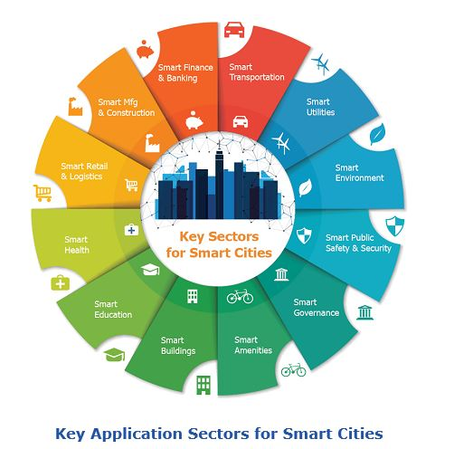

Slide 3
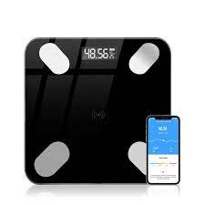
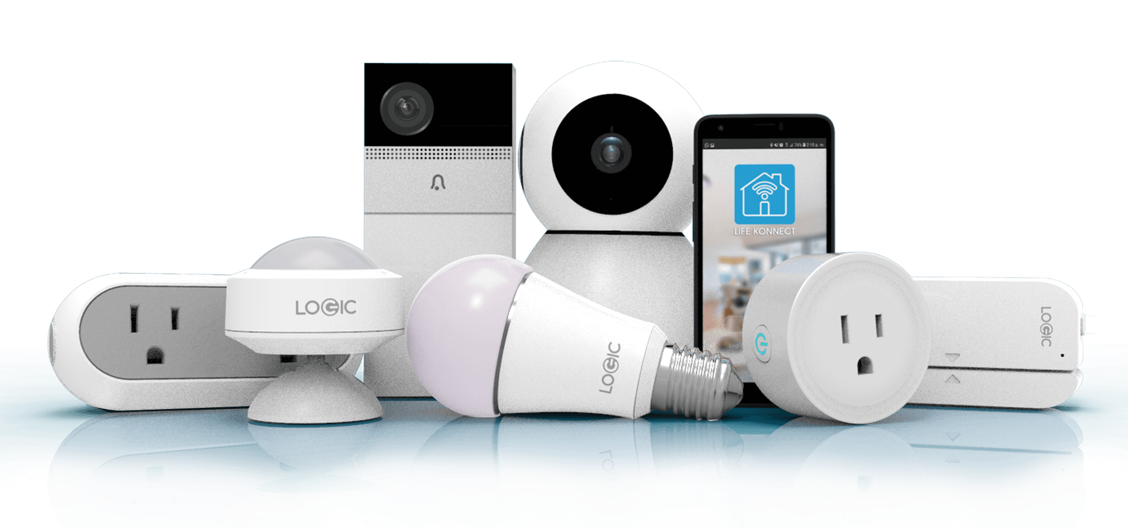
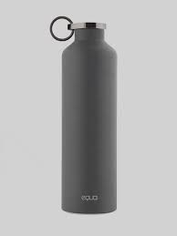
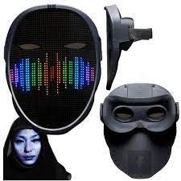
smart devices

Slide 4
Smart homes
A residence equipped with a high-tech network, sensors and devices, and features
that can be remotely monitored, controlled,
and provide services that respond to the needs of its inhabitants.
Goals:
live a safe, healthy, comfortable life
energy efficiency

Slide 5
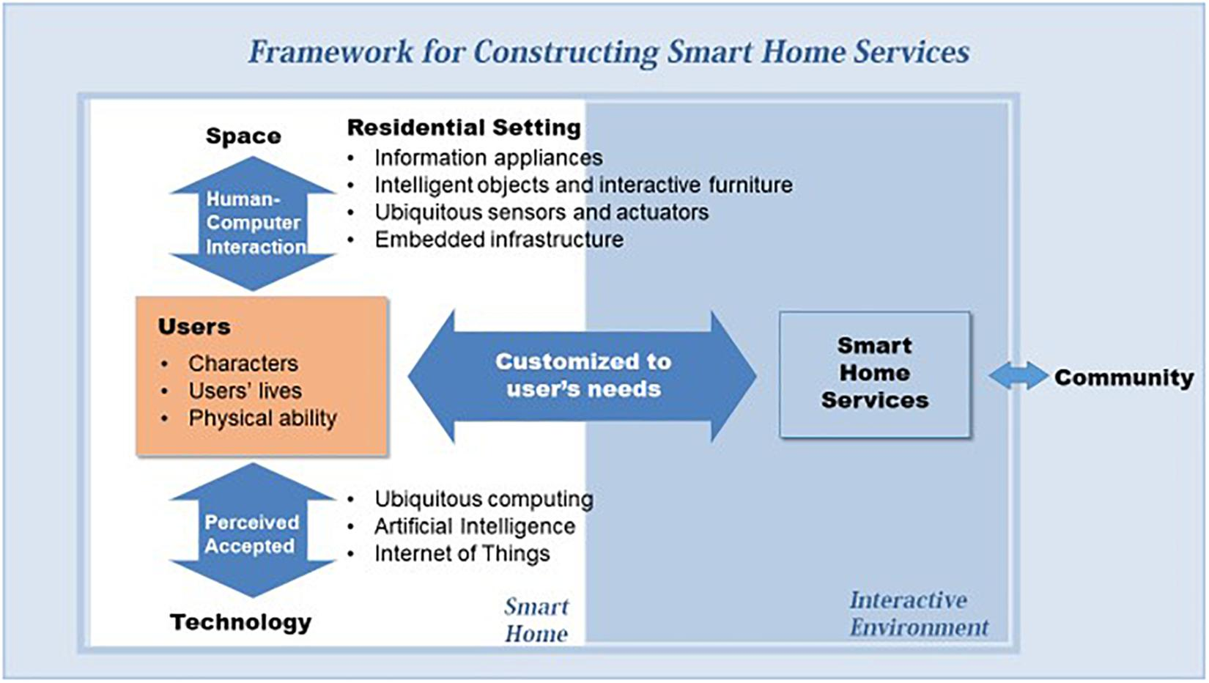
Notes:
it is critical to understand the factors that potential users consider important and necessary, and then decide on acceptable technologies and functions, rather than being concerned with technological performance in isolation

Slide 6
Smart home users
characteristics
age, educational level, income…
lives
daily routine, habits…
physical ability
health
houshold
community life

Slide 7
Smart home design
What is important and what are the problems for the residents in each situation presented in the scenarios?
How can space or technology improve their lives?
What are the smart home services that should be provided for residents in each situation?

Slide 8
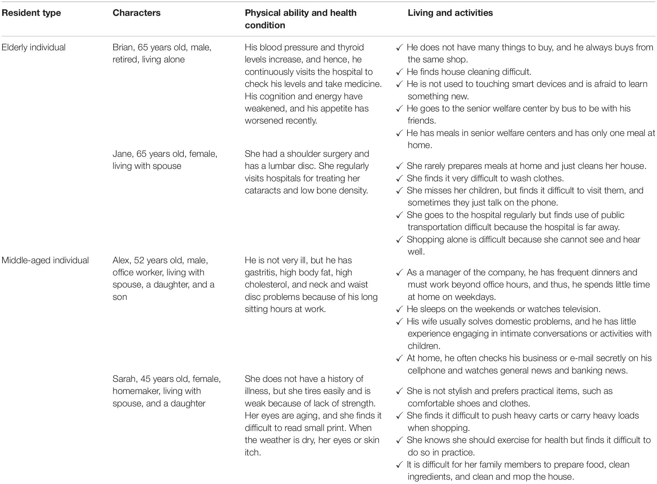

Slide 9
Ambient Assisted Living
ensuring the life quality of our senior citizens
Safety
emergency response systems,
fall detection systems, and video surveillance
daily activities
monitoring activities of daily living
issuing reminders
helping with mobility
communication

Slide 10
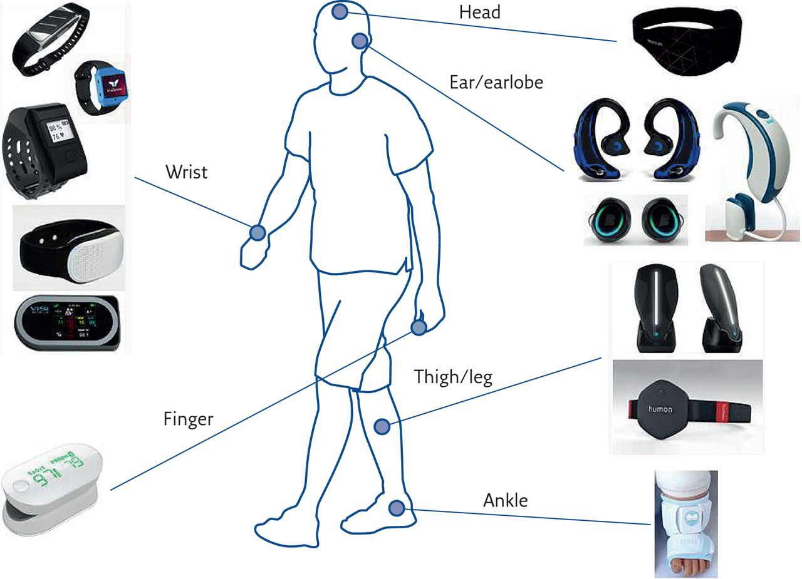
Smartphone + non-invasive sensors (wearables)

Slide 11
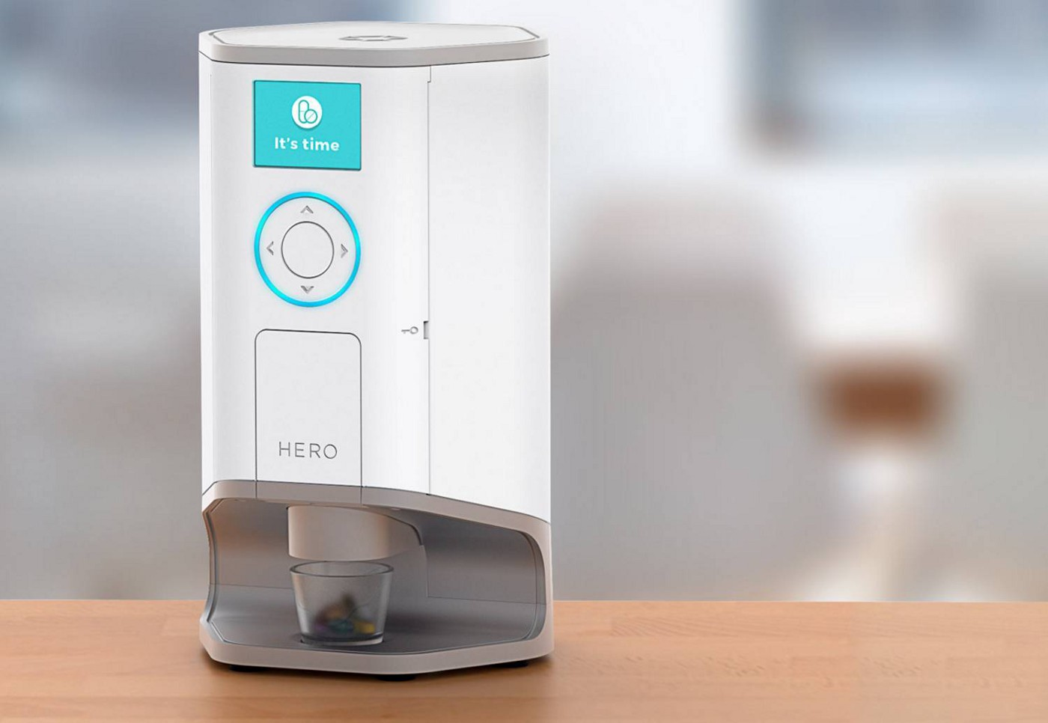

Slide 12
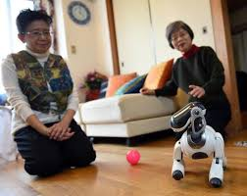
Assistive robots
Activities of Daily Living
feeding, dressing, grooming
retrieve dropped objects, transfer
Instrumental Activities of Daily Living
personal hygiene, meal preparation, shopping
Enhanced Activities of Daily Living
hobbies, communication, and learning
service robots, companion robots

