Slide 1
Europe is a continent located entirely in the Northern Hemisphere and mostly in the Eastern Hemisphere. It comprises the westernmost peninsulas of the continental landmass of Eurasia,^{[10]} and is bordered by the Arctic Ocean to the north, the Atlantic Ocean to the west, the Mediterranean Sea to the south, and Asia to the east. Europe is commonly considered to be separated from Asia by the watershed of the Ural Mountains, the Ural River, the Caspian Sea, the Greater Caucasus, the Black Sea, and the waterways of the Turkish Straits.^{[11]} Although much of this border is over land, Europe is generally accorded the status of a full continent because of its great physical size and the weight of history and tradition. Europe covers about 10,180,000 km² (3,930,000 sq mi), or 2% of the Earth's surface (6.8% of land area), making it the second smallest continent (using the seven-continent model). Politically, Europe is divided into about fifty sovereign states, of which Russia is the largest and most populous, spanning 39% of the continent and comprising 15% of its population. Europe had a total population of about 741 million (about 11% of the world population) as of 2018.^{[2][3]} The European climate is largely affected by warm Atlantic currents that temper winters and summers on much of the continent, even at latitudes along which the climate in Asia and North America is severe. Further from the sea, seasonal differences are more noticeable than close to the coast. European culture is the root of Western civilization, which traces its lineage back to ancient Greece and ancient Rome.^{[12][13]} The fall of the Western Roman Empire in 476 AD and the subsequent Migration Period marked the end of Europe's ancient history and the beginning of the Middle Ages. Renaissance humanism, exploration, art and science led to the modern era. Since the Age of Discovery, started by Portugal and Spain, Europe played a predominant role in global affairs. Between the 16th and 20th centuries, European powers colonized at various times the Americas, almost all of Africa and Oceania, and the majority of Asia.The Age of Enlightenment, the subsequent French Revolution and the Napoleonic Wars shaped the continent culturally, politically and economically from the end of the 17th century until the first half of the 19th century. The Industrial Revolution, which began in Great Britain at the end of the 18th century, gave rise to radical economic, cultural and social change in Western Europe and eventually the wider world. Both world wars took place for the most part in Europe, contributing to a decline in Western European dominance in world affairs by the mid-20th century as the Soviet Union and the United States took prominence.^{[14]} During the Cold War, Europe was divided along the Iron Curtain between NATO in the West and the Warsaw Pact in the East, until the revolutions of 1989 and fall of the Berlin Wall. In 1949, the Council of Europe was founded with the idea of unifying Europe to achieve common goals and prevent future wars. Further European integration by some states led to the formation of the European Union (EU), a separate political entity that lies between a confederation and a federation.^{[15]} The EU originated in Western Europe but has been expanding eastward since the fall of the Soviet Union in 1991. The currency of most countries of the European Union, the euro, is the most commonly used among Europeans; and the EU's Schengen Area abolishes border and immigration controls between most of its member states and some non-members states. There exists a political movement favoring the evolution of the European Union into a single federation encompassing much of the continent.

Slide 2
Europe is a continent located entirely in the Northern Hemisphere and mostly in the Eastern Hemisphere. It comprises the westernmost peninsulas of the continental landmass of Eurasia,^{[10]} and is bordered by the Arctic Ocean to the north, the Atlantic Ocean to the west, the Mediterranean Sea to the south, and Asia to the east. Europe is commonly considered to be separated from Asia by the watershed of the Ural Mountains, the Ural River, the Caspian Sea, the Greater Caucasus, the Black Sea, and the waterways of the Turkish Straits.^{[11]} Although much of this border is over land, Europe is generally accorded the status of a full continent because of its great physical size and the weight of history and tradition. Europe covers about 10,180,000 km² (3,930,000 sq mi), or 2% of the Earth's surface (6.8% of land area), making it the second smallest continent (using the seven-continent model). Politically, Europe is divided into about fifty sovereign states, of which Russia is the largest and most populous, spanning 39% of the continent and comprising 15% of its population. Europe had a total population of about 741 million (about 11% of the world population) as of 2018.^{[2][3]} The European climate is largely affected by warm Atlantic currents that temper winters and summers on much of the continent, even at latitudes along which the climate in Asia and North America is severe. Further from the sea, seasonal differences are more noticeable than close to the coast. European culture is the root of Western civilization, which traces its lineage back to ancient Greece and ancient Rome.^{[12][13]} The fall of the Western Roman Empire in 476 AD and the subsequent Migration Period marked the end of Europe's ancient history and the beginning of the Middle Ages. Renaissance humanism, exploration, art and science led to the modern era. Since the Age of Discovery, started by Portugal and Spain, Europe played a predominant role in global affairs. Between the 16th and 20th centuries, European powers colonized at various times the Americas, almost all of Africa and Oceania, and the majority of Asia.The Age of Enlightenment, the subsequent French Revolution and the Napoleonic Wars shaped the continent culturally, politically and economically from the end of the 17th century until the first half of the 19th century. The Industrial Revolution, which began in Great Britain at the end of the 18th century, gave rise to radical economic, cultural and social change in Western Europe and eventually the wider world. Both world wars took place for the most part in Europe, contributing to a decline in Western European dominance in world affairs by the mid-20th century as the Soviet Union and the United States took prominence.^{[14]} During the Cold War, Europe was divided along the Iron Curtain between NATO in the West and the Warsaw Pact in the East, until the revolutions of 1989 and fall of the Berlin Wall. In 1949, the Council of Europe was founded with the idea of unifying Europe to achieve common goals and prevent future wars. Further European integration by some states led to the formation of the European Union (EU), a separate political entity that lies between a confederation and a federation.^{[15]} The EU originated in Western Europe but has been expanding eastward since the fall of the Soviet Union in 1991. The currency of most countries of the European Union, the euro, is the most commonly used among Europeans; and the EU's Schengen Area abolishes border and immigration controls between most of its member states and some non-members states. There exists a political movement favoring the evolution of the European Union into a single federation encompassing much of the continent.

Slide 3
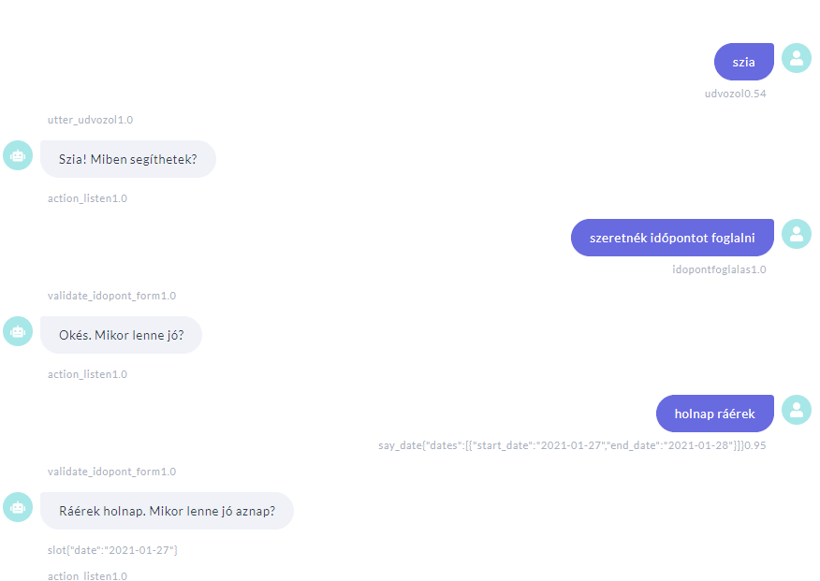
Human-Machine interaction

Slide 4
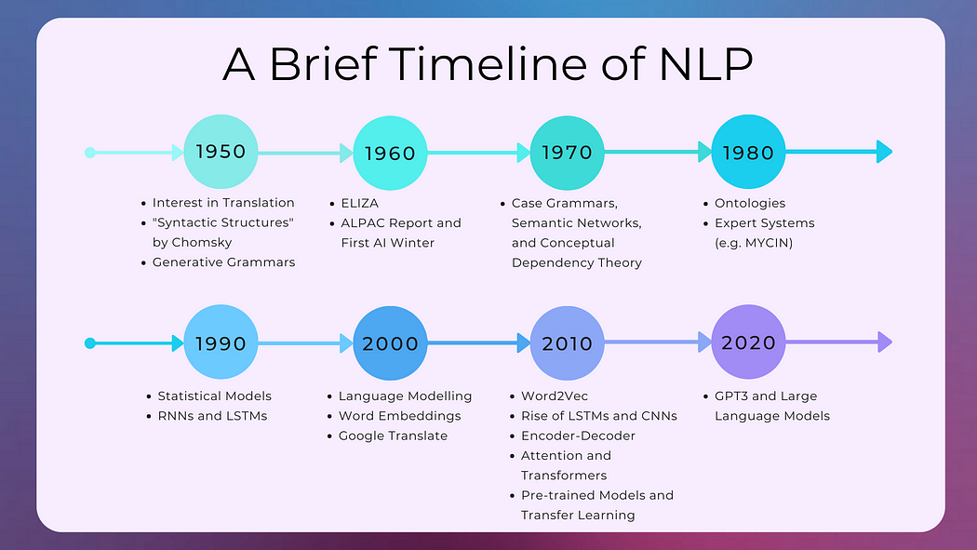

Slide 5
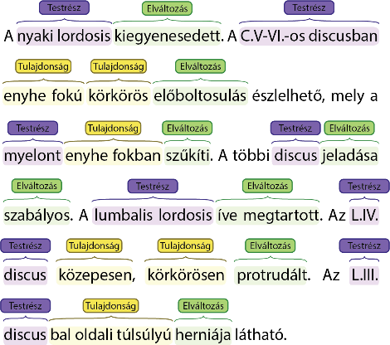
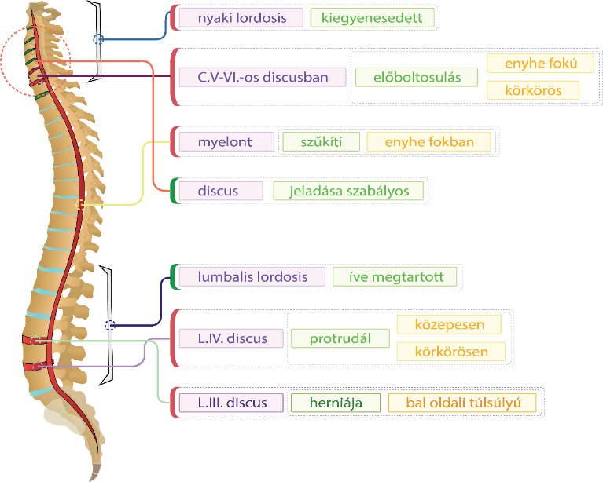
Domains

Slide 6
Large Language Models

Slide 7
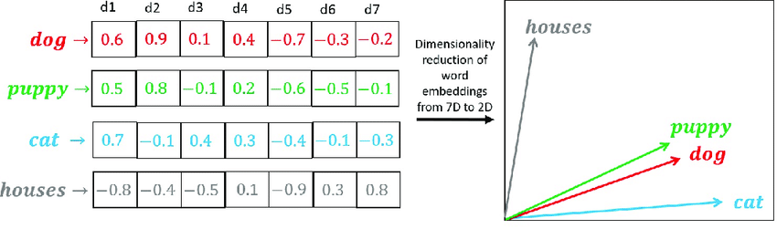
Static word embeddings

Slide 8
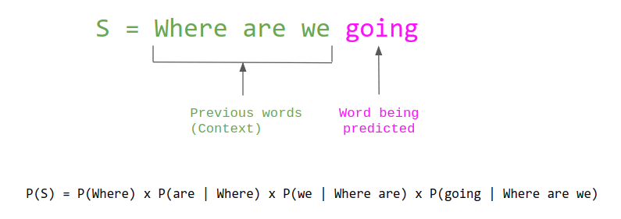
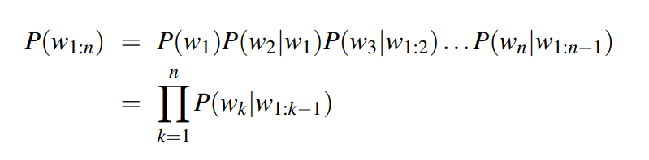
N-gramm Language Models

Slide 9
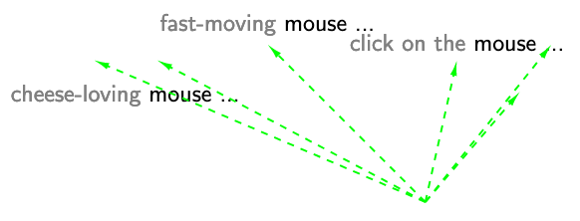
Contextualised word embeddings

Slide 10
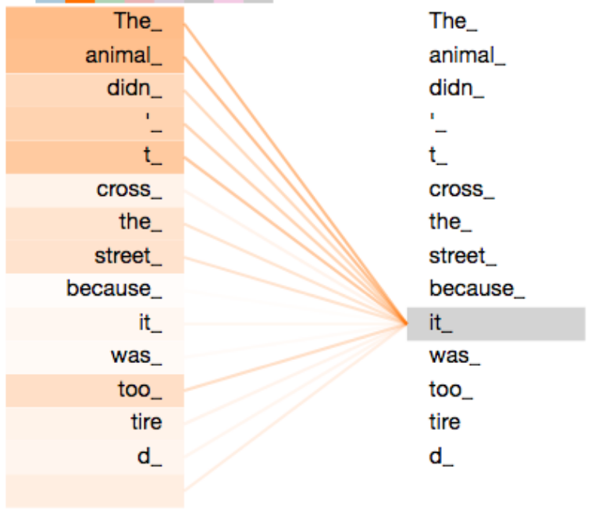
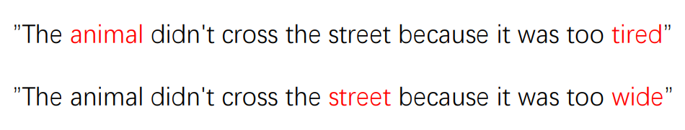
Self-attention
Forrás: http://jalammar.github.io/illustrated-bert/

Slide 11
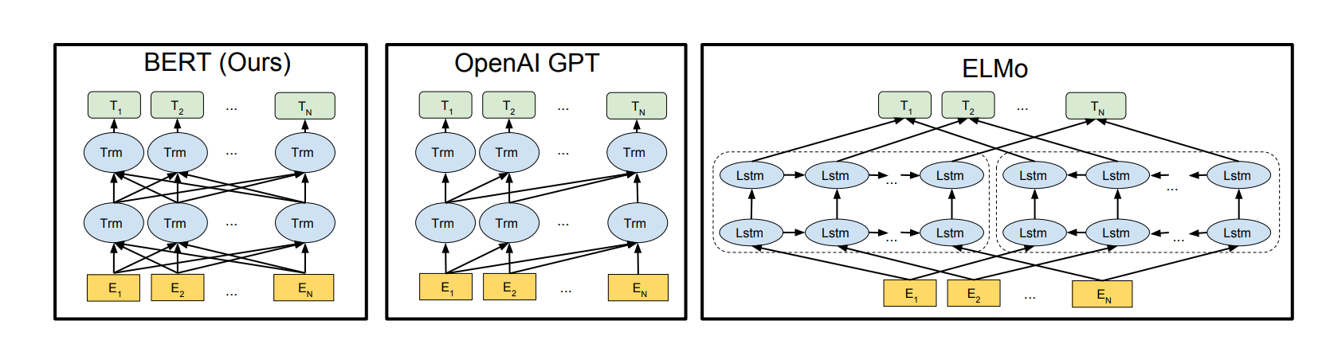


Medium Language Models 2018Q4
Bidirectional Encoder Representations from Transformers (BERT)
Forrás: Devlin et al. (2018)

Slide 12
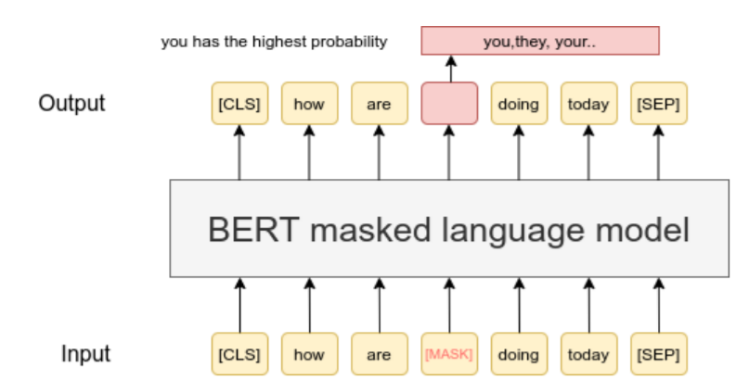
Pretraining by masking

Slide 13
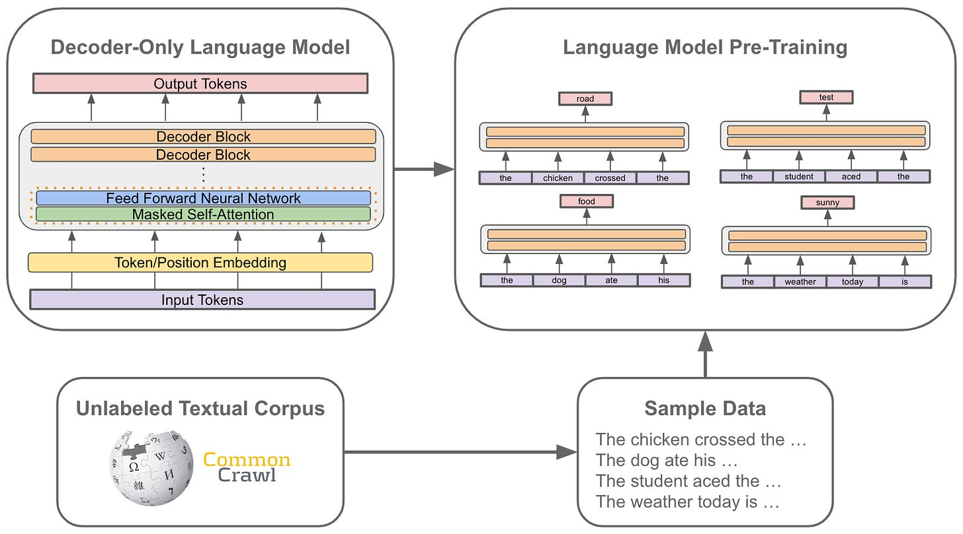
Pretraining -> Foundation model

Slide 14
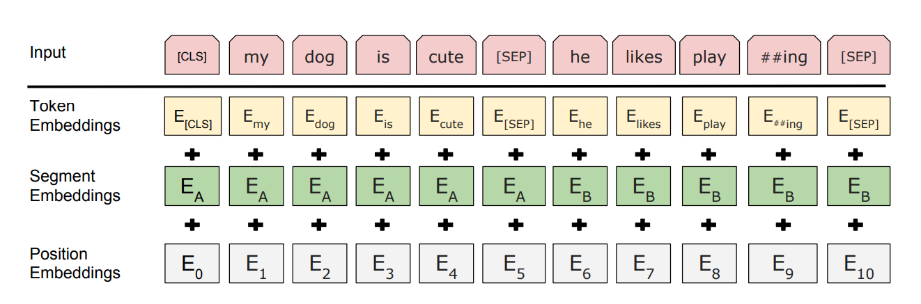
Sentence position in transformers
Forrás: Devlin et al. (2018)

Slide 15
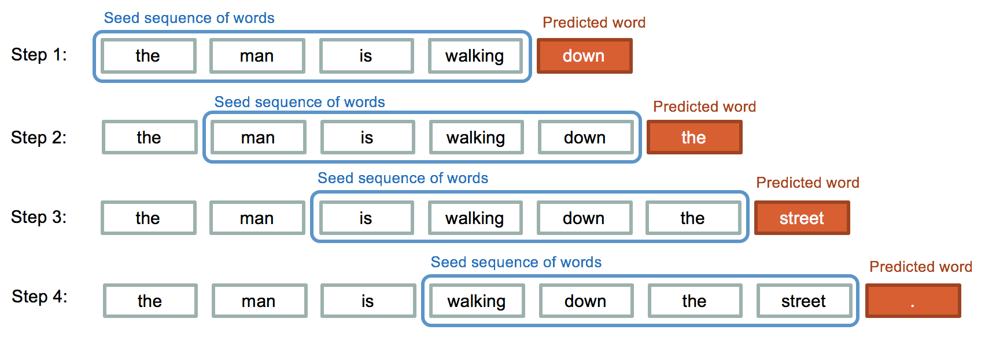
Text generation

Slide 16
Large Language Models, LLMs
NLU NLG

Slide 17
Natural Language Processing (NLP)
NL Understanding (NLU)
Text is input
Document classification
Named Entity Recognition
Information extraction
…
NL Generation (NLG)
Text is output
Chatbot
Machine Translation
Image captioning
…

Slide 18
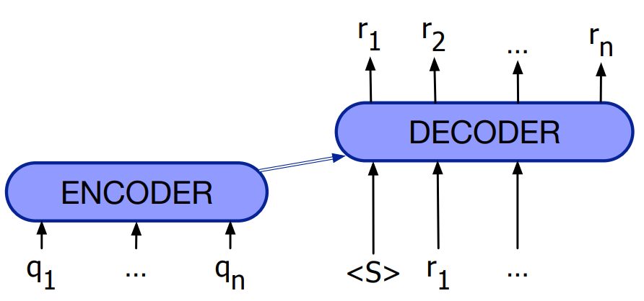
LLM-based text generation

Slide 19
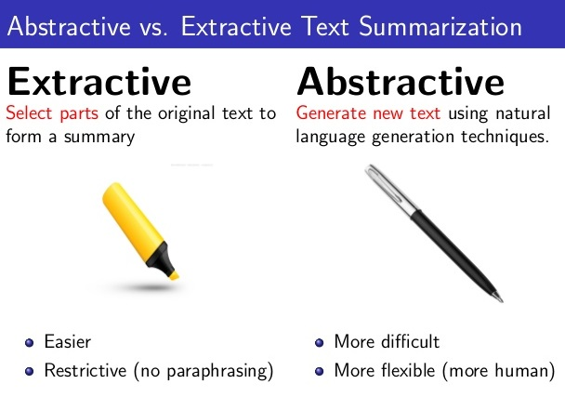
Natural Language Processing (NLP)
NL Understanding (NLU)
Text is input
Document classification
Named Entity Recognition
Information extraction
…
NL Generation (NLG)
Text is output
Chatbot
Machine Translation
Image captioning
…

Slide 20
LLMs for NLU tasks

Slide 21
(classic) Supervised Machine Learning
Feature extraction +
supervised Machine Learning
Feature representation for Document classifciation:
- bag-of-words
- static word embedddings (doc2vec)
- contextual word embeddings (BERT CLS)

Slide 22
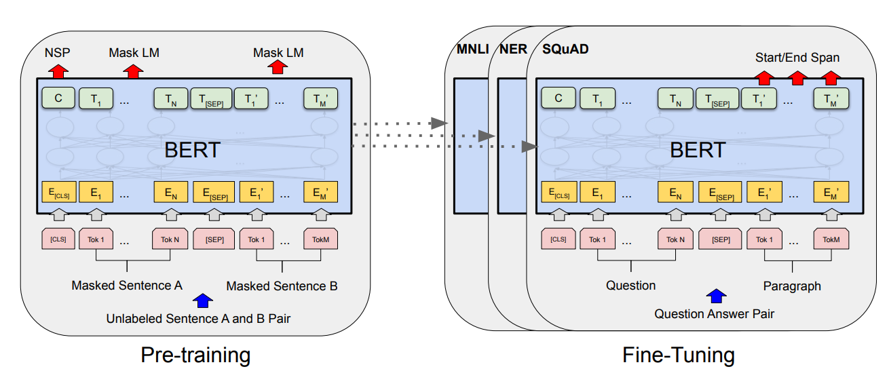
Fine-tuning BERT-type modells

Slide 23
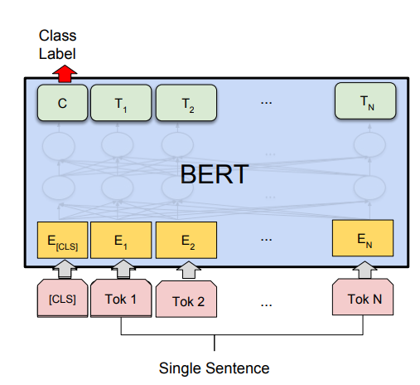
Document classification

Slide 24
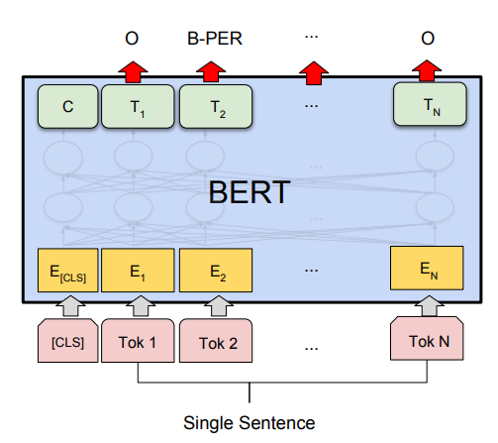
Sequence labeling

Slide 25
Zero-shot learning
Zero-shot = no training examples
utilises exclusevily the pretrained LLM
What is the sentiment of the following tweet?
Best pizza ever!

Slide 26
Few-shot learning
Small amount of training examples
tweet | Class label
Best pizza ever! | +
Excellent Hungarian cousine :-) | +
Dirty, expensive, cannot recommend | -
… | …

Slide 27
Few-shot learning
Small amount of training examples
Fine-tuning BERT-type LLMs

Slide 28
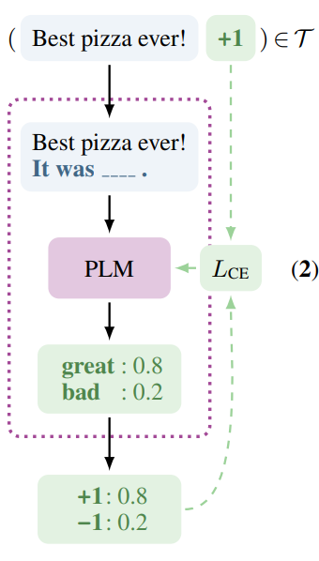
Pattern-exploiting training (PET)

Slide 29
In context (few shot) learning
Training examples in the prompt
Sentiment classify the following tweets!
Best pizza ever! => POSITIVE
Excellent Hungarian cousine :-) => POSITIVE
Dirty, expensive, cannot recommend => NEGATIVE
It wasn’t dirty as expected =>

Slide 30
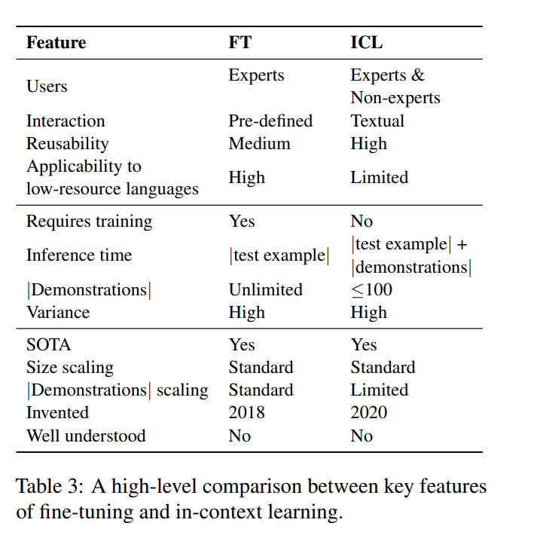

Slide 31
LLMs for NLG tasks

Slide 32
Prompt engineering
Write descriptions of the following animals.
Penguin, Giraffe, Cheetah
Write two-sentence descriptions of the following animals.
Penguin, Giraffe, Cheetah
Write two-sentence descriptions of the following animals. Include the most characteristic features of the animals.
Penguin, Giraffe, Cheetah

Slide 33
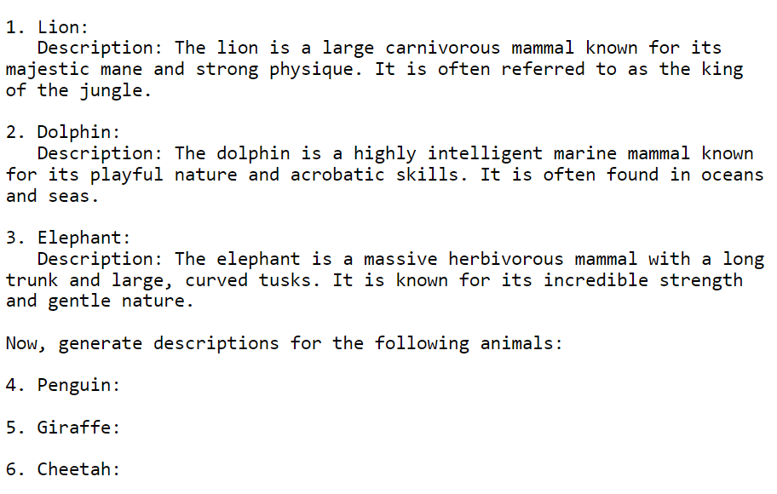
In context (few shot) learning

Slide 34
Fine-tuning GPT-type modells
Human written expected input-output pairs
Forrás: Jurafsky and Martin: Speech and Language Processing (3rd ed. 2020)

Slide 35
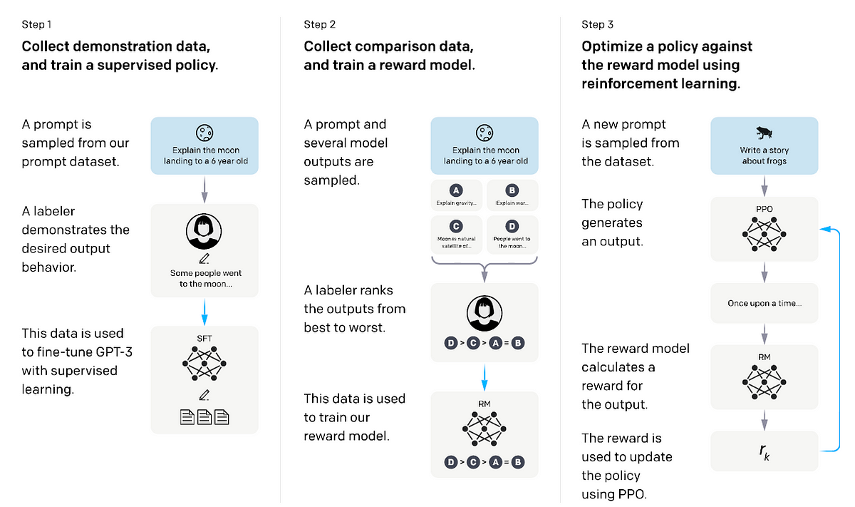
Training ChatGPT (aka instruct tuning)

Slide 36
Which LLM?

Slide 37
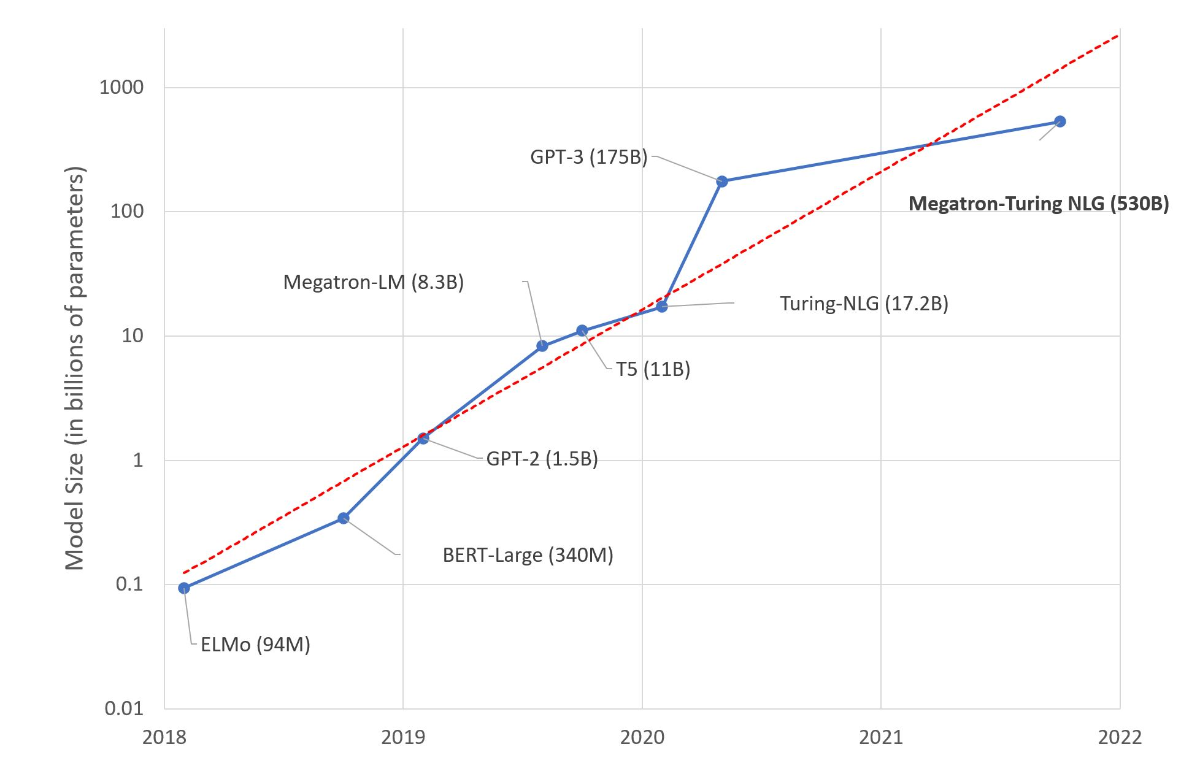
Size does matter!

Slide 38

Which LLM to employ?
NLU or NLG
Price/speed vs accuracy tradeoff
API or hosted
Open source (OLMO, Mistral, Llama2 …)
Fine-tuning!?
Multi-modality

Slide 39
On the generative hype…

Slide 40
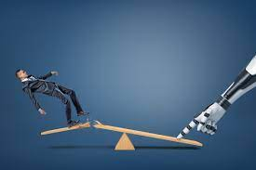
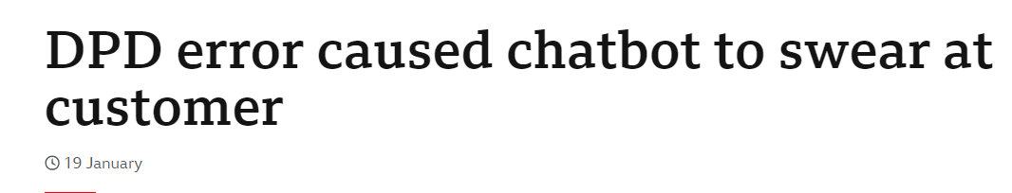

On the generative hype…
Risks of Generative AI:
Controllability
Bias
Data privacy/security

Slide 41
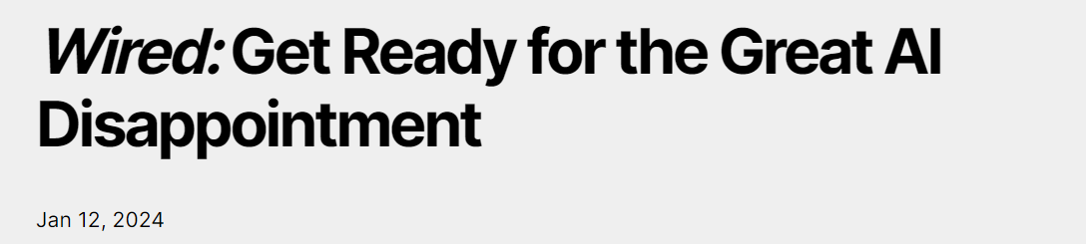
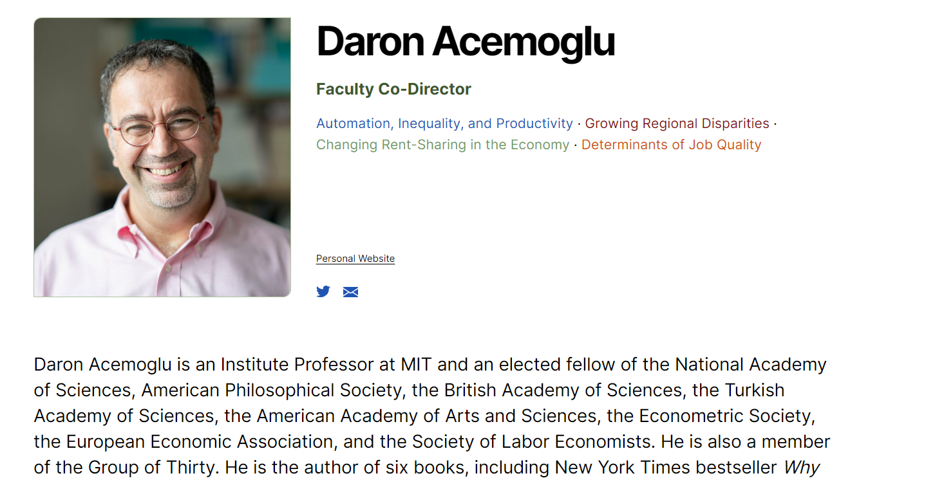

Slide 42
