Slide 1
Evaluating RAGs

Slide 2
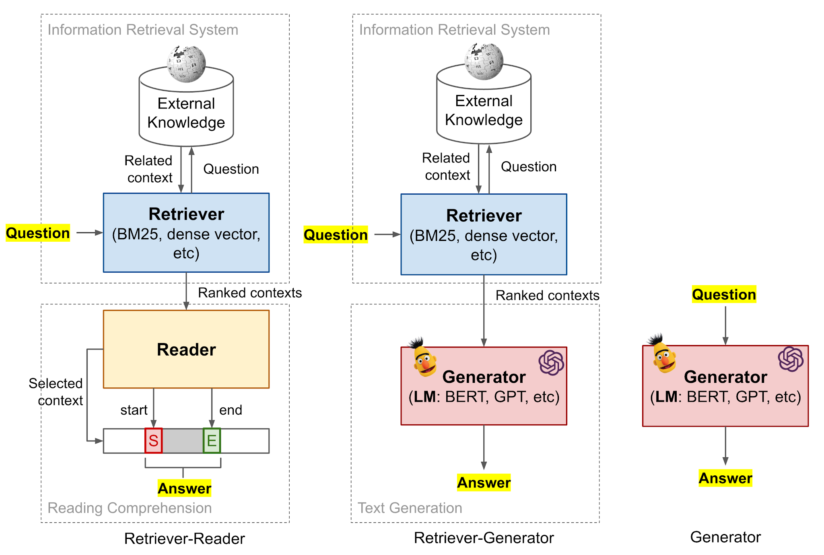
RAG

Slide 3
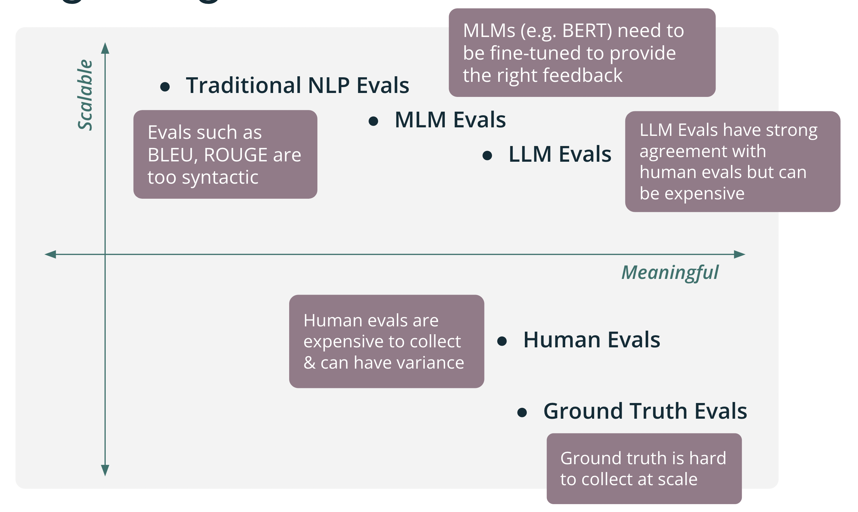
How to evaluate?

Slide 4
Human evaluation

Slide 5
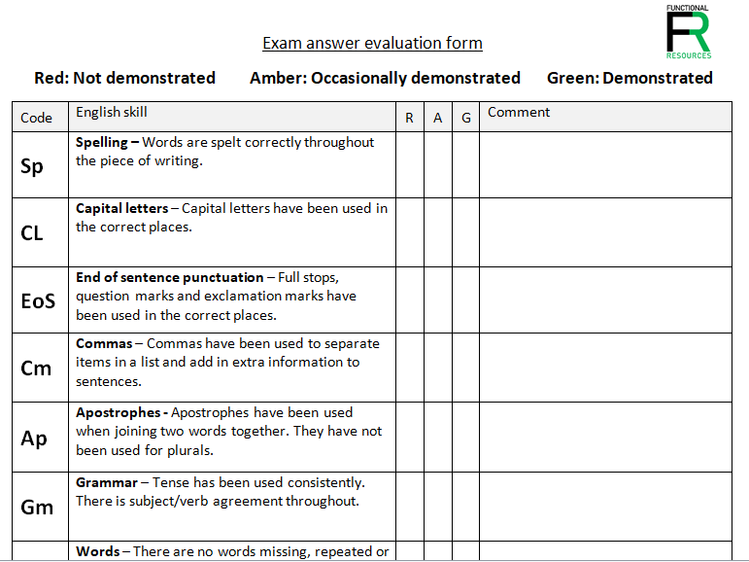
Human end-to-end evaluation
Comments!

Slide 6
Ground Truth answers (HF)

Slide 7
Quality assurance challenges
Testers write questions vs Question bank
Instructions to testers, assessment aspects
Out-of-scope detection
Content filtering / moderation
Easy questions (unit testing) and real-world questions
Multi-turn !?

Slide 8
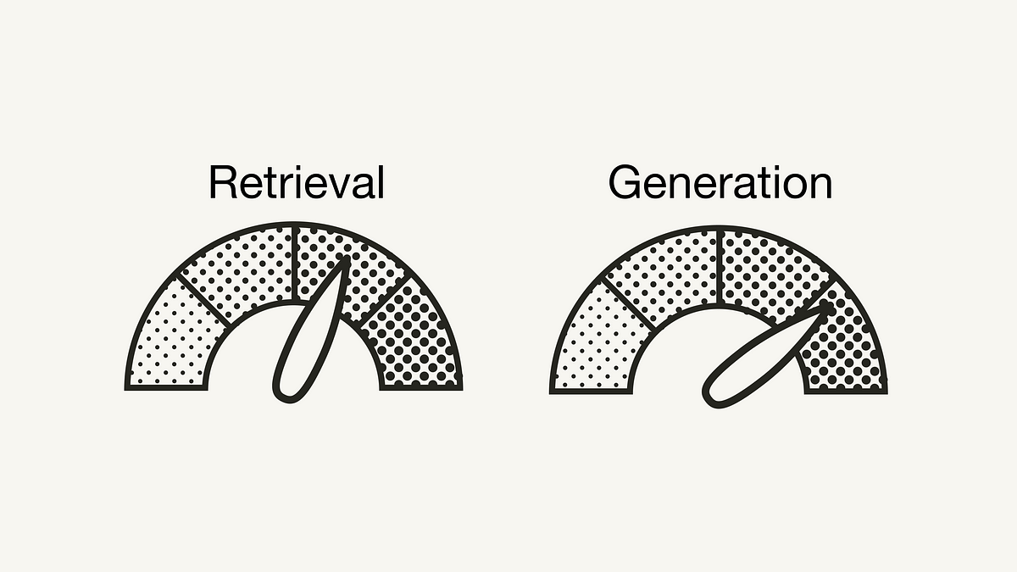

Slide 10
Evaluation of the retriever (GTE)
Question - most relevant document(s)
Precision
P@k
MRR
Capability testing
Context recall
Question - context(s) = text snippets
Chunking!
topK retriever

Slide 11
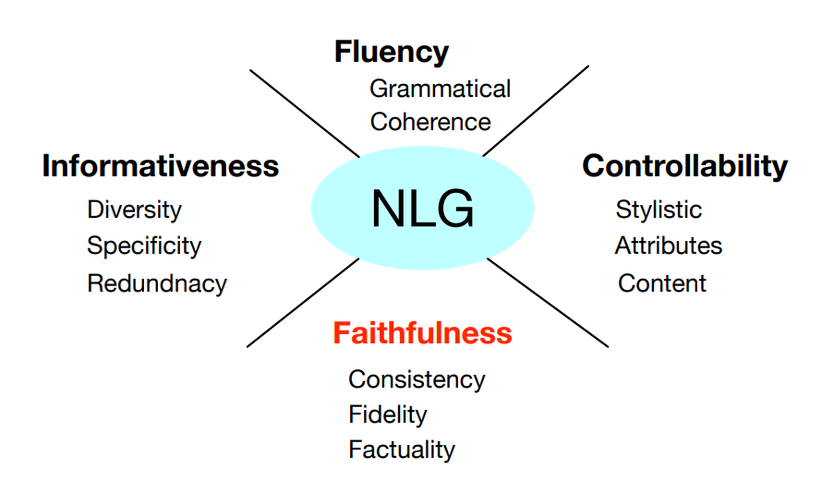
Evaluation of generation
Harmless

Slide 12
Correctness
answer has to be
correct,
informative,
all relevant information,
succinct and verbose
GT answer ~ generated answer
Question – GT answer
(usually with GT context)
similarity, MLM, LLM scores

Slide 13
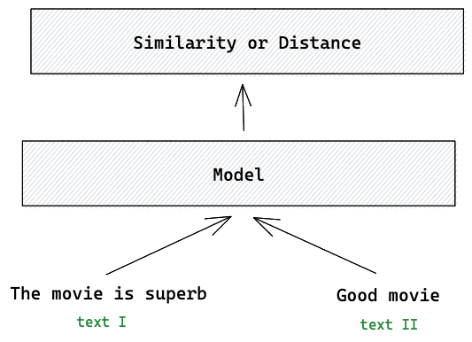
Semantic similarity comparision

Slide 14
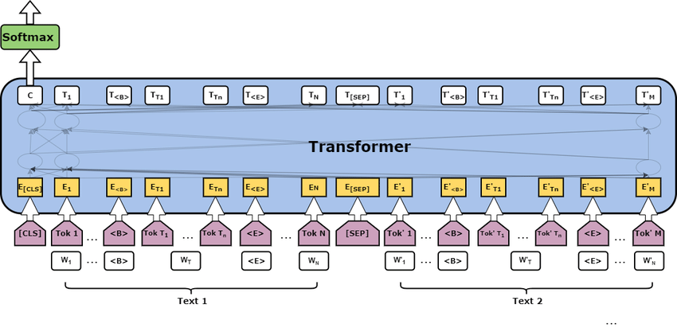
MLM (learning-based evaluation)
GT correct – GT correct
GT correct – GT incorrect

Slide 15
MLMs trained on external harmless-specific dataset
Prompted LLMs

Slide 16
Faithfulness
generated content is inconsistent with the input information, hallucinates or non-factual information
context ~ generated answer
GT is not needed!
similarity, MLM, LLM

Slide 17
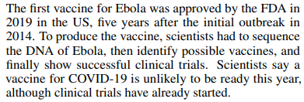
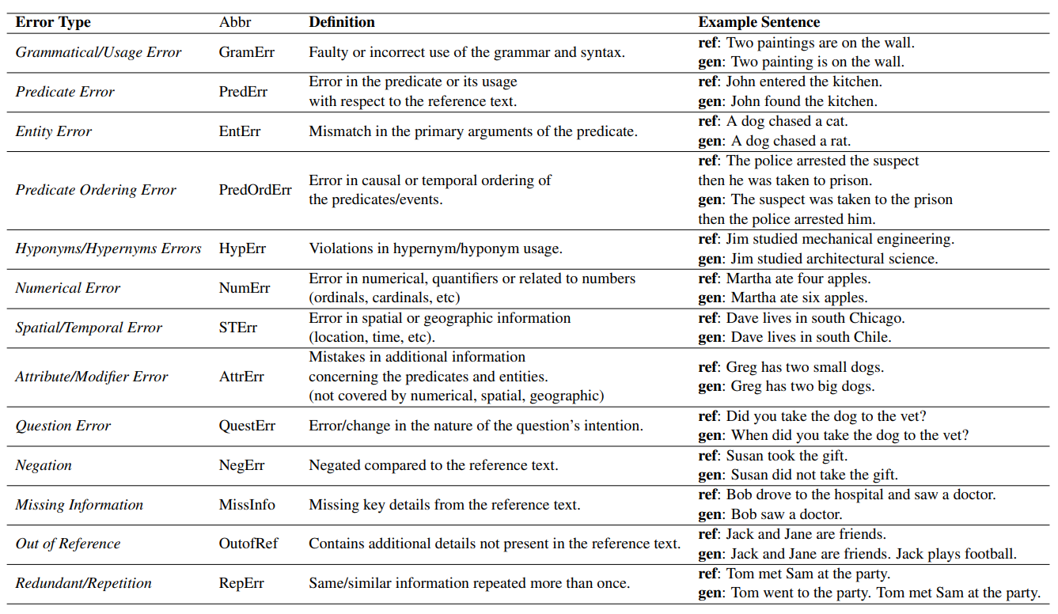
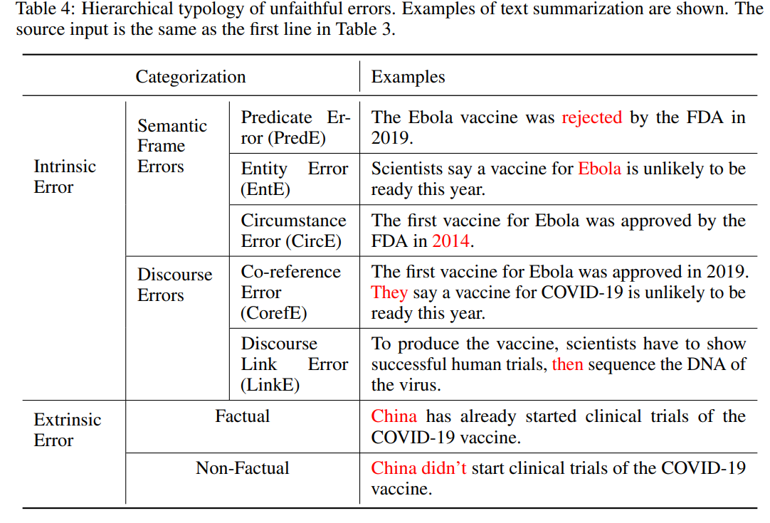
Faithfulness error types

Slide 18
Faithfulness by Question Answering

Slide 19
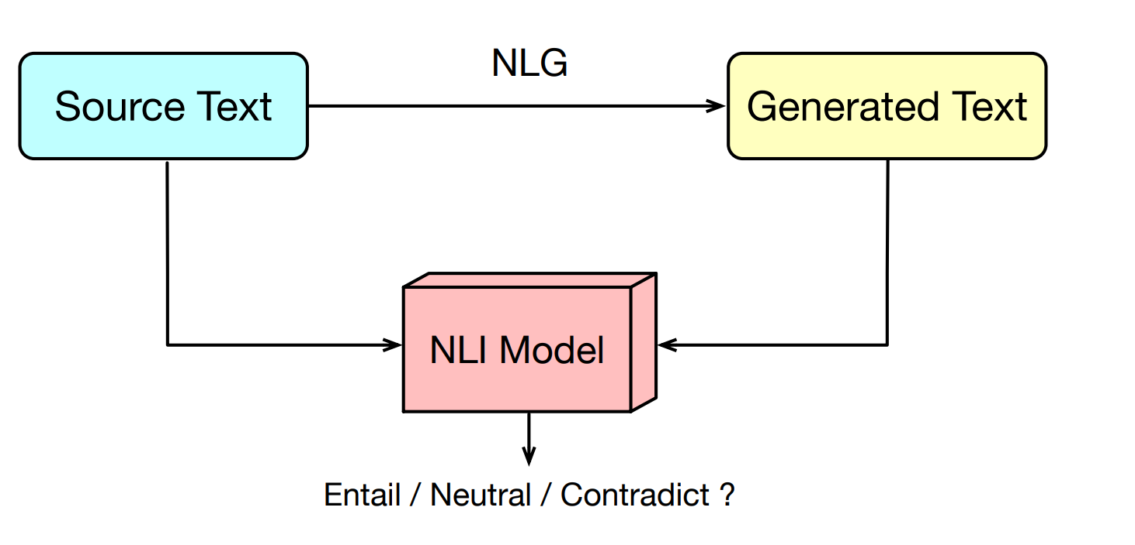
Faithfulness by Natural Language Inference

Slide 20
Factuality metrics
Are Named Entites (and their relations) in the Generated Text present in the Source Text?

Slide 21
Task-specific evaluation methodologies
summarisation,
Question Answering,
image captioning etc
meta evaluation: evaluate the evaluation methods!
evaluation vs unit test vs smoke test

