Slide 1
Reinforcement Learning from Human Feedback (RLHF)
Homayoun Safarpour
Department of Software Engineering
University of Szeged, Hungary

Slide 2
The Problem: What if there is no obvious reward?
What is the reward?
Is a longer answer better?
Should it be polite? Factual? Concise?

Slide 3
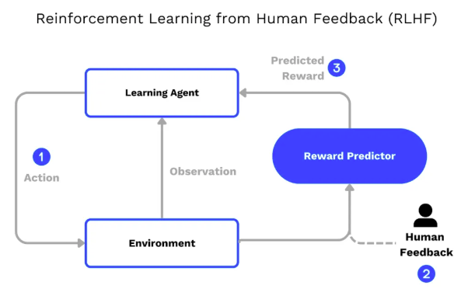
RLHF
is a machine learning (ML) technique that uses human feedback to optimize ML models to self-learn more efficiently.
train software (a model) to make decisions that maximize rewards, making their outcomes more accurate

Slide 4
Why RLHF?
Next-token prediction ≠ user intent
Mis-aligned models cause real harms
RLHF reframes alignment as control

Slide 5
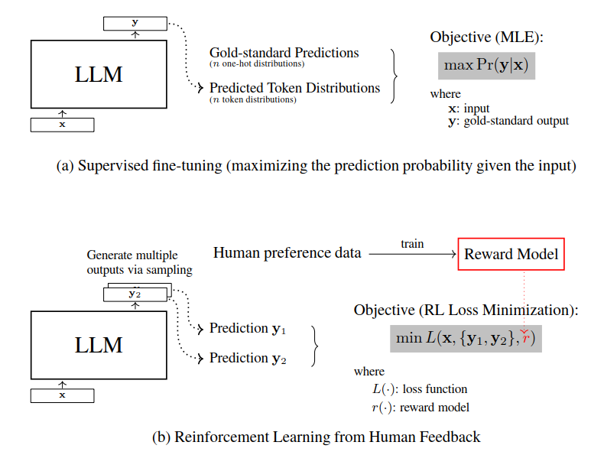

Slide 6
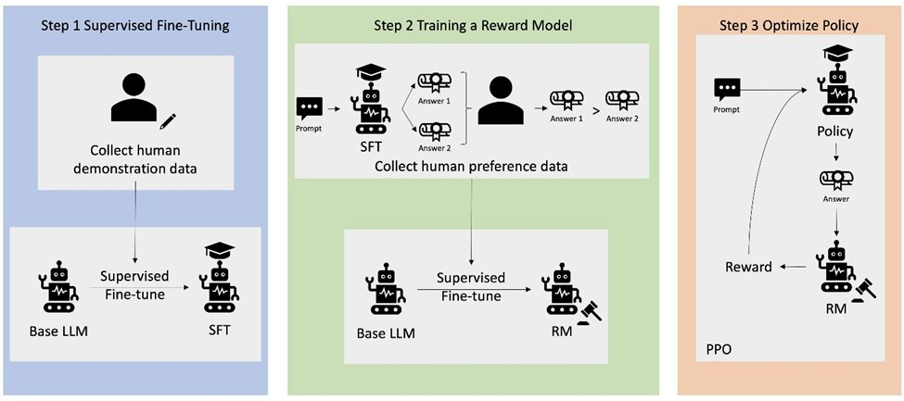
Pre-train → SFT reference policy
Collect human preference comparisons
Train a scalar reward model
Fine-tune the policy with PPO(Proximal Policy Optimization)
.
Notes:
The policy (the fine-tuned model that generates answers) takes a new prompt and produces an answer.
The reward model (the separate model that evaluates answers) assigns a score to that answer.
A reinforcement learning algorithm (often PPO) uses that score to adjust the policy so it produces higher-scoring (i.e., more human-aligned) answers next time

Slide 7
Collecting High-Quality Preference Data
Diverse sampling to expose failures
Pairwise vs listwise ranking trade-off
Annotator calibration & adjudication
Type | Pros | Cons
Pairwise | Easy for humans; simple loss (Bradley-Terry) | Needs more comparisons to learn well
Listwise | More info per prompt; captures full ranking | Harder for humans; labels noisier
Notes:
Pre-train → SFT reference policy – Begin with a large LM and instruction-fine-tune it (SFT); this is frozen as the “reference model”. ​
Collect human preference comparisons – For each prompt, sample several completions and ask annotators to rank them; pairwise Bradley-Terry is most common. ​
Train a scalar reward model – Concatenate prompt+completion, feed through a decoder head, train with the pairwise loss so preferred outputs score higher. ​
Fine-tune the policy with PPO – Optimise expected reward while penalising KL from the reference, giving a stable trust-region update. ​
Mini example – Prompt “Write a poem about rain.” Sampled outputs get ranked; these pairs become {better, worse} tuples for reward-model learning.

Slide 8
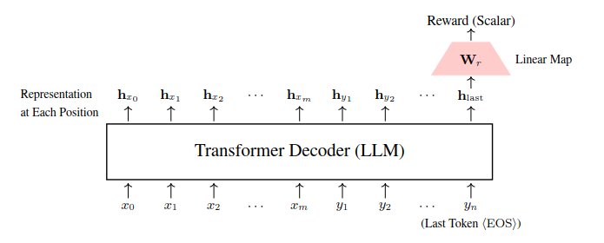
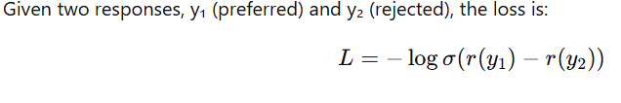
Inside the Reward Model
Decoder backbone + linear head
Bradley-Terry loss function
Extending beyond pairwise signals
last token in the sequence + Self-Attention
Embedding
(a high-dimensional vector)
[“The”, “ mitochondria”, “ is” , “…, the”, “ powerhouse”, “.”]
Notes:
how the reward model is built and trained?

Slide 9
Why Can This Mismatch Cause Problems?
Training Instability:
Conflict Between Objectives: The model is pulled in two directions. On one hand, it’s being trained to generate fluent and natural language (guided by log-likelihood). On the other hand, it’s being trained to produce responses that are aligned with human preferences (guided by the DPO reward).
Result : This misalignment can lead the model to oscillate between these objectives, making the optimization process unstable.
Unexpected Outputs at Inference:
Sampling Behavior : When generating responses, the model typically uses its log-likelihood (e.g., beam search or sampling) to decide what to output.
Mismatch in Practice : Even if a response is highly rated by the DPO reward (because humans prefer it), it might not be the one that the model assigns the highest probability to. This means that during inference, the model might not naturally generate the “winning” response.
Reduced Alignment with Human Preferences:
Goal of Alignment: Ultimately, we want the model to generate responses that are both natural and aligned with what humans prefer.
Problem : If the training reward (DPO) and the generation objective (average log-likelihood) aren’t in sync, the model might produce responses that are: 1-Too Safe/Conventional: Highly probable but not necessarily preferred by humans.2-Too Tailored to the Reward: Over-optimized for the reward function but less natural or less likely according to the model’s own probability distribution.

Slide 10
RLHF Challenge VS DPO
It typically involves training a reward model from human data and then using that model to optimize the language model's behavior—a multi-stage and sometimes unstable process.
Direct Preference Optimization (DPO):It is a method that streamlines the process by reparameterizing the reward function. Instead of separately training a reward model, DPO leverages the ratio of probabilities between the current model and a reference (usually a supervised fine-tuned model).
Notes:
Architecture of the reward model based on Transformer. The main component of this model is still an LLM.
We use the Transformer decoder as the sequence representation model. We extract the representation of the last position
of the decoder as the representation of the entire sequence [x, y]. We then map this representation to a scalar through a
linear transformation, which serves as the reward score for [x, y].

Slide 11
Direct Preference Optimization (DPO)
using an extra reference model, which adds computational and memory overhead
Reference Model Dependence: Requires using an extra reference model, which adds computational and memory overhead.

Slide 12
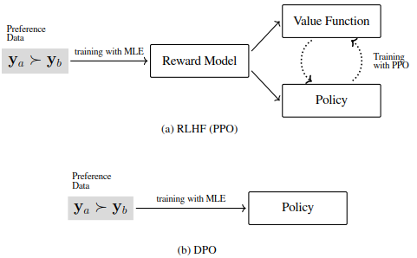
Direct Preference Optimisation (DPO)
*Eliminates explicit reward model
*Closed-form preference objective
*Training: Offline & sample-efficient
Notes:
No reward model – DPO treats preferences as a supervised loss on the policy itself, sidestepping reward-model training complexity. ​
Closed-form objective – Minimise −log σ(β · log π/π_ref) over preference pairs; elegant cancellation removes the normaliser Z(x). ​
Offline, sample-efficient – Learns from a fixed dataset; ideal when GPU time or human labels are scarce, but lacks on-policy exploration. ​

Slide 13
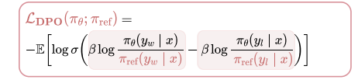
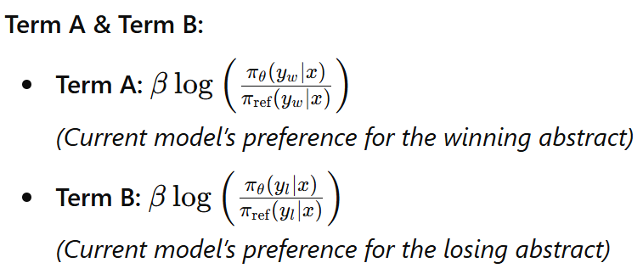
DPO loss function
Intuitively, if the current model is more confident about y than the reference model, the ratio (and thus the reward) is high.
β =scaling factor = the reward difference = the sensitivity of the reward score=0.2
log function makes small differences in probability more pronounced
Prompt x:“Improving Neural Network Training for Image Classification.”
Candidate Abstracts:
  Winning Abstract (yw ): “We propose a novel algorithm that accelerates neural network training by introducing dynamic learning rates.”
  Losing Abstract (yl ): “Our work explores advanced techniques in optimizing neural network training using adaptive algorithms.”
  (Assume human annotators or a reward model decided yw is preferred over yl)

Slide 14
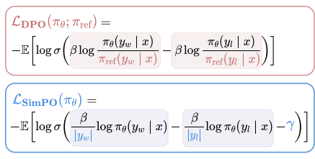
No Reference Model in SimPO
  Pro: Less memory/computational cost (no second forward pass).
  Con: Loses direct comparison to a baseline, so the model might drift more if not carefully tuned.
Length Normalization
  Pro (SimPO): Prevents the model from exploiting token probabilities by just making responses longer.
  Con (DPO without LN): Potential length bias unless additional techniques or a variant (like R-DPO) is used.
Margin γ
  Pro: Forces a clear gap between winning and losing responses, which can sharpen the model’s preferences.
  Con: If γ is too large, the model might become unstable or degrade quality by over-penalizing small differences.

Slide 15
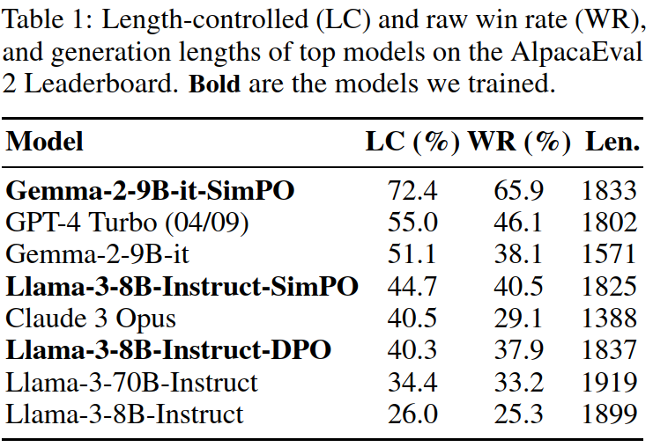
Length-Controlled (LC)
Measures how often the model’s answers are chosen as better when you only compare answers of roughly the same length. This is to avoid the bias that sometimes people perceive longer (or shorter) answers as automatically “better.”
Raw Win Rate (WR)
Measures how often the model’s answers are chosen as better in general, with no adjustments for length.

Slide 16
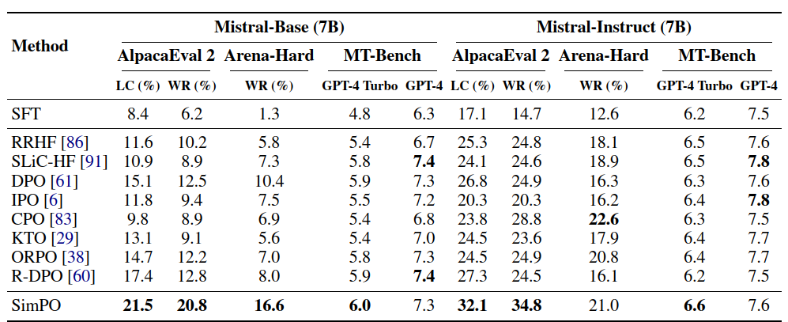
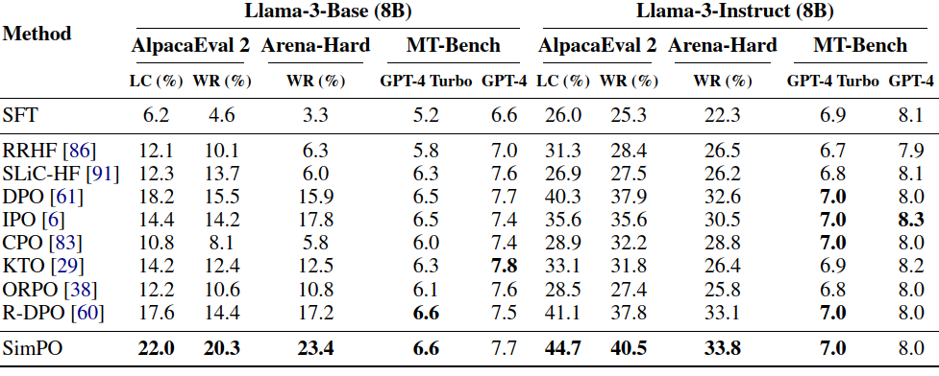

Slide 17
Q&A / Discussion

