Slide 1
Intelligent Human-Computer Interactions
2023

Slide 2
admin
Richárd Farkas
Computer Algorithms and Artificial Intelligence department
communication: coosp
inf.u-szeged.hu/~rfarkas/IHCI
lectures in English, you can choose the language of the exam

Slide 3
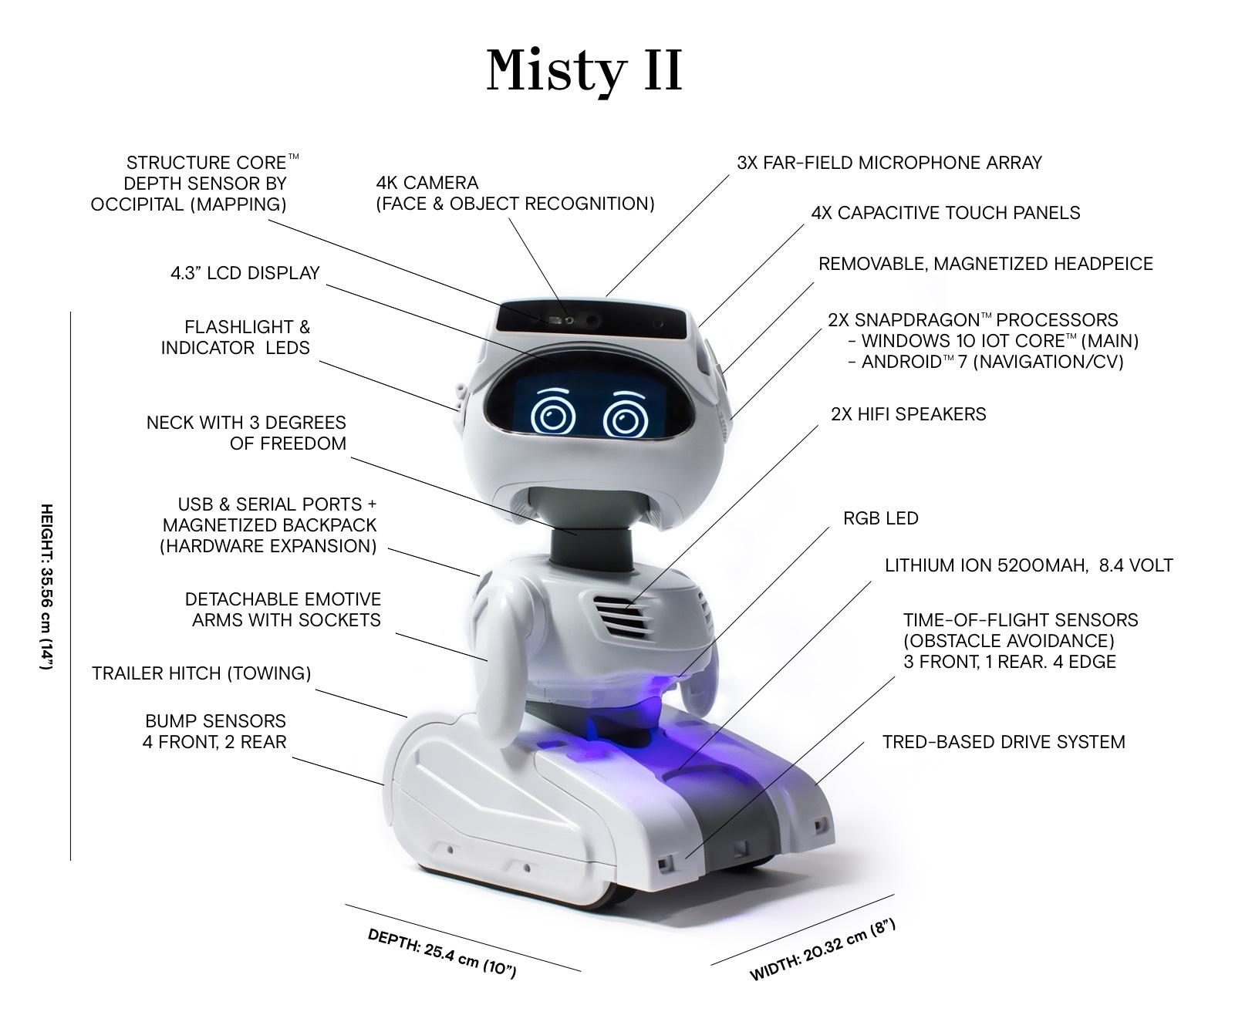
IHCI lab
Project work in teams of 2 or 3
Demo day on 10th May!
Project status meeting fortnightly
Deepfake video
Emotions from speech
Seq2seq chatbot
Rock paper scissors
„Do I show an apple or a key?”

Slide 4
Grades
MSc students:
Lectures: oral exam from lecture topics
Lab: project demo
PhD students:
Single grade from
oral exam from lecture topics
project demo
paper/topic presentation

