Slide 1


1. Introduction to
Cloud Computing
Openstack-alapú privát felhő üzemeltetés
2020/2021 II. félév
SZTE
2021.02.18.
A prezentáció az EFOP-3.6.1-16-2016-00008 számú projekt támogatásával készült.

Slide 2
Welcome

Slide 3
Welcome
“It’s worse than stupidity: it’s marketing hype. Somebody is saying this is inevitable - and
whenever you hear that, it’s very likely to be a set of businesses campaigning to make it true.”
Richard Stallman, Founder, Free Software Foundation (The Guardian, Sept. 29, 2008)
“The interesting thing about cloud computing is that we've redefined cloud computing
to include everything that we already do. I can't think of anything that isn't cloud
computing with all of these announcements.”
Larry Ellison, CEO, Oracle (Wall Street Journal, Sept. 26, 2008)
"Cloud computing is ... the user-friendly version of grid computing."
Trevor Doerksen, (Virtualization, Electronic Magazin, August 2008)
"Our industry is going through quite a wave of innovation and it's being
powered by a phenomenon which is referred to as the cloud.”
Steve Ballmer (Microsoft, 2010)
"$112 billion is what enterprises will spend over the next six years cumulatively
on cloud-related technologies such as SaaS, PaaS and Iaas.”
Gartner’s Cloud Computing Outlook 2011

Slide 4
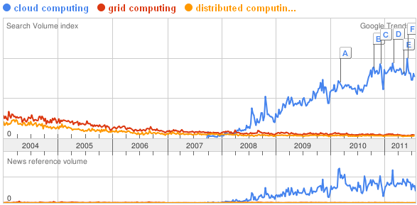
Origins
Parallel and distributed computing
Virtualization solutions
Grid Computing
Hype started to grow around 2007-2008
Strong interest from industry

Slide 5
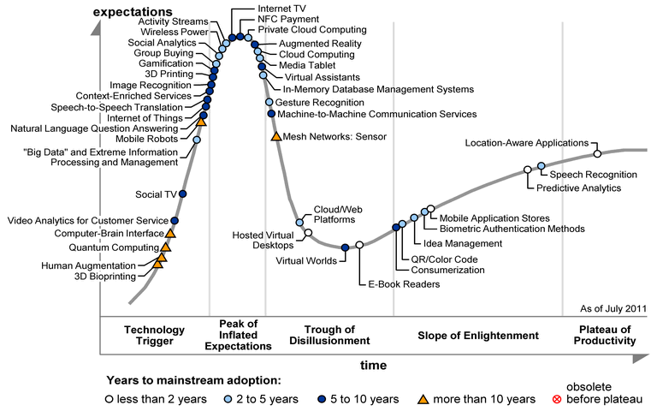
Gartner Hype Cycle for Emerging Technologies, August 2011

Slide 6
Definitions
When a Cloud is made available in a pay-as-you-go manner to the public, we call it a Public Cloud;
The service being sold is Utility Computing.
Current examples of public Utility Computing include:
  AmazonWeb Services,
  Google
  AppEngine,
  Microsoft Azure.

Slide 7
Definitions
Definition by Buyya et. al.:
„A Cloud is a type of parallel and distributed system consisting of a collection of inter-connected and virtualized computers that are dynamically provisioned and presented as one or more unified computing resource(s) based on service-level agreements established through negotiation between the service provider and consumers.”

Slide 8
European Commission definition
A 'cloud' is an elastic execution environment of resources involving multiple
stakeholders and providing a metered service at multiple granularities for a
specified level of quality (of service).

Slide 9
Characteristics
Virtual.
software, databases, Web servers, operating systems, storage and networking as virtual servers.
On demand.
add and subtract processors, memory, network bandwidth, storage.

Slide 10
Characteristics
Cloud computing often leverages:
  Massive scale
  Virtualization
  Free software
  Autonomic computing
  Multi-tenancy
  Geographically distributed systems
  Advanced security technologies

Slide 11
Virtualization
Host operating system that provides an abstraction layer for running virtual “guest” operating systems
  “hypervisor” or “virtual machine monitor”
Enables guest OSs to run in isolation of other OSs
Run multiple types of OSs
  Increases utilization of physical servers
  Enables portability of virtual servers between physical servers

Slide 12
Grid vs Clouds
 | Cloud Computing | Grid Computing
Platform | Commodity node/network HW | Custom node/network HW
Environment | Virtualized: Exact execution environment can be created and cloned in the cloud, arbitrary apps supported | Library-based and customized to HW, hard to ensure consistent libraries across HW domains
Resource allocation | HW resources can be fractionally allocated, maximizing utilization | Whole machine unit of allocation
Quality of Service | Only CPU-based QoS guarantee (some variation) | Strong CPU and I/O performance guarantees
Capacity | “Infinite” resources available | Finite allocation of resources

Slide 13
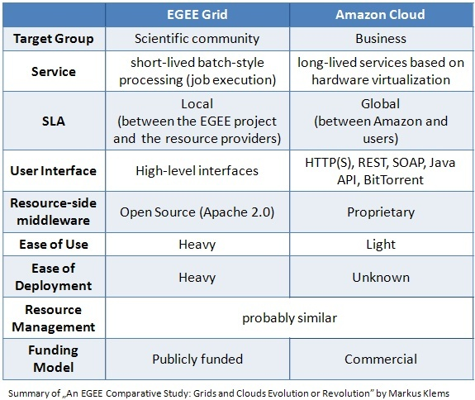
Grids vs Clouds

Slide 14
XaaS
X may be:
  Infrastructure
  Hardware
  Platform
  Application
  Software
  And …

Slide 15



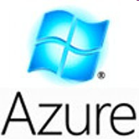
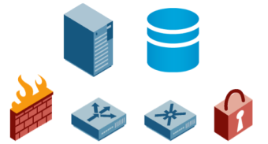

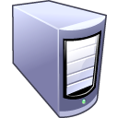
Cloud delivery models
Software as a Service
Platform as a Service
Infrastructure as a Service

Slide 16
Cloud delivery models*
- Software as a Service (SaaS). The capability provided to the consumer is to use the provider’s applications running on a cloud infrastructure. The applications are accessible from various client devices through a thin client interface such as a Web browser (e.g., Web-based email). The consumer does not manage or control the underlying cloud infrastructure including network, servers, operating systems, storage, or even individual application capabilities, with the possible exception of limited user specific application configuration settings.
- Platform as a Service (PaaS). The capability provided to the consumer is to deploy onto the cloud infrastructure consumer-created or acquired applications created using programming languages and tools supported by the provider. The consumer does not manage or control the underlying cloud infrastructure including network, servers, operating systems, or storage, but has control over the deployed applications and possibly application hosting environment configurations.
- Infrastructure as a Service (IaaS). The capability provided to the consumer is to provision processing, storage, networks, and other fundamental computing resources where the consumer is able to deploy and run arbitrary software, which can include operating systems and applications. The consumer does not manage or control the underlying cloud infrastructure but has control over operating systems, storage, deployed applications, and possibly limited control of select networking components e.g., host firewalls).
*Michael Hogan, Fang Liu, Annie Sokol, Jin Tong, NIST Cloud Computing Standards Roadmap – Version 1.0,
Special Publication 500-291, NIST Cloud Computing Standards Roadmap Working Group, July 5, 2011.

Slide 17
Cloud infrastructure deployment models
Private Cloud
Public Cloud
SP
SP
IP
IP
Community Cloud
Hybrid Cloud
SP
SP
IP1
IP1
IP2
IP1
IP3

Slide 18
Cloud deployment models*
1. Private Clouds are typically owned by the respective enterprise and / or leased. Functionalities are not directly exposed to the customer, though in some cases services with cloud enhanced features may be offered – this is similar to (Cloud) Software as a Service from the customer point of view.
Example: eBay.
2. Public Clouds. Enterprises may use cloud functionality from others, respectively offer their own services to users outside of the company. Providing the user with the actual capability to exploit the cloud features for his / her own purposes also allows other enterprises to outsource their services to such cloud providers, thus reducing costs and effort to build up their own infrastructure. As noted in the context of cloud types, the scope of functionalities thereby may differ.
Example: Amazon, Google Apps, Windows Azure.
*K. Jeffery and B. Neidecker-Lutz: „The Future of Cloud Computing,
Opportunities for European Cloud Computing beyond 2010”. Expert Group Report, January 2010.

Slide 19
Cloud deployment models
3. Hybrid clouds consist of a mixed employment of private and public cloud infrastructures so as to achieve a maximum of cost reduction through outsourcing whilst maintaining the desired degree of control over e.g. sensitive data by employing local private clouds. There are not many hybrid clouds actually in use today, though initial initiatives such as the one by IBM and Juniper already introduce base technologies for their realization.
4. Community Clouds. Typically cloud systems are restricted to the local infrastructure, i.e. providers of public clouds offer their own infrastructure to customers. Though the provider could actually resell the infrastructure of another provider, clouds do not aggregate infrastructures to build up larger, cross-boundary structures. In particular smaller SMEs could profit from community clouds to which different entities contribute with their respective (smaller) infrastructure. Community clouds can either aggregate public clouds or dedicated resource infrastructures. We may thereby distinguish between private and public community clouds. For example smaller organizations may come together only to pool their resources for building a private community cloud. As opposed to this, resellers such as Zimory may pool cloud resources from different providers and resell them.

Slide 20
EC challenges/vision

Slide 21
Legal issues
Three main fields of law should be considered:
  Intellectual property law, as data and applications (i.e., code) hosted in the cloud may contain trade secrets or be subject to copyright and/or patent protection;
  Green (i.e., ecological) legislation, since the data centers hosting the basic cloud infrastructure (e.g., servers, switches, routers, etc.) require a large amount of energy to operate and indirectly produce carbon dioxide;
  Data protection and privacy law.

Slide 22
Green Clouds
The energy consumption of unused resources in a Cloud federation could be reduced by down-scaling: switching off resources.
Balancing up-scaling in a federated cloud environment can be regulated by policies not only with cost, but also carbon emission issues.
The EU has a clear strategy to reduce the carbon footprint and also has a commitment on reducing greenhouse gas emissions.
Furthermore, the corresponding quotas and the legislation vary widely from country to country, even among Member States.

Slide 23
Brief history of Academic Clouds
Xen, Xenoserver platform: 2001-2003
In Vigo Project – till 2005
RTEFactory (2003) -> Virtual Workspace (2005) Service -> Nimbus (2008)
OpenNebula, Eucalyptus 2008-
OpenStack 2010-
Apache Tashi 2009-
Clever 2010-

Slide 24
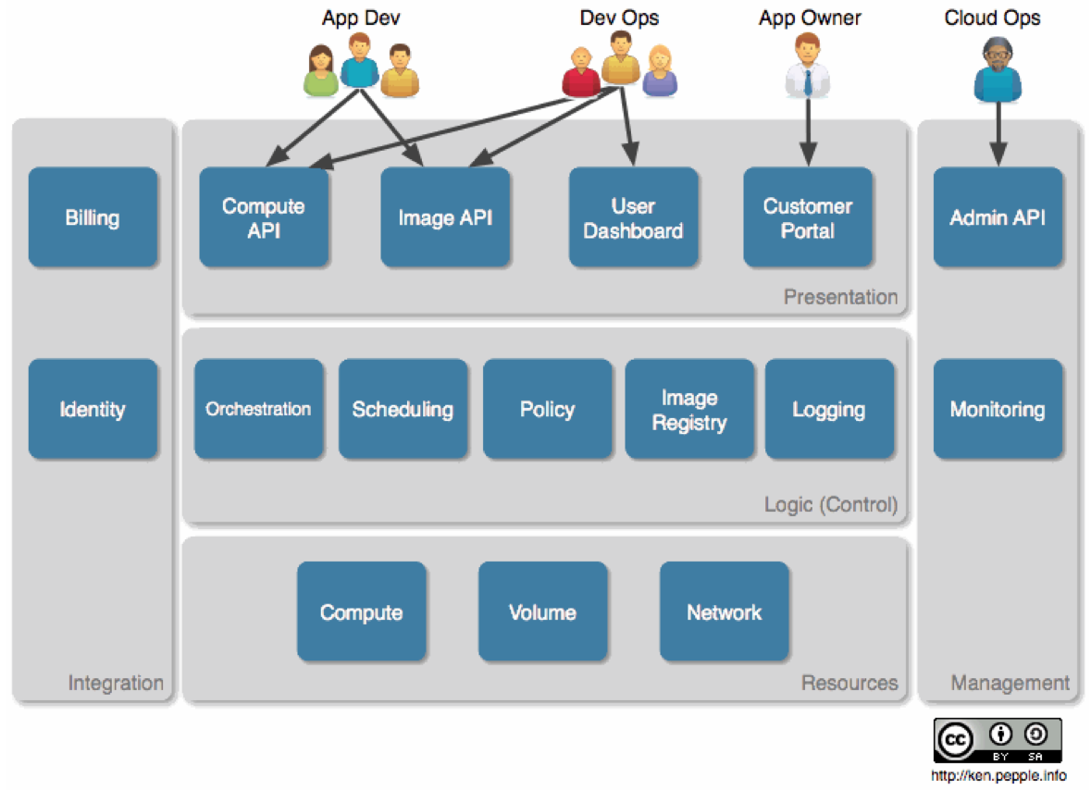
OpenStack

Slide 25
IaaS utilization steps
Host
1. Upload
Repository
VM
Virtual Appliance
4. Access
Instantiation
Libs+
OS
Support
VA
Service
VA
VA
VA
Environment
2. Delivery
3. Deployment
Infrastructure as a Service Cloud
VMM
Host
Host
VA
Host
Host
Host
Host
Host
Host
VMM
VMM
VMM
VMM
VMM
VMM
VMM
VMM
Notes:
To deploy a service with virtualization based deployment, the service has to be encapsulated in a virtual appliance alongside of its support environment (e.g. its configuration and even an entire operating system).
Infrastructure as a service clouds require these appliances in repositories. They allow users to choose from a list of services easily deployable in the infrastructure.
When a user needs to deploy a service, he selects an appliance from the repository. Then the cloud delivers the appliance to a host running a virtual machine monitor.
These components can instantiate virtual machines executing the appliance.
When the appliance starts up in the virtual machine, the service becomes available. As a result, its deployment has completed.
25

Slide 26

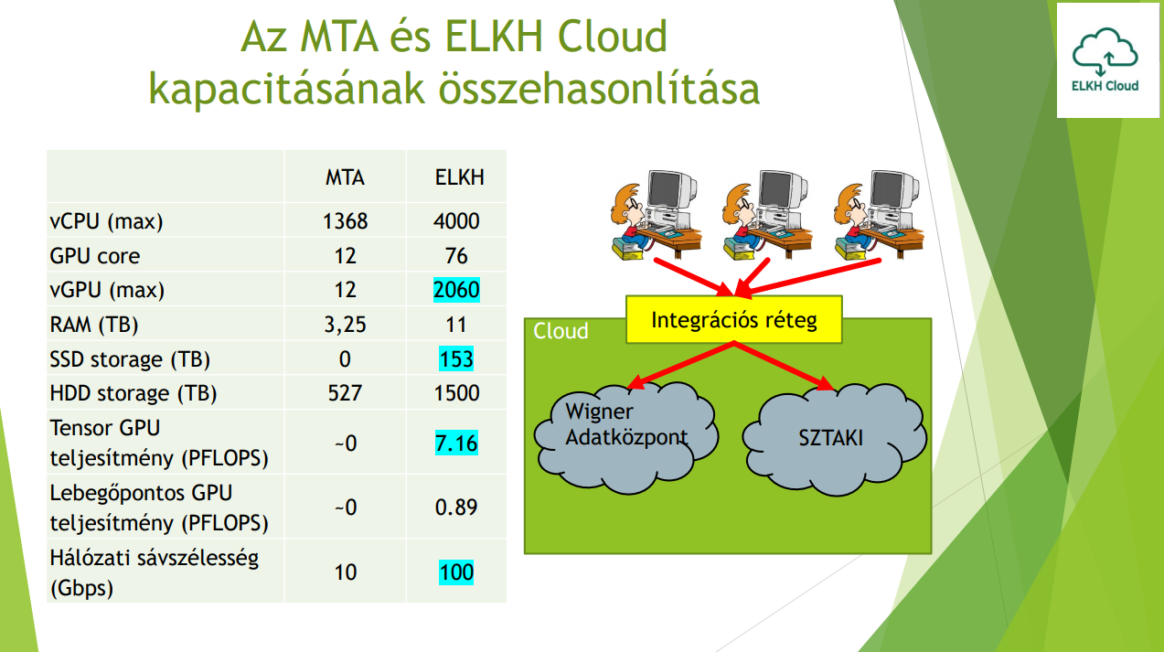
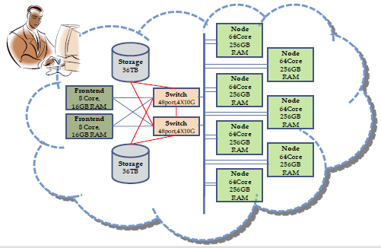


http://cloud.sztaki.hu/en/home

Slide 27
Data in Clouds:
Why use cloud storage?
Companies need only pay for the storage they actually use
Companies do not need to install physical storage devices
Storage maintenance tasks, backup, data replication, are offloaded to the responsibility of a service provider
Notes:
27

Slide 28
Why NOT to use cloud storage
Security of stored data and data in transit may be a concern
Performance may be lower than local storage
Reliability and availability depends on wide area network availability
Specific records-keeping requirements may cause complications
  such as public agencies that must retain electronic records
Notes:
28

Slide 29
I have never seen cloud storage
Google Docs (Google's data servers)
  upload documents, spreadsheets and presentations
  publish documents so that other people can read them or even make edits
Web e-mail providers
  Gmail, Hotmail and Yahoo! Mail
  Users can access their e-mail from computers and other devices connected to the Internet.
Notes:
29

Slide 30
I have never seen cloud storage
Flickr and Picasa
  host billions of digital photographs
YouTube
  billions of user-uploaded video files
Web site hosting like StartLogic, Hostmonster and GoDaddy
Social networking sites like Facebook and MySpace
  post pictures and other personal content
Notes:
30

Slide 31
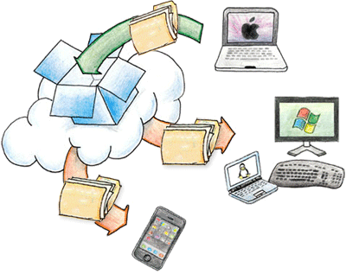
Cloud Storage Services
Storing data online
Synchronization
Data sharing
Backup
Version control
Encryption

Slide 32
Research: Benchmarking
In order to efficiently manage a Cloud infrastructure, proper monitoring solutions are needed.
Typical monitoring metrics are: availability, responce time, computing and transfer speed.
These metrics and methods can be coupled in a benchmarking framework.
Such benchmarking is needed by scheduling and brokering Cloud services, and valuable for user communities and service providers.

Slide 33
CloudHarmony*
CloudHarmony is a commercial tool launched in 2009, that provides a set of benchmarks for objective, independent performance comparisons between different cloud providers.
These benchmarks fall into three categories:
  Performance Benchmarking
  Network Benchmarking
  Uptime Monitoring
Metering more than 80 public clouds
*http://cloudharmony.com/benchmarks, 2010.

Slide 34
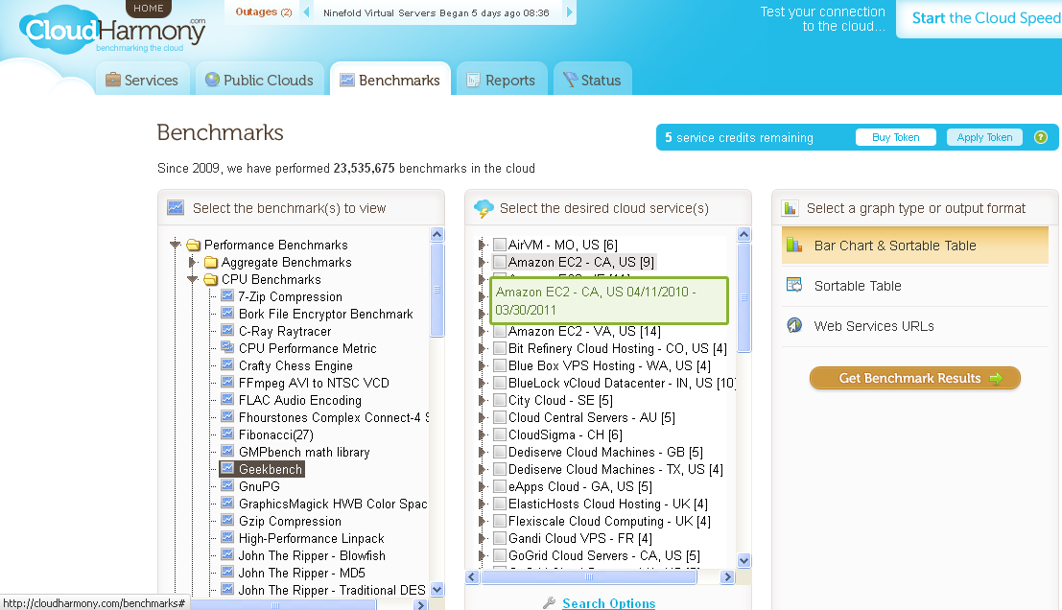
CloudHarmony

Slide 35
Related monitoring approaches
As we have seen Cloud benchmarking is a relatively new area
Sophisticated solutions are still missing in the academic research, yet.
Even though IaaS providers offer some level of monitoring (e.g. Amazon CloudWatch), generic solutions are also missing and in the spotlight of current research

Slide 36
Cloud scheduling/brokering
Besides users and providers, specific cloud management services rely on monitoring and benchmarking
Cloud managers need to schedule user requests and VMs among the available resources
Coordinating these tasks among different Clouds can be done using a Federated Cloud Management architecture*
*https://www.lpds.sztaki.hu/CloudResearch

Slide 37
Additional reading and references
J. D. Dombi, A. Kertész, Innovatív felhő technológiák, Szegedi Tudományegyetem, 142 oldal, 2015. ISBN: 978-963-12-2787-1
R. Buyya, C. S. Yeo, S. Venugopal, J. Broberg, and I. Brandic: „Cloud computing and emerging it platforms: Vision, hype, and reality for delivering computing as the 5th utility”. Future Generation Computer Systems, vol. 25, no. 6, pp. 599-616, June 2009.
K. Jeffery and B. Neidecker-Lutz: „The Future of Cloud Computing, Opportunities for European Cloud Computing beyond 2010”. Expert Group Report, January 2010.
A. Cs. Marosi, G. Kecskemeti, A. Kertesz and P. Kacsuk: „FCM: an Architecture for Integrating IaaS Cloud Systems”. In Proceedings of The Second International Conference on Cloud Computing, GRIDs, and Virtualization. Rome, Italy. September, 2011.
A. Kertesz, G. Kecskemeti, M. Oriol, P. Kotcauer, S. Acs, M. Rodriguez, O. Merce, A. Cs. Marosi, J. Marco, X. Franch, Enhancing Federated Cloud Management with an Integrated Service Monitoring Approach, Journal of Grid Computing, Published Online in June 2013.
Fraunhofer Institute for Secure Information Technology: On The Security of Cloud Storage Services, SIT Technical reports, March 2012. Online: http://www.sit.fraunhofer.de/content/dam/sit/en/documents/Cloud-Storage-Security_a4.pdf

