Slide 1
OpenStack-based private cloud operations
University of Szeged

Slide 2
Introduction
History
Other IaaS providers
AWS, Azure, Google
User stories
Distributions
Mirantis
Ubuntu
RedHat
…
Pro/con
When to use cloud
When to use OpenStack
Containers
P2P, IoT, Fog

Slide 3
History
1977: ARPANET cloud symbol
Telecom companies (+ others)
Grid
Supercomputer
1996: “cloud computing”
2006: Amazon Elastic Compute Cloud
2008: Google App Engine
2008: NASA OpenNebula
2010: MS Azure
2010: OpenStack
2011: IBM, Oracle
2012: Google Compute Engine

Slide 4
OpenStack History
Austin (2010)
NASA (Nebula - nova)
Rackspace (swift)
Bexar (2011)
Ubuntu
…
+ Debian, SUSE, Red Hat
+ Oracle, HP
…
IceHouse (2014)
…
Pike (2017)
35+ projects
Victoria (2020)
42+ projects
Yoga (2022)
~6 month cycle
from 2023: „tick-tock” schedule
OpenStack Foundation
9 out of top 10 telcos
Manages 25+M CPU cores
180+ public cloud data centers
Compatibility projects:
AWS, Google Compute Engine
https://releases.openstack.org/
http://stackalytics.io

Slide 5

Other IaaS proviers
Amazon Web Services (AWS) https://aws.amazon.com/
One of the first public cloud provider
Services
Amazon Simple Queue Service (SQS)
Elastic Compute Cloud (EC2)
Simple Storage Service (S3)
Many more…

Slide 6

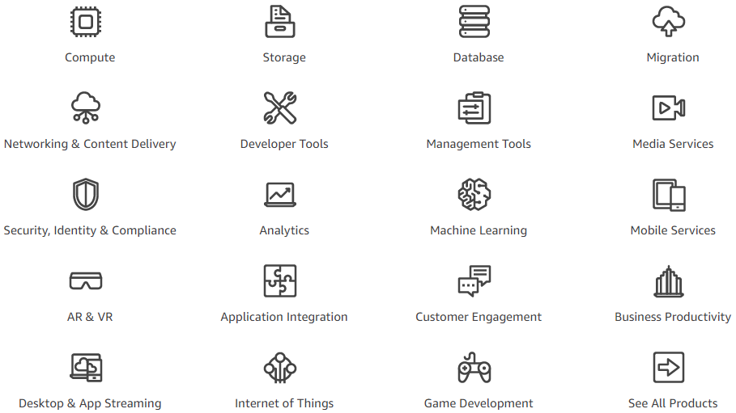
AWS

Slide 7
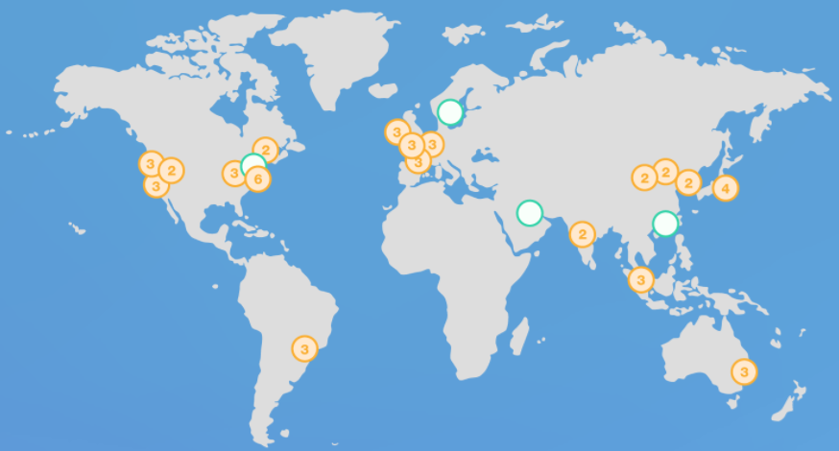
AWS

Slide 8

Microsoft Azure
https://azure.microsoft.com/
Integration with Microsoft systems
Windows Server,
System Center and
Active Directory
+ PaaS

Slide 9
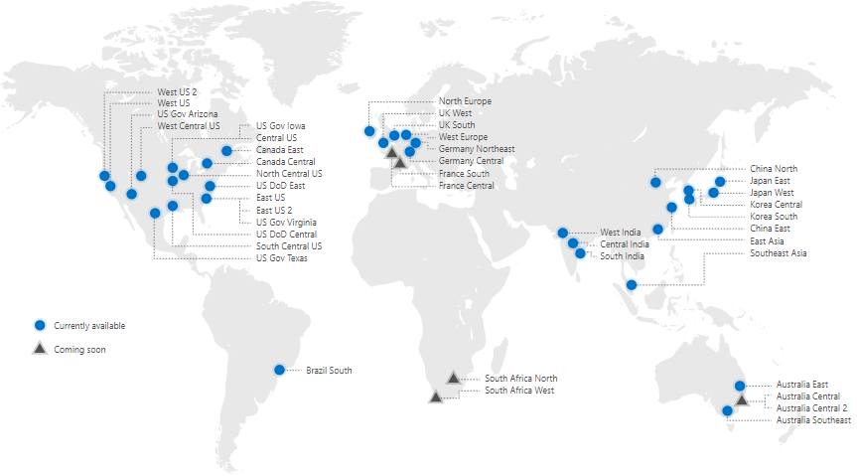
Microsoft Azure

Slide 10
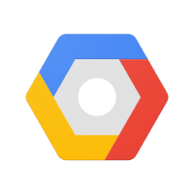
Google Cloud Platform
https://cloud.google.com/
Compute Engine (IaaS)
Google App Engine (PaaS)
Cloud AI
Google BigQuery

Slide 11
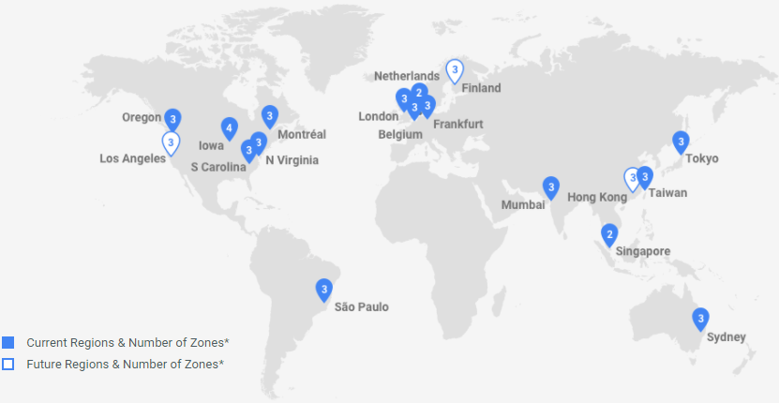
Google Cloud Platform

Slide 12
Other IaaS providers
AWS
Azure
GCP
Similar basic capabilities around flexible compute, storage and networking.
All share the common elements of a public cloud:
self-service and instant provisioning,
autoscaling,
security,
compliance and identity management features

Slide 13
User Stories
https://www.openstack.org/user-stories/
CERN https://www.openstack.org/videos/tokio-2015/unveiling-cern-cloud-architecture
Bank of China https://www.openstack.org/summit/barcelona-2016/summit-schedule/events/15884/postal-savings-bank-of-china-with-the-most-of-outlets-embraces-mobile-internet-by-using-openstack
China Mobile https://01.org/sites/default/files/performance_analysis_and_tuning_in_china_mobiles_openstack_production_cloud_2.pdf
AT&T https://www.openstack.org/videos/video/at-and-ts-openstack-journey-driving-enterprise-workloads-using-openstack-as-the-unified-control-plane

Slide 14
User Stories
VW https://www.youtube.com/watch?v=HL_pzkDnal4
Walmart http://superuser.openstack.org/articles/inside-walmartlabs-and-its-openstack-core/
eBay https://www.openstack.org/videos/boston-2017/managing-kubernetes-on-openstack-at-scale
Bloomberg https://www.youtube.com/watch?v=zA6TxlJKjwU&list=PLAdAdMXKqNvYnFDKJBBaabPloKTPpAX5s&index=7
Nike http://superuser.openstack.org/articles/how-openstack-keeps-nike-running-smoothly/

Slide 15







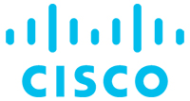
Distributions
https://www.openstack.org/marketplace/distros/
Mirantis
Canonical
Red Hat
SUSE
VMWare
Debian
Oracle
CISCO
IBM

Slide 16
Pro/Con
Public cloud
Easy access to resources
No initial cost (hardware)
No maintenance (SLA)
(Auto)Scale (PayAsYouGo)
Access from everywhere
Private cloud
Moderate initial cost (hardware)
More secure
Customizable
Public (security, overprovisioning)
Later could be expensive
Trust (SLA)
Price
Depends on networks
Limited capacity
Needs knowledge
Maintenance

Slide 17
Incidents
2009 PayPal
1 hour outage + 3.5 hour partial outage
$32M transaction disrupts
processing average $2000 / sec
2010 MS configuration issue
non-authorized access employee contact info
fixed in 2 hours, small number of users
2012 Dropbox
stolen 68M user accounts (email, password)
black market ~$1000
2012 LinkedIn
6M user passwords stolen
2016 167M (email, password)
added two-way-authentication

Slide 18
Incidents
2013 Nirvanix
1998 cloud storage
2011 IBM agreement for cloud storage
2013 IBM out, 2 weeks to download data
2013 Yahoo
1B user accounts compromised
2014 Home Depot (DIY retailer) terminal hack
56M credit card numbers
$100M compensation
2014 Apple iCloud
private photos leaked
2016 Mexico elections
93M voter registration records
poorly configured DB + illegal AWS server

Slide 19
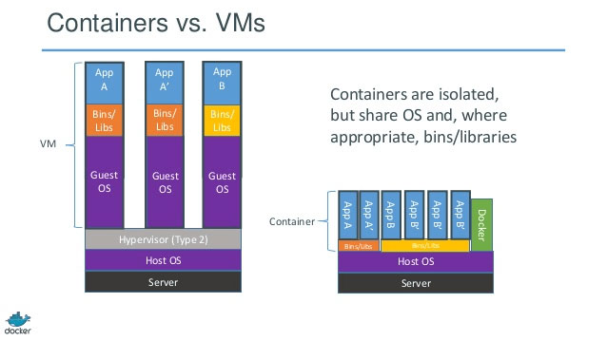
Containers

Slide 20
Containers
Docker
Kubernetes
Containers vs OpenStack
Zun (ex Higgins)
Magnum (deploy, manage)
Kolla

Slide 21
P2P, IoT, Fog
P2P (decentralized vs distributed)
No critical components
Could be robust
Emergency, censor, criminals
Could be scalable
BitTorrent, skype, Spotify
Could be secure (privacy)
IoT
Fog

