Slide 1
Openstack DevStack
University of Szeged
1
Notes:
1

Slide 2
Mission Statement
DevStack's mission is to provide and maintain tools used for the installation of the central OpenStack services
source can come from git repository master, or specific branches
suitable for development and operational testing
It also demonstrates and documents examples of configuring and running services as well as command line client usage
2

Slide 3
What is DevStack?
DevStack is an opinionated script to quickly create an OpenStack development environment
It can also be used to demonstrate starting/running OpenStack services and provide examples of using them from a command line
The example exercises were fleshed out beyond simple examples and became useful as a quick sanity check for the OpenStack installation
3

Slide 4
What is DevStack?
DevStack is not and has never been intended to be a general OpenStack installer.
It has evolved to support a large number of configuration options and alternative platforms and support services
However, that evolution has grown well beyond what was originally intended and unfortunately many of the configuration combinations are rarely, if ever, tested.
4

Slide 5
DevStack possibilities
DevStack is a series of extensible scripts used to quickly bring up a complete OpenStack environment suitable for non-production use.
It is used interactively as a development environment.
Since DevStack installs all-in-one OpenStack environment, it can be used to deploy OpenStack on a single VM, a physical server or a single LXC container
5

Slide 6
DevStack possibilites
Each option is suitable depending on the hardware capacity available and the degree of isolation required. A multi-node OpenStack environment can also be deployed using DevStack, but that’s not a thoroughly tested use-case.
For either kind of setup, the steps would involve installing a minimal version of one of the supported Linux distributions and downloading the DevStack git repository
6

Slide 7
Approved distributions
The official approved and tested Linux distributions are Ubuntu(LTS plus current dev release), Fedora(latest and previous release) and CentOS/RHEL 7(latest major release)
The supported databases are MySQL and PostgreSQL.
RabbitMQ and Qpid are the recommended messaging service along with Apache as the webserver.
The setup defaults to a FlatDHCP network using Nova Network or a similar configuration in Neutron.
7

Slide 8
Default services
The default services configured by DevStack are:
Keystone, Glance, Cinder, Nova, Placement, Horizon and Neutron.
DevStack has a plugin architecture to include additional services that are not included directly in the install.
8

Slide 9
Installation Process (Summary)
Install one of the supported Linux Distributions
Download DevStack from git
Make any desired changes to the configuration
Add a non-root user, with sudo enabled, to run the install script
Run the install and go grab a coffee
9

Slide 10
Add Stack User
Start with a clean and minimal install of a Linux system
Devstack should be run as a non-root user with sudo enabled (standard logins to cloud images such as “ubuntu” or “cloud-user” are usually fine).
10

Slide 11
Create user
You can quickly create a separate stack user to run DevStack with:
sudo useradd -s /bin/bash -d /opt/stack -m stack
Since this user will be making many changes to your system, it should have sudo privileges:
echo "stack ALL=(ALL) NOPASSWD: ALL" | sudo tee /etc/sudoers.d/stack
sudo su - stack
11

Slide 12
Download DevStack
git clone https://opendev.org/openstack/devstack -b stable/victoria
cd devstack
The devstack repo contains a script that installs OpenStack and templates for configuration files
12

Slide 13
Create a local.conf
DevStack configuration is modified via the file local.conf.
It is a modified INI format file that introduces a meta-section header to carry additional information regarding the configuration files to be changed.
13

Slide 14
Local.conf
This is the minimum required config to get started with DevStack:
[[local|localrc]]
ADMIN_PASSWORD=secret
DATABASE_PASSWORD=$ADMIN_PASSWORD
RABBIT_PASSWORD=$ADMIN_PASSWORD
SERVICE_PASSWORD=$ADMIN_PASSWORD
14

Slide 15
Start the install
./stack.sh
git trees and packages will be installed during this process
Your devstack will have installed keystone, glance, nova, cinder, neutron, and horizon. Floating IPs will be available, guests have access to the external world.
You can access horizon to experience the web interface to OpenStack, and manage VMs, networks, volumes, and images from there.
15

Slide 16
Openrc
openrc configures login credentials suitable for use with the OpenStack command-line tools.
openrc sources stackrc at the beginning (which in turn sources the localrc section of local.conf) in order to pick up HOST_IP and/or SERVICE_HOST to use in the endpoints. The values shown below are the default values
16

Slide 17
Example openrc
OS_PROJECT_NAME=demo
OS_USERNAME=demo
OS_PASSWORD=secret #The usual cautions about putting passwords in environment variables apply
HOST_IP=127.0.0.1 #Typically set in thelocalrc section
SERVICE_HOST=$HOST_IP
OS_AUTH_URL=http://$SERVICE_HOST:5000/v2.0
#commented out by default
# export KEYSTONECLIENT_DEB
17

Slide 18
Minimal Configuration
stack.sh can run without a localrc section in local.conf, it is easier to repeat installs by setting a few minimal variables. Below is an example of a minimal configuration for values that are often modified
Advanteges: no logging
pre-set the passwords to prevent interactive prompts
move network ranges away from the local network
set the host IP
18

Slide 19
Minimal Configuration
[[local|localrc]]
ADMIN_PASSWORD=secret
DATABASE_PASSWORD=$ADMIN_PASSWORD
RABBIT_PASSWORD=$ADMIN_PASSWORD
SERVICE_PASSWORD=$ADMIN_PASSWORD
#FIXED_RANGE=172.31.1.0/24
#FLOATING_RANGE=192.168.20.0/25
#HOST_IP=10.3.4.5
19

Slide 20
Service Repositories
The Git repositories used to check out the source for each service are controlled by a pair of variables set for each service.
*_REPO points to the repository and *_BRANCH selects which branch to check out.
These may be overridden in local.conf to pull source from a different repo.
GIT_BASE points to the primary repository server.
NOVA_REPO=$GIT_BASE/openstack/nova.git
NOVA_BRANCH=master
20

Slide 21
Logging
By default stack.sh output is only written to the console where it runs
It can be sent to a file in addition to the console by setting LOGFILE to the fully-qualified name of the destination log file.
LOGFILE=$DEST/logs/stack.sh.log
LOGDAYS=1
LOG_COLOR=False
LOGDIR=$DEST/logs
21

Slide 22
Database Backend
The available databases are defined in the lib/databases directory. MySQL is the default database but can be replaced in the localrc section:
disable_service mysql
enable_service postgresql
22

Slide 23
Messaging Backend
Support for RabbitMQ is included. Additional messaging backends may be available via external plugins. Enabling or disabling RabbitMQ is handled via the usual service functions
disable_service rabbit
23

Slide 24
Instance Type
DEFAULT_INSTANCE_TYPE can be used to configure the default instance type.
When this parameter is not specified, Devstack creates additional micro & nano flavors for really small instances to run Tempest tests.
DEFAULT_INSTANCE_TYPE=m1.tiny
24

Slide 25
Guest Images
Images provided in URLS via the comma-separated IMAGE_URLS variable will be downloaded and uploaded to glance by DevStack.
Default guest-images are predefined for each type of hypervisor and their testing-requirements in stack.sh
DOWNLOAD_DEFAULT_IMAGES=False
IMAGE_URLS="http://foo.bar.com/image.qcow"
25

Slide 26
Upgrade packages used pip
By default stack.sh only installs Python packages if no version is currently installed or the current version does not match a specified requirement.
If PIP_UPGRADE is set to True then existing required Python packages will be upgraded to the most recent version that matches requirements.
PIP_UPGRADE=True
26

Slide 27
Projects
There are some configuration commands to the projects below
Neutron
Swift
Tempest
Cinder
Keystone
27

Slide 28
Exercises
exerciserc is used to configure settings for the exercise scripts.
The values shown below are the default values. These can all be overridden by setting them in the localrc section.
Max time to wait while vm goes from build to active state
ACTIVE_TIMEOUT==30
Max time to wait for proper IP association and dis-association.
ASSOCIATE_TIMEOUT=15
28

Slide 29
Exercises
Max time till the vm is bootable
BOOT_TIMEOUT=30
Max time from run instance command until it is running
RUNNING_TIMEOUT=$(($BOOT_TIMEOU T + $ACTIVE_TIMEOUT))
Max time to wait for a vm to terminate
TERMINATE_TIMEOUT=30
29

Slide 30
Exercises
The scripts in the exercises directory are meant to
perform basic operational checks on certain aspects of OpenStack;
document the use of the OpenStack command-line clients.
30

Slide 31
aggregates.sh
This script demonstrates how to use host aggregates:
Create an Aggregate
Updating Aggregate details
Testing Aggregate metadata
Testing Aggregate delete
Testing General Aggregates
Testing add/remove hosts (with one host)
31

Slide 32
Boot_from_volume.sh
This script demonstrates how to boot from a volume
Create a bootable volume
Boot a volume-backed instance
32

Slide 33
Client-args.sh & client-env.sh
Test OpenStack client authentication arguments handling
Test OpenStack client environment variable handling
33

Slide 34
volumes.sh
Test cinder volumes with the „cinder” command from „python-cinderclient”.
34

Slide 35
Other tests
floating_ips.sh
Test instance connectivity with the „nova” command from „python-novaclient”
neutron-adv-test.sh
Perform integration testing of Nova and other components with Neutron
sec_groups.sh
Test security groups via the command line
Swift.sh
Test swift via the „python-openstackclient” command line
35

Slide 36
Other devstack commands
To shutdown a running DevStack.
./unstack.sh
To cleanup your VM of DevStack installed software.
./clean.sh
36

Slide 37
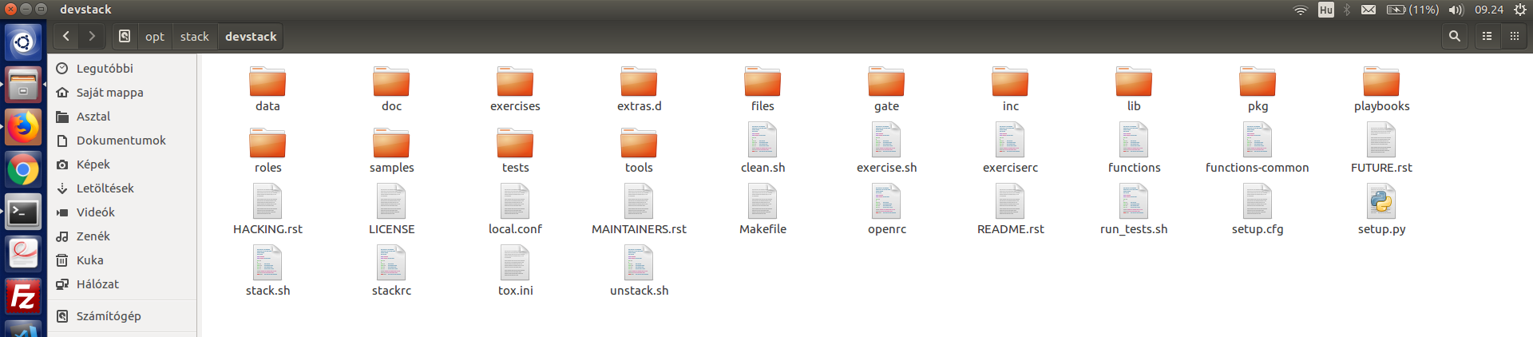
Result of the cloning
From the GitHub repository
37

Slide 38
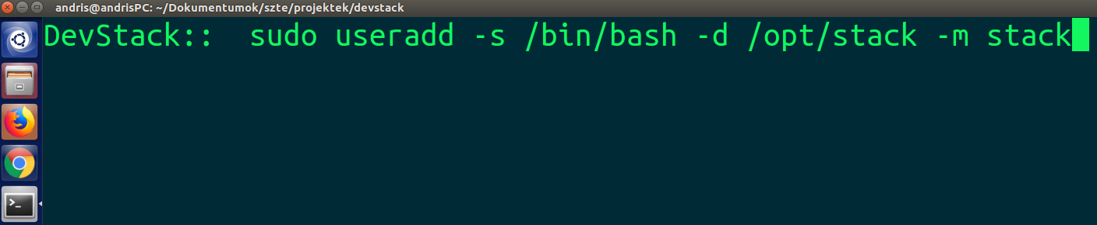
Example of the installing
Adding Stack user
38

Slide 39
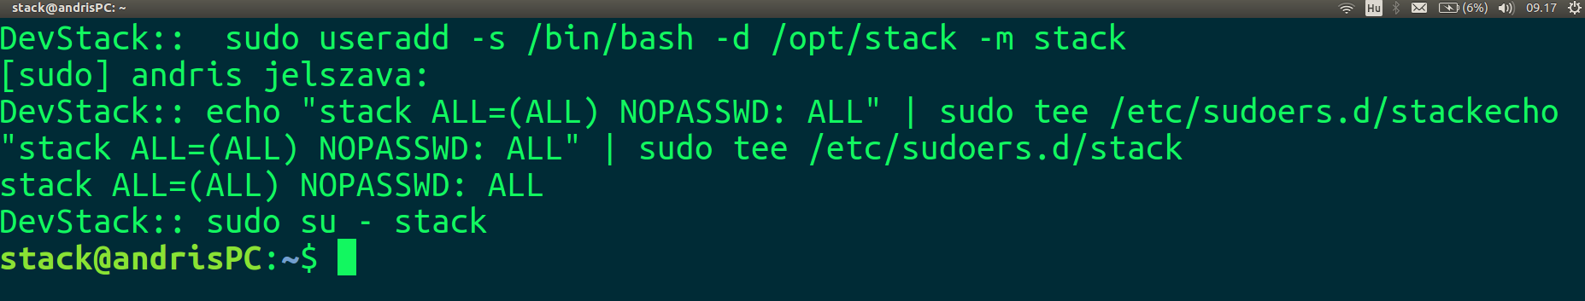
Example of the installing
Adding Stack user
39

Slide 40
Example of the installing
Start the install from bash script
40

Slide 41
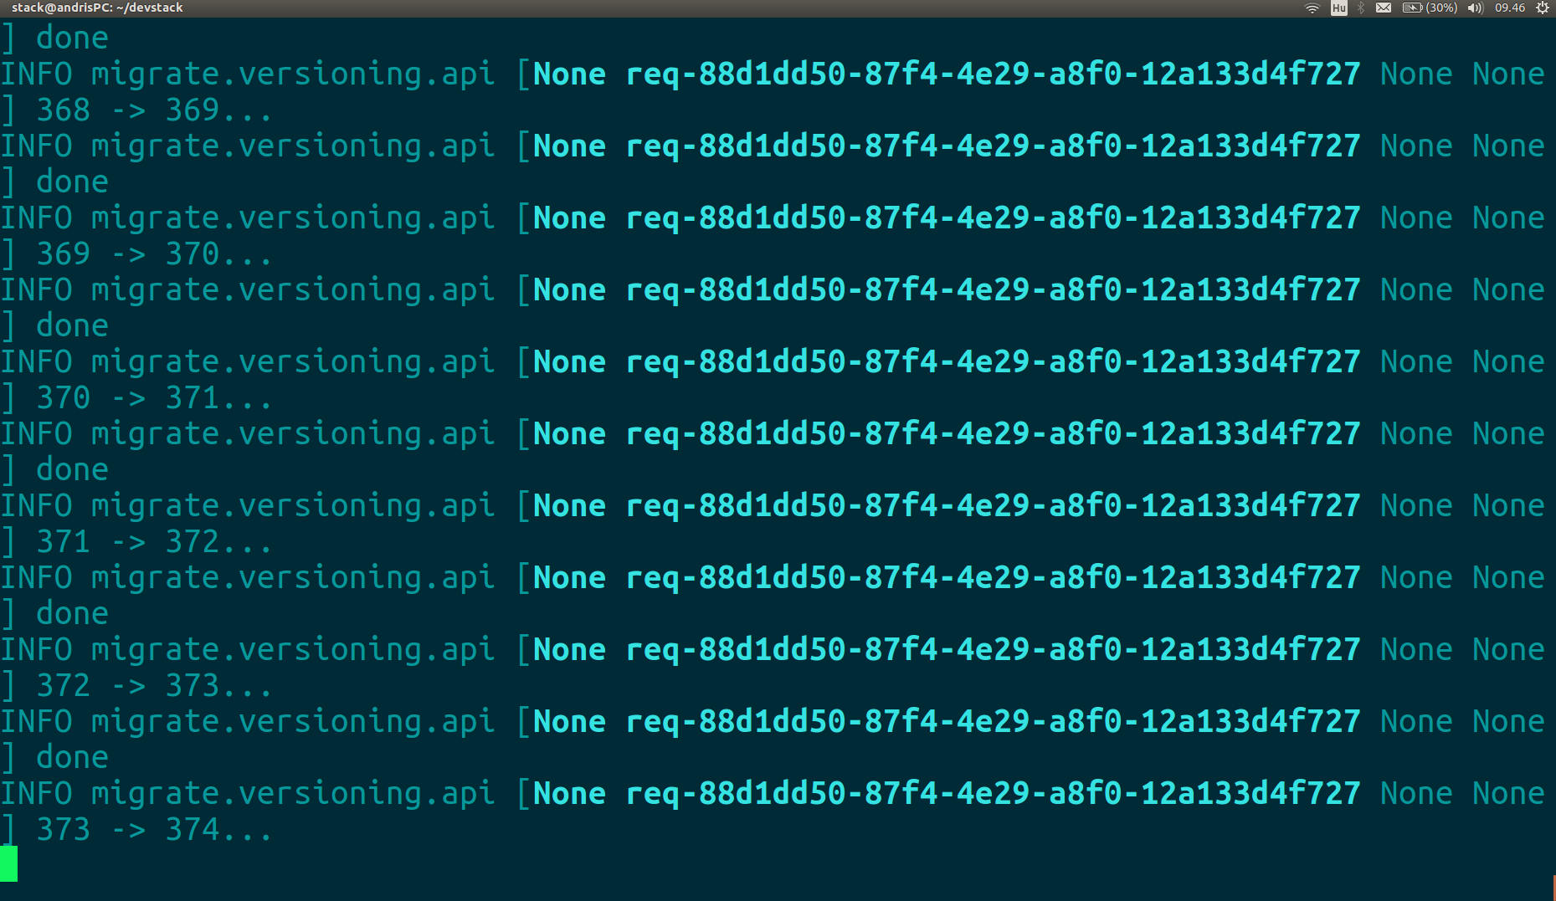
The process
Start the install from bash script
41

Slide 42
OpenStack RC file
To set the required environment variables for the OpenStack command-line clients, you must download and source an environment file
Copy the openrc.sh file to the machine from where you want to run OpenStack commands
The command (example demo project):
source demo-openrc.sh
42

Slide 43
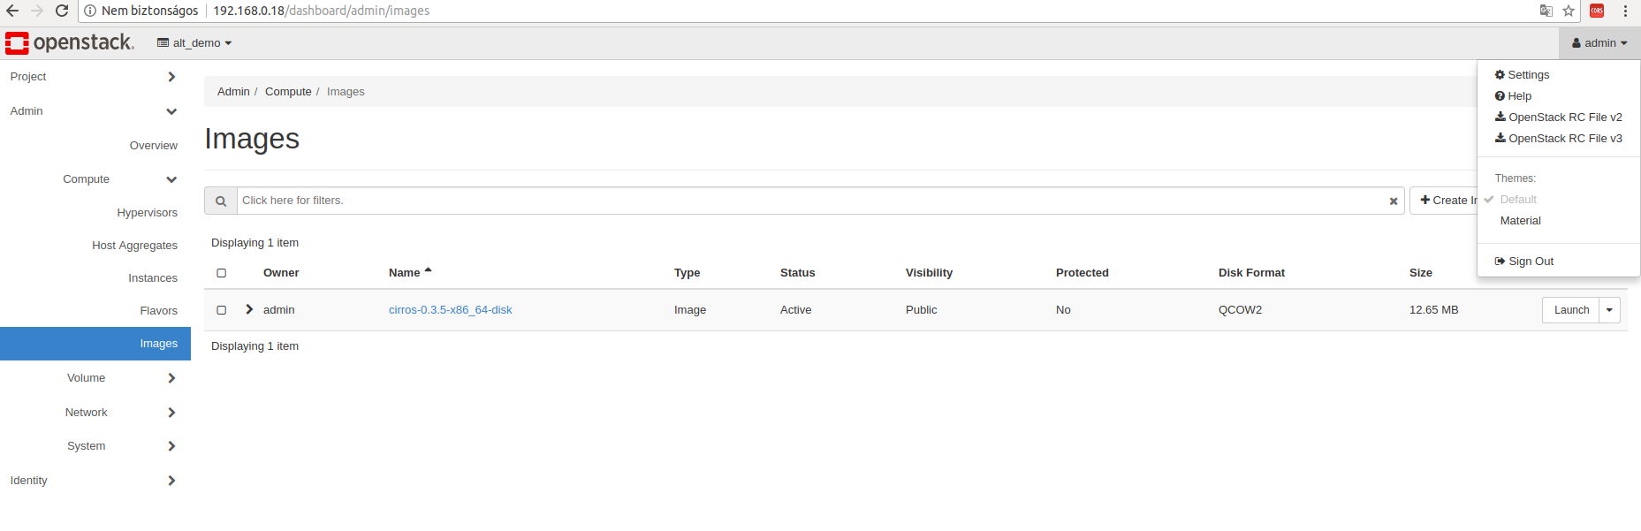
OpenStack RC file
43

Slide 44
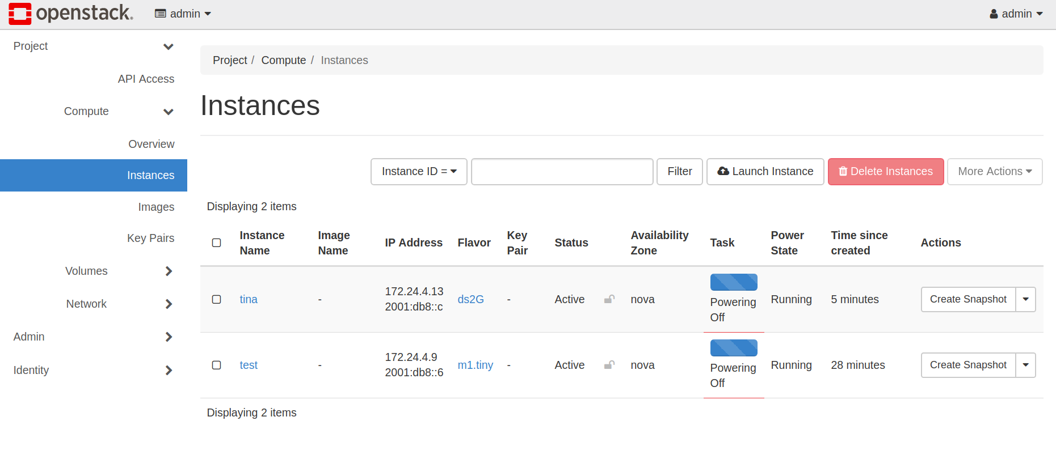
Example instances
44

Slide 45
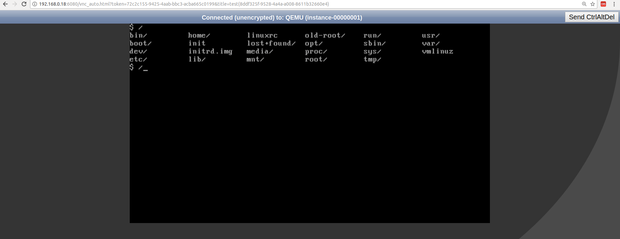
Console of the instance
45

Slide 46
References
OpenStack DevStack Offical Website: https://docs.openstack.org/devstack/latest/
GitHub: https://github.com/openstack-dev/devstack
46

