Slide 1
Openstack Components
1
Notes:
1

Slide 2
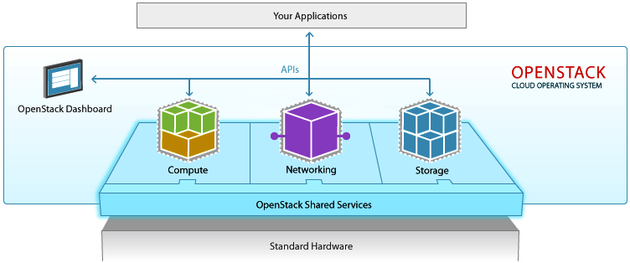
Components
2

Slide 3
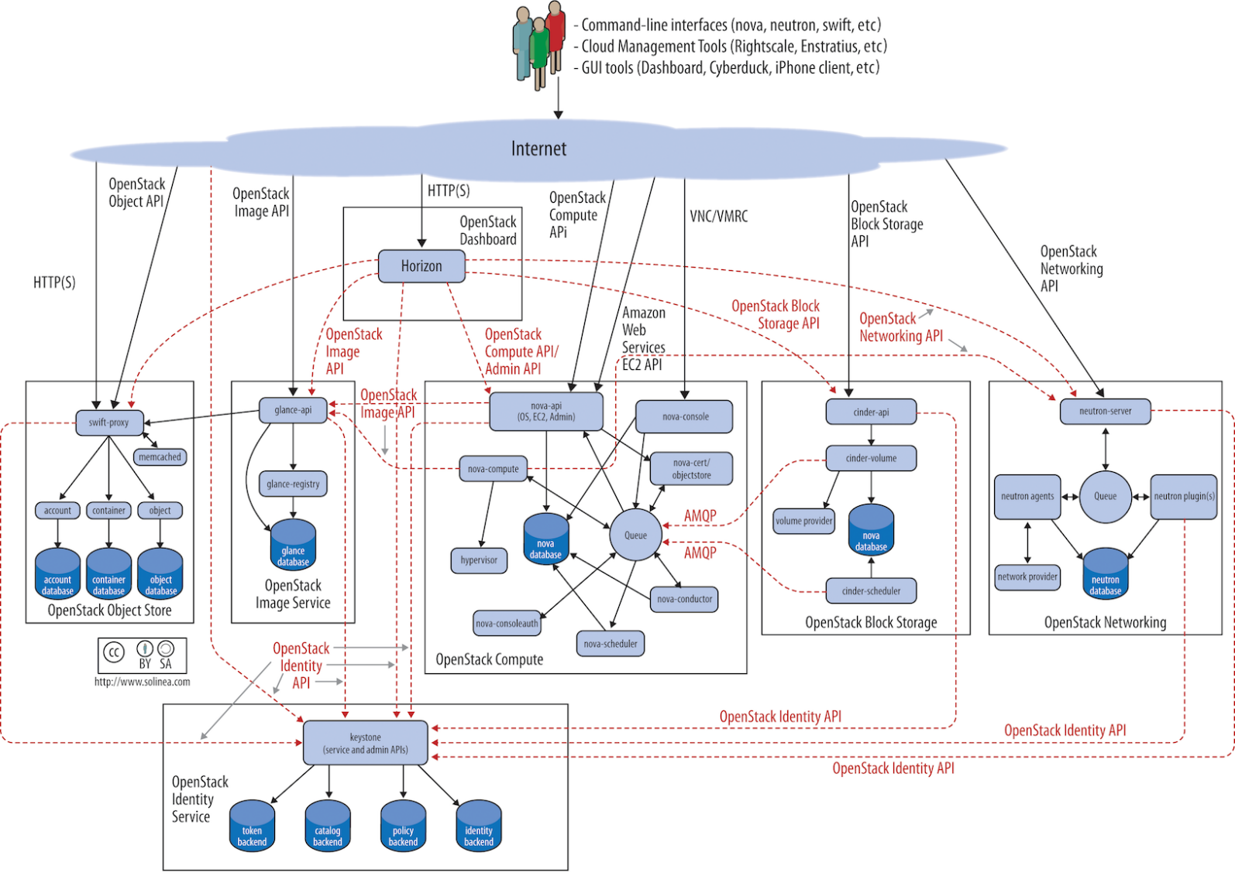
Components
https://docs.openstack.org/arch-design/design.html
3

Slide 4
Components
More than 40 projects in different categories:
Compute
Storage
Networking
Data & Analytics
Security & Identity
Management Tools
Deployment Tools
Application Services
Monitoring & Metering
https://www.openstack.org/software/project-navigator/
4

Slide 5
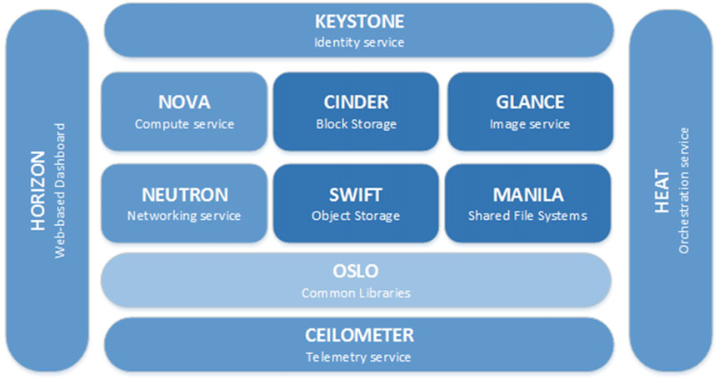
Compute - Nova
5

Slide 6
Compute - Nova
one of the basic services
installed on all cluster computer nodes
It manages the level of abstraction of virtual equipment (processors, memory, block devices, network adapters)
Nova provides the management of instances of virtual machines addressing the hypervisor and giving such commands as it is launching and stopping
6

Slide 7
Compute - Nova
OpenStack Compute (Nova) service is the heart of the OpenStack cloud
Its main goal is to manage basic virtual machines functions like creating, starting, stopping, etc.
Nova uses a message broker and database.
by default the database is MariaDB and the message broker is RabbitMQ.
7

Slide 8
Compute - Nova
The main services that support Nova are:
nova-api: This service receives REST API calls from other services and clients and responds to them.
nova-scheduler: It takes requests for starting instances from the queue and selects a compute node for running a virtual machine on it. The selection of Hypervisor is based on its weight and filters. Filters can include an amount of memory, a requested availability zone, a set of group hosts, among others
8

Slide 9
Compute - Nova
nova-conductor: This is the proxy service between the database and the nova compute services. It helps with horizontal scalability.
nova-compute: This is the main part of an IaaS system. This daemon usually runs only on compute nodes. It is designed to manage pools of computer resources and can work with widely available virtualization technologies.
nova-nonvncproxy and nova-consoleauth: These are two services for providing access to the instances console through remote access VNC protocol.
9

Slide 10
Compute - Glance
OpenStack Image Service (Glance) runs the catalog of virtual machines’ images, which users can use as templates to run instances of virtual machines in the cloud.
This service also delivers the backup functionality and snapshots creation.
Glance supports many different formats, including vhd , vmdk , vdi , iso ,qcow2 , and ami.
10

Slide 11
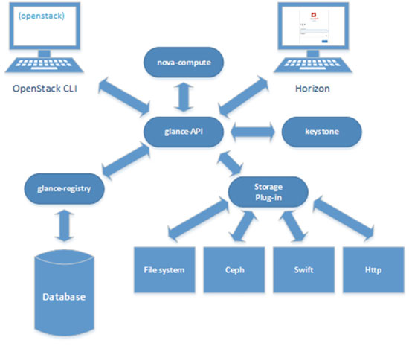
Compute - Glance
11

Slide 12
Compute - Glance
Glance consists of two services that are implemented as GNU/Linux daemons:
glance-api: Accepts Image REST API calls for image discovery, retrieval, and storage.
glance-registry: Stores, processes, and retrieves metadata about imagesGlance itself does not store images by themselves. Glance uses plug-ins for particular storage, which can be your local file system, Swift object storage, Ceph storage or Network File System. Metadata of images are stored in the Glance database, usually as a MariaDB instance.
12

Slide 13
Storage - Cinder
Instances use an ephemeral volume by default.
This kind of volume does not save the changes made on it and reverts to its original state when the current user relinquishes control.
One of the methods for storing data permanently in OpenStack cloud is the use of a block storage service named Cinder.
13

Slide 14
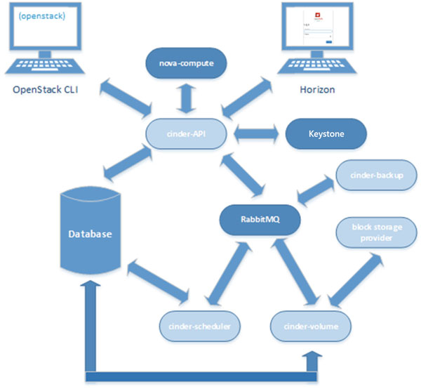
Storage - Cinder
14

Slide 15
Storage - Cinder
OpenStack block storage service consists of four services implemented as GNU/Linux daemons:
cinder-api: API service provides an HTTP endpoint for API requests. At the time of this writing, two versions of API are supported and required for the cloud. So Cinder provides six endpoints. The cinder-api verifies the identity requirements for an incoming request and after that routes them to the cinder-volume for action through the message broker.
15

Slide 16
Storage - Cinder
cinder-scheduler: Scheduler service reads requests from the message queue and selects the optimal storage provider node to create or manage the volume.
cinder-volume : The service works with a storage back end through the drivers. It gets requests from the scheduler and responds to read and write requests sent to the block storage service to maintain state.
cinder-backup: The backup service works with the backup back end through the driver architecture.
16

Slide 17
Management Tools – Horizon
OpenStack Dashboard (Horizon) service allows management of cloud resources through the web console.
Horizon gives access to only about 70-80% of its overall functions.
OpenStack Dashboard is a Python project aimed at providing a complete dashboard along with an extensible framework for building new dashboards.
Horizon aims to support all core OpenStack projects.
17

Slide 18
Management Tools – Horizon
The minimum required set of running OpenStack services comprises Keystone, Nova, Neutron, and Glance.
If the Keystone endpoint for a service is configured, Horizon detects it and enables support for optional services, such as Cinder, Swift, and Heat.
Horizon can also work with services that are out of the scope of this presentation, such as Ceilometer, Sahara, and Trove.
18

Slide 19
Management Tools – Horizon
OpenStack Dashboard runs under a web server, which is commonly Apache or NGINX.
For large-scale deployments, it is recommended that you configure a caching layer in front of Horizon, for example, the memcached daemon.
You will need to use a web browser with JavaScript and HTML5 support while working with Horizon.
Horizon is primarily tested and supported on the latest versions of Firefox, Chrome, and IE.
19

Slide 20
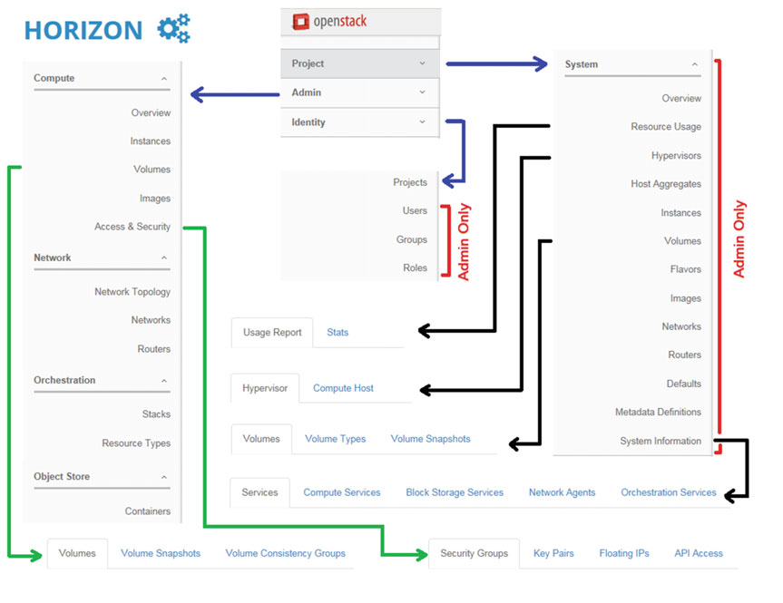
Management Tools – Horizon
Verify Operation of the Dashboard
OpenSta
20

Slide 21
Security & Identity – Keystone
The Keystone or OpenStack Identity service acts as a catalog of all OpenStack services and provides the ability for authenticating and managing user accounts and role information for the cloud environment.
Usually Keystone is the first component to be installed when starting an OpenStack cloud.
Keystone supports multiple forms of authentication, including login name and password, token-based credentials, and REST API log ins.
21

Slide 22
Security & Identity – Keystone
From an architectural point of view, Keystone is the simplest service in the cloud.
As for many other OpenStack services, OpenStack Identity service uses the MariaDB/MySQL database.
Keystone uses the Apache web server as the front end, so you no longer need to start openstack-keystone service.
22

Slide 23
Networking - Neutron
OpenStack Networking is one of the most complicated OpenStack services.
There are several components of most importance in OpenStack Networking
Tenant network: A virtual network that provides connectivity between entities. The network consists of subnets, and each subnet is a logical subdivision of an IP network. A subnet can be private or public. Virtual machines can get access to an external world through the public subnet. If a virtual machine is connected only to the private subnet, then only other virtual machines from this particular network can access it. Only a user with an admin role can create a public network.
23

Slide 24
Networking - Neutron
Router: A virtual network device that passes network traffic between different networks. A router can have one gateway and many connected subnets.
Security Group: The set of ingress and egress firewall rules that can be applied to one or many virtual machines. It is possible to change a Security Group at runtime.
24

Slide 25
Networking - Neutron
Floating IP address: An IP address that can be associated with a virtual machine so that the instance has the same IP from the public network each time it boots.
Port: A virtual network port within OpenStack Networking. It is a connection between the subnet and vNIC or virtual router.
vNIC (virtual Network Interface Card) or VIF (Virtual Network Interface) : An interface that is plugged into a port in a network.
25

Slide 26
Networking - Neutron
26

Slide 27
Networking - Neutron
27

Slide 28
Networking - Neutron
Neutron consists of several services that are implemented as standard GNU/Linux daemons:
neutron-server: The main service of Neutron. Accepts and routes API requests through message bus to the OpenStack Networking plug-ins for action.
neutron-openvswitch-agent: Receives commands from neutron-server and sends them to Open vSwitch (OVS) for execution.
28

Slide 29
Networking - Neutron
Neutron consists of several services that are implemented as standard GNU/Linux daemons:
neutron-l3-agent : Provides routing and Network Address Translation (NAT.
neutron-dhcp-agent : Manages dnsmasq services. Dnsmasq is a lightweight Dynamic Host Configuration Protocol (DHCP) and caching DNS server.
neutron-metadata-agent : Provides the ability for instances to get information
such as hostname, SSH keys, etc.
29

Slide 30
Storage - Swift
OpenStack Swift is a highly available, distributed, eventually consistent object Software Defined Storage (SDS) system.
In contrast to file storage, object storage works with an object that contains data and metadata itself.
Generally, object storage provides access through an API. Objects are available via URLs and HTTP/ HTTPS protocols.
Object storage can distribute requests across a number of storage hosts.
30

Slide 31
Storage - Swift
All objects are accessible in one single namespace, and object storage systems are usually highly scalable.
Logically, Swift consists of three levels: accounts, containers, and objects.
Account in Swift corresponds to the Project/Tenant in other OpenStack services.
Swift users are primarily people who have a username and password. Swift users correspond to accounts in other OpenStack services. Objects are stored in containers that belong to the accounts.
31

Slide 32
Storage - Swift
32

Slide 33
Storage - Swift
33

Slide 34
Application Service - Heat
The main purpose of the service is to manage the entire lifecycle of the infrastructure and applications within OpenStack clouds.
For orchestration, Heat uses templates that describe instances, networks, volumes, etc.
Two formats of templates can be used with OpenStack Orchestration:
HOT (Heat Orchestration Template) : OpenStack-native YAML-based template format.
CFT (AWS CloudFormation Template) : Compatible with AWS CloudFormation. JSON-based template format.
34

Slide 35
Application Service - Heat
35

Slide 36
Application Service - Heat
Heat consists of several services that are implemented as GNU/Linux daemons and CLI commands:
heat-api: Accepts an OpenStack-native REST API call for template processing. After receiving API calls, heat-api processes them by sending them to the heat-engine via the AMQP protocol.
heat-api-cfn: This is a CloudFormation API service. It is similar to heat-api by function.
36

Slide 37
Application Service - Heat
heat-engine: The main service of Heat. The engine does all the work of orchestrating, launching templates, and providing feedback to the client.
heat-api-cloudwatch: An additional minimal implementation of AWS CloudWatch–compatible service. It is primarily required to enable metric collection for high availability and autoscaling functionality.
heat: The CLI tool that communicates with the heat-api.
37

Slide 38
Components
More than 40 projects in different categories:
Compute
Storage
Networking
Data & Analytics
Security & Identity
Management Tools
Deployment Tools
Application Services
Monitoring & Metering
https://www.openstack.org/software/project-navigator/
38

Slide 39
Compute
Nova - Compute Service
Glance - Image Service
Ironic - Bare Metal Provisioning Service
Magnum - Container Orchestration Engine Provisioning
Storlets - Computable Object Store
Zun - Containers Service
39

Slide 40
Compute - Nova
To implement services and associated libraries to provide massively scalable, on demand, self service access to compute resources, including bare metal, virtual machines, and containers.
40

Slide 41
Compute - Glance
Glance image services include discovering, registering, and retrieving virtual machine images.
Glance has a RESTful API that allows querying of VM image metadata as well as retrieval of the actual image.
VM images made available through Glance can be stored in a variety of locations from simple filesystems to object-storage systems like the OpenStack Swift project.
41

Slide 42
Compute - Ironic
Ironic is an OpenStack project which provisions bare metal (as opposed to virtual) machines.
It may be used independently or as part of an OpenStack Cloud, and integrates with the OpenStack Identity (keystone), Compute (nova), Network (neutron), Image (glance) and Object (swift) services.
When the Bare Metal service is appropriately configured with the Compute and Network services, it is possible to provision both virtual and physical machines through the Compute service’s API.
42

Slide 43
Compute - Magnum
Magnum makes container orchestration engines such as Docker Swarm, Kubernetes, and Apache Mesos available as first class resources in OpenStack.
Magnum uses Heat to orchestrate an OS image which contains Docker and Kubernetes and runs that image in either virtual machines or bare metal in a cluster configuration.
43

Slide 44
Compute - Storlets
Openstack Storlets is an extension to Openstack Swift with the ability to run user defined computations - called storlets - inside the object store in a secure and isolated manner through the use of Docker containers.
A storlet is a compiled and packaged code (e.g. a .jar file) that can be uploaded to Swift as any other object.
Once uploaded the storlet can be invoked over data objects in Swift.
44

Slide 45
Compute - Zun
Zun provides an OpenStack API for launching and managing containers backed by different container technologies.
Different from Magnum, Zun is for users who want to treat containers as OpenStack-managed resource.
Containers managed by Zun are supposed to be integrated well with other OpenStack resources, such as Neutron network and Cinder volume.
45

Slide 46
Storage
Swift - Object Store
Cinder - Block Storage
Manila - Shared Filesystems
Karbor - Application Data Protection as a Service
Freezer - Backup, Restore, and Disaster Recovery
46

Slide 47
Storage - Swift
Swift is a highly available, distributed, eventually consistent object/blob store.
Organizations can use Swift to store lots of data efficiently, safely, and cheaply.
It's built for scale and optimized for durability, availability, and concurrency across the entire data set.
Swift is ideal for storing unstructured data that can grow without bound.
47

Slide 48
Storage - Cinder
Cinder is a Block Storage service for OpenStack.
It virtualizes the management of block storage devices and provides end users with a self service API to request and consume those resources without requiring any knowledge of where their storage is actually deployed or on what type of device.
48

Slide 49
Storage - Manila
Manila proposes and is in the process of implementing a new OpenStack service (originally based on Cinder).
Cinder presently functions as the canonical storage provisioning control plane in OpenStack for block storage as well as delivering a persistence model for instance storage.
The File Share Service prototype, in a similar manner, provides coordinated access to shared or distributed file systems.
49

Slide 50
Storage - Karbor
Karbor deals with protecting the Data and Meta-Data that comprises an OpenStack-deployed application against loss/damage (e.g. backup, replication) - not to be confused with Application Security or DLP.
It does that by providing a standard framework of APIs and services that enables vendors to introduce various data protection services into a coherent and unified flow for the user.
50

Slide 51
Storage - Freezer
Freezer is a distributed backup, restore and disaster recovery as a service platform.
It is designed to be multi OS (Linux, Windows, OSX, *BSD), focused on providing efficiency and flexibility for block based backups, file based incremental backups, point-in-time actions, jobs synchronization (i.e. backup synchronization over multiple nodes) and many other features.
It is aimed at being useful for all environments, including large ephemeral Clouds.
51

Slide 52
Networking
Neutron - Networking
Designate - DNS Service
Dragonflow - Neutron Plugin
Kuryr - Container plugin
Octavia - Load Balancer
Tacker - NFV Orchestration
Tricircle - Networking Automation for Multi-Region Deployments
52

Slide 53
Networking - Neutron
OpenStack Neutron is an SDN networking project focused on delivering networking-as-a-service (NaaS) in virtual compute environments.
53

Slide 54
Networking - Designate
Designate provides DNSaaS services for OpenStack.
REST API for domain/record management
Integrated with Keystone for authentication
54

Slide 55
Networking - Dragonflow
Dragonflow is a distributed control plane implementation of Neutron.
Its mission is to implement advanced networking services driven by the Neutron API and running on a distributed control plane.
It’s designed to support containers networking and large scale production loads.
55

Slide 56
Networking - Kuryr
Kuryr provides a bridge between container framework networking and storage models to OpenStack networking and storage abstractions.
56

Slide 57
Networking - Octavia
Octavia is an open source, operator-scale load balancing solution designed to work with OpenStack.
Octavia accomplishes its delivery of load balancing services by managing a fleet of virtual machines, containers, or bare metal servers which it spins up on demand.
This on-demand, horizontal scaling feature differentiates Octavia from other load balancing solutions, thereby making Octavia truly suited “for the cloud.”
57

Slide 58
Networking - Tacker
Tacker provides a generic VNF Manager (VNFM) and an NFV Orchestrator (NFVO) to deploy and operate Network Services and Virtual Network Functions (VNFs) on an NFV infrastructure platform like OpenStack.
It is based on ETSI MANO Architectural Framework and provides a functional stack to Orchestrate Network Services end-to-end using VNFs.
58

Slide 59
Networking - Tricircle
Tricircle provides networking automation across Neutron in multi-region OpenStack deployments.
Use cases include application high availability, dual ISPs for internet link redundancy, east-west traffic isolation, cross Nuetron L2 network for NFV, and cloud capacity expansion.
59

Slide 60
Data & Analytics
Trove - Database as a Service
Sahara - Big Data Processing Framework Provisioning
Searchlight - Indexing and Search
60

Slide 61
Data & Analytics - Trove
Trove is a database-as-a-service provisioning relational and non-relational database engines.
61

Slide 62
Data & Analytics - Sahara
The sahara project aims to provide users with a simple means to provision data processing frameworks (such as Hadoop, Spark and Storm) on OpenStack.
This is accomplished by specifying configuration parameters such as the framework version, cluster topology, node hardware details and more.
62

Slide 63
Data & Analytics - Searchlight
The Searchlight project provides indexing and search capabilities across OpenStack resources.
Its goal is to achieve high performance and flexible querying combined with near real-time indexing.
It uses Elasticsearch, a real-time distributed indexing and search engine built on Apache Lucene, but adds OpenStack authentication and Role Based Access Control to provide appropriate protection of data.
63

Slide 64
Security & Identity
Keystone - Identity service
Barbican - Key Management
Congress - Governance
Mistral - Workflow service
64

Slide 65
Security & Identity - Keystone
Keystone is an OpenStack service that provides API client authentication, service discovery, and distributed multi-tenant authorization by implementing OpenStack’s Identity API.
It supports LDAP, OAuth, OpenID Connect, SAML and SQL.
65

Slide 66
Security & Identity - Barbican
Barbican is the OpenStack Key Manager service.
It provides secure storage, provisioning and management of secret data, such as passwords, encryption keys, X.509 Certificates and raw binary data.
66

Slide 67
Security & Identity - Congress
Congress is an OpenStack project to provide policy as a service across any collection of cloud services in order to offer governance and compliance for dynamic infrastructures.
67

Slide 68
Security & Identity - Mistral
Mistral is a workflow service.
Most business processes consist of multiple distinct interconnected steps that need to be executed in a particular order in a distributed environment.
One can describe such process as a set of tasks and task relations (via YAML-based language) and upload such description to Mistral so that it takes care of state management, correct execution order, parallelism, synchronization and high availability.
68

Slide 69
Management Tools
Horizon - Dashboard
OpenStack Client (CLI) - Command-line client
Rally - Benchmark service
Senlin - Clustering service
Vitrage - RCA (Root Cause Analysis service)
Watcher - Optimization Service
69

Slide 70
Management Tools - Horizon
Horizon is the canonical implementation of OpenStack's dashboard, which is extensible and provides a web based user interface to OpenStack services.
70

Slide 71
Management Tools - CLI
Provide a single command-line interface for OpenStack services with a uniform command set and format.
71

Slide 72
Management Tools - Rally
Rally is a benchmarking and performance analysis tool for OpenStack that can be used to automate measuring and profiling focused on how new code changes affect OpenStack performance, detect scaling and performance issues, and investigate how different deployment architectures and hardware affect OpenStack performance.
72

Slide 73
Management Tools - Senlin
Senlin is a clustering service for OpenStack clouds.
It creates and operates clusters of homogeneous objects exposed by other OpenStack services.
The goal is to make orchestration of collections of similar objects easier.
73

Slide 74
Management Tools - Vitrage
Vitrage is the OpenStack RCA (Root Cause Analysis) service for organizing, analyzing and expanding OpenStack alarms & events, yielding insights regarding the root cause of problems and deducing their existence before they are directly detected.
74

Slide 75
Management Tools - Watcher
Watcher provides a flexible and scalable resource optimization service for multi-tenant OpenStack-based clouds.
Watcher provides a complete optimization loop—including everything from a metrics receiver, optimization processor and an action plan applier.
75

Slide 76
Deployment Tools
Chef OpenStack - Chef cookbooks for OpenStack
Kolla - Container deployment
OpenStack Charms - Juju Charms for OpenStack
OpenStack-Ansible - Ansible Playbooks for OpenStack
Puppet OpenStack - Puppet Modules for OpenStack
TripleO - Deployment service
76

Slide 77
Deployment Tools - Chef
The Chef OpenStack team builds Chef cookbooks for deploying OpenStack services.
77

Slide 78
Deployment Tools - Kolla
Kolla provides production-ready containers and deployment tools for operating OpenStack clouds that are scalable, fast, reliable, and upgradable using community best practices.
78

Slide 79
Deployment Tools - Charms
Develop and maintain Juju Charms for deploying and managing OpenStack services.
79

Slide 80
Deployment Tools - Ansible
OpenStack-Ansible provides Ansible playbooks and roles for the deployment and configuration of an OpenStack environment.
80

Slide 81
Deployment Tools - Puppet
The Puppet modules for OpenStack bring scalable and reliable IT automation to OpenStack cloud deployments.
81

Slide 82
Deployment Tools - TripleO
Develop and maintain tooling and infrastructure able to deploy OpenStack in production, using OpenStack itself wherever possible.
82

Slide 83
Application Services
Heat - Orchestration
Zaqar - Messaging Service
Murano - Application Catalog
Solum - Software Development Lifecycle Automation
83

Slide 84
Application Services - Heat
Heat orchestrates the infrastructure resources for a cloud application based on templates in the form of text files that can be treated like code.
Heat provides both an OpenStack-native REST API and a CloudFormation-compatible Query API.
Heat also provides an autoscaling service that integrates with the OpenStack Telemetry services, so you can include a scaling group as a resource in a template.
84

Slide 85
Application Services - Zaqar
Zaqar is a multi-tenant cloud messaging service for web and mobile developers.
The service features a fully RESTful API, which developers can use to send messages between various components of their SaaS and mobile applications.
Other OpenStack components can integrate with Zaqar to surface events to end users and to communicate with guest agents that run in the "over-cloud" layer.
85

Slide 86
Application Services - Murano
Murano enables application developers and cloud administrators to publish various cloud-ready applications in a browsable catalog.
Cloud users can then use the catalog to compose reliable application environments with the push of a button.
Murano uses OpenStack Heat to orchestrate infrastructure resources for the application.
86

Slide 87
Application Services - Solum
To make cloud services easier to consume and integrate with your application development process by automating the source-to-image process, and simplifying app-centric deployment.
87

Slide 88
Monitoring & Metering
Ceilometer - Metering & Data Collection Service
CloudKitty - Billing and chargebacks
Monasca - Monitoring
AODH - Alarming Service
PANKO - Event, Metadata Indexing Service
88

Slide 89
Monitoring - Ceilometer
Ceilometer's goal is to efficiently collect, normalise and transform data produced by OpenStack services.
The data it collects is intended to be used to create different views and help solve various telemetry use cases.
89

Slide 90
Monitoring - CloudKitty
CloudKitty is a rating-as-a-service project designed to translate metrics to prices.
CloudKitty supports multiple collectors, multiple rating policies and multiple outputs.
90

Slide 91
Monitoring - Monasca
Monasca is a open-source multi-tenant, highly scalable, performant, fault-tolerant monitoring-as-a-service solution that integrates with OpenStack.
It uses a REST API for high-speed metrics processing and querying and has a streaming alarm engine and notification engine.
91

Slide 92
Monitoring - AODH
Aodh's goal is to enable the ability to trigger actions based on defined rules against sample or event data collected by Ceilometer.
92

Slide 93
Monitoring - PANKO
Panko is designed to provide a metadata indexing, event storage service which enables users to capture the state information of OpenStack resources at a given time.
Its aim is to enable a scalable means of storing both short and long term data for use cases such as auditing and system debugging.
93

Slide 94
References
Openstack Official Website: https://www.openstack.org/software/project-navigator
Andrey Markelov: Certified OpenStack Administrator Study Guide
94

