Slide 1
Openstack Orchestration
Heat
1
Notes:
1

Slide 2
Orchestration
The Mission
is to create a human- and machine-accessible service for managing the entire lifecycle of infrastructure and applications within OpenStack clouds.
https://wiki.openstack.org/wiki/Heat
2

Slide 3
OpenStack Heat
The main project in the OpenStack Orchestration program
Implements an orchestration engine
To launch multiple composite cloud applications
Based on templates (try to be compatible with AWS CloudFormation*)
*https://docs.aws.amazon.com/AWSCloudFormation/latest/APIReference/Welcome.html?r=7078
3

Slide 4
Heat template
Describes the infrastructure for a cloud application
in a text file that is readable and writable by humans
and can be checked into version control, diffed, etc.
https://github.com/openstack/heat-templates
4

Slide 5
Infrastructure resources
Servers
Floating IPs
Volumes
Security groups
Users
Etc.
5

Slide 6
Autoscaling
Integrates with Telemetry*
collect data on the utilization of the physical and virtual resources
Metering,
Monitoring,
and Alarming
*https://wiki.openstack.org/wiki/Telemetry
6

Slide 7
Releationships
For example: this volume is connected to this server
Create resources in the correct order
Completly launch the application
7

Slide 8
Lifecycle
Heat manages the whole lifecycle of the application
When you need to change your infrastructure
simply modify the template
knows how to make the necessary changes
it will delete all of the resources too
8

Slide 9
Software configuration management tools
Integration between infrastructure and software
Integrates with
Puppet*
Chef**
Ansible
*https://s3.amazonaws.com/cloudformation-examples/IntegratingAWSCloudFormationWithPuppet.pdf
**https://www.full360.com/2011/02/27/integrating-aws-cloudformation-and-chef.html
9

Slide 10
Heat Orchestration Template (HOT)
Yaml file
Content:
Version
Description
Parameter groups
Parameters
Resources
Outputs (for example IP)
Conditions
Restrict resources or properties
10

Slide 11
HOT example #1
heat_template_version: 2015-04-30
description: Simple template to deploy a single compute instance
resources:
my_instance:
type: OS::Nova::Server
properties:
key_name: my_key
image: F18-x86_64-cfntools
flavor: m1.small
networks:
- network: private
11

Slide 12
HOT example #2/1
parameters:
key_name:
type: string
label: Key Name
description: Name of key-pair to be used for compute instance
default: mykey
image_id:
type: string
label: Image ID
description: Image to be used for compute instance
default: cirros
instance_type:
type: string
label: Instance Type
description: Type of instance (flavor) to be used
default: m1.small
...
12

Slide 13
HOT example #2/2
...
parameters:
network:
type: string
label: Network
description: Network used by the instance
default: private
resources:
my_instance:
type: OS::Nova::Server
properties:
key_name: { get_param: key_name }
image: { get_param: image_id }
flavor: { get_param: instance_type }
networks: [{network: { get_param: network} }]
13

Slide 14
HOT example #3
outputs:
instance_ip:
description: The IP address of the deployed instance
value: { get_attr: [my_instance, first_address] }
14

Slide 15
Stack
CLI
GUI
Horizon (from Keystone)
Project / Orchestration / Stacks
Launch Stack
From file
From text
From URL
15

Slide 16
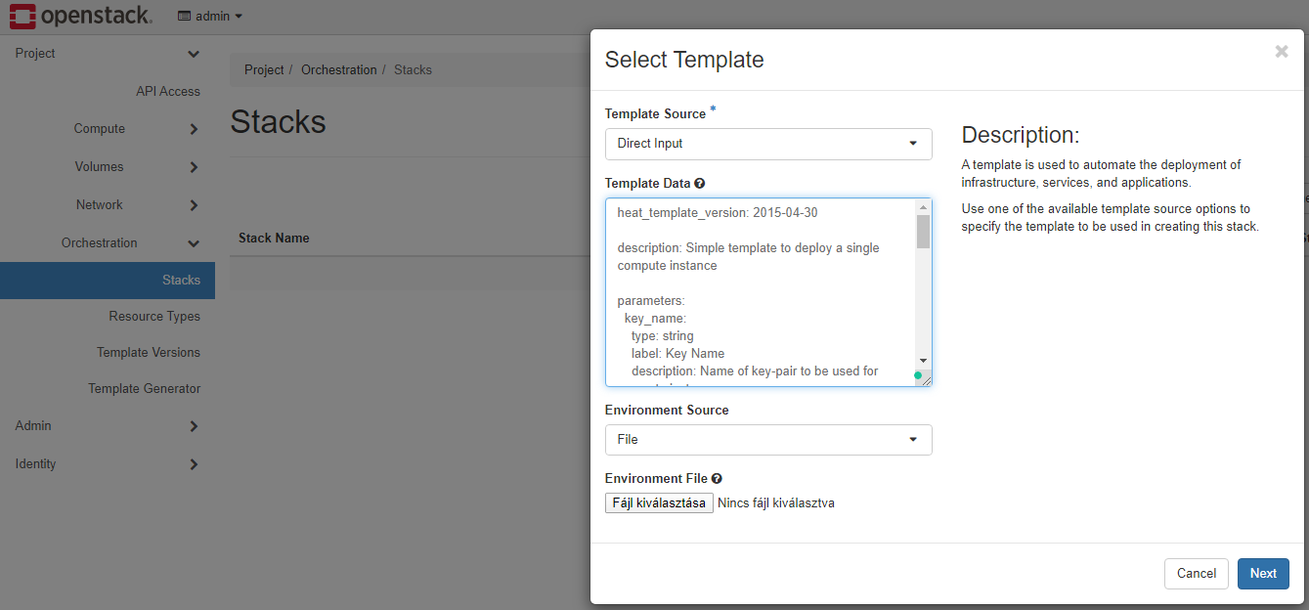
Stack
16

Slide 17
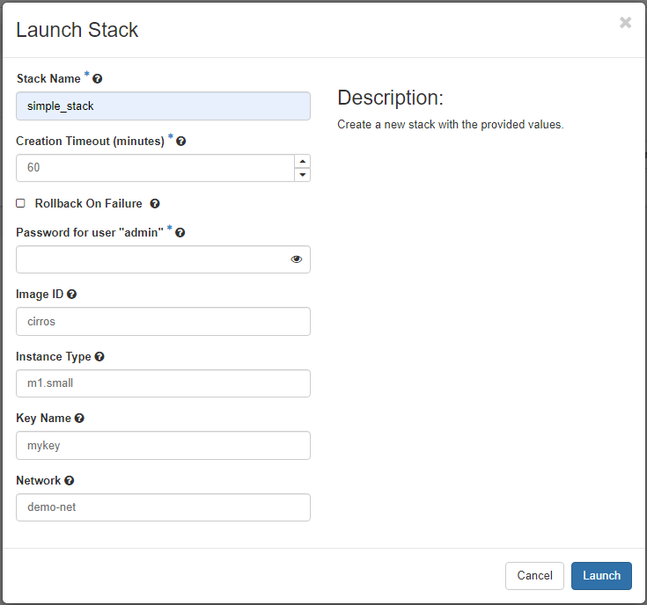
Stack
17

Slide 18
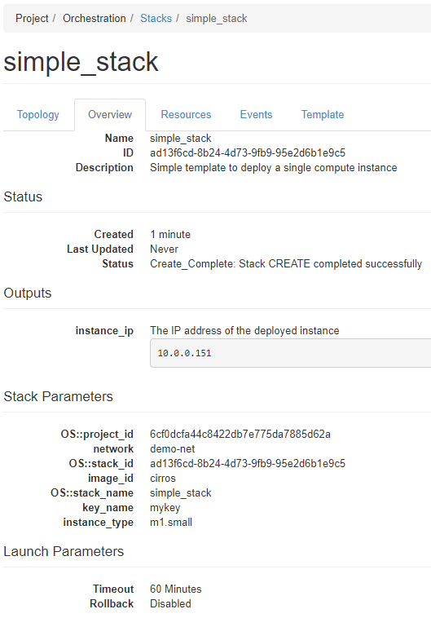
Stack
18

Slide 19
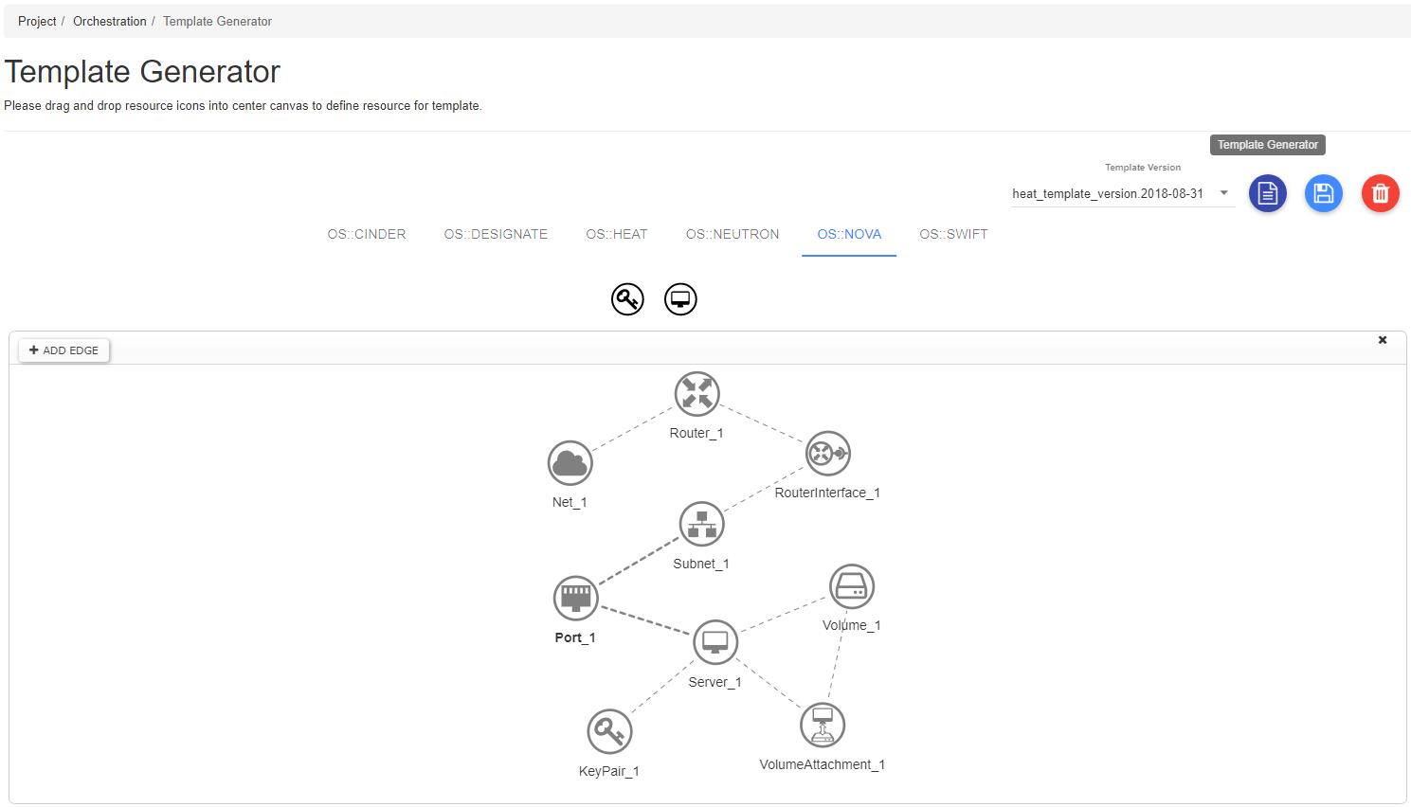
Template generator
19

Slide 20
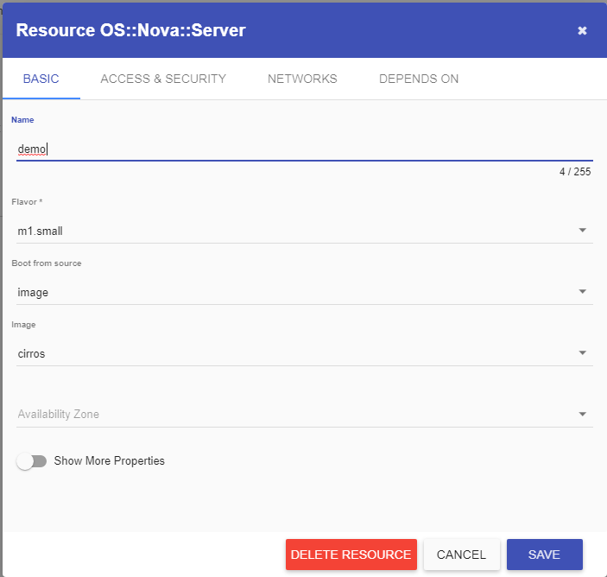
Template generator
20

Slide 21
Heat and DevStack
Heat is fully integrated into DevStack
Enable Heat / Heat Plugin
Icehouse and Juno
Configured by default
Newer versions:
Enable in local.conf
#Enable heat services enable_service h-eng h-api h-api-cfn h-api-cw
*https://docs.openstack.org/heat/latest/getting_started/on_devstack.html
21

Slide 22
Heat and DevStack
Since Newton release:
Heat DevStack plugin:
Enable in local.conf
#Enable heat plugin enable_plugin heat https://opendev.org/openstack/heat stable/newton
*https://docs.openstack.org/heat/latest/getting_started/on_devstack.html
22

Slide 23
Extras
Ceilometer DevStack plugin
Profiler
Notifications
Aodh DevStack plugin
Define VM image on local.conf
*https://docs.openstack.org/heat/latest/getting_started/on_devstack.html
23

