Slide 1

Rally

Slide 2
Rally
Testing tool
“How does OpenStack work at scale?”
Automates and unifies multi-node OpenStack deployment, cloud verification, testing & profiling

Slide 3
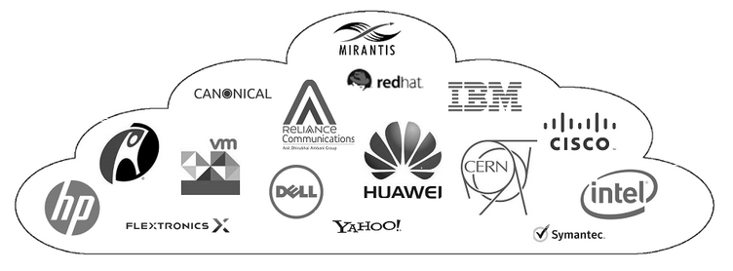
Users

Slide 4
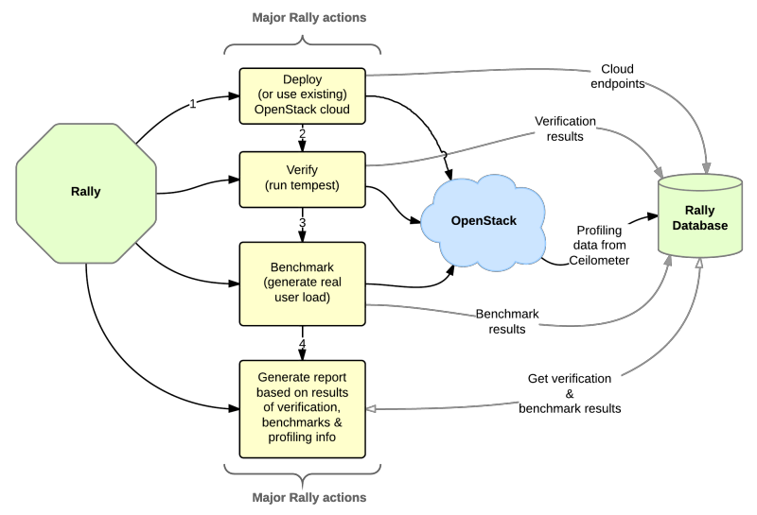
Workflow

Slide 5
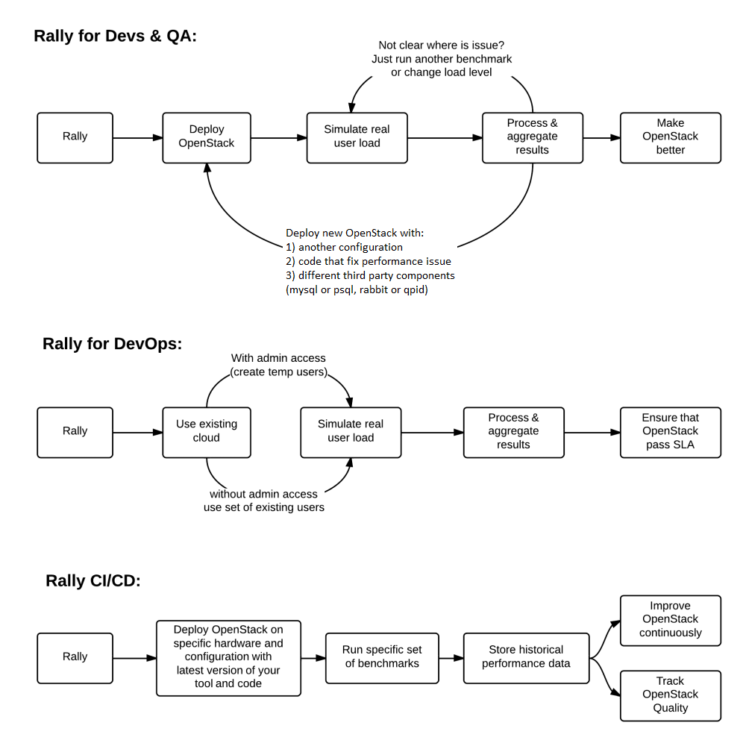

Slide 6
Aims to help
Automate measuring & profiling focused on how new code changes affect the OpenStack performance
Using Rally profiler to detect scaling & performance issues
Investigate how different deployments affect the OS performance
Automate the production cloud specification generation

Slide 7
Complex scenarios
Most Rally scenarios are a sequence of atomic actions
NovaServers.snapshot:
  Boot VM
  Snapshot VM
  Delete VM
  Boot VM from snapshot
  Delete VM
  Delete Snapshot

Slide 8
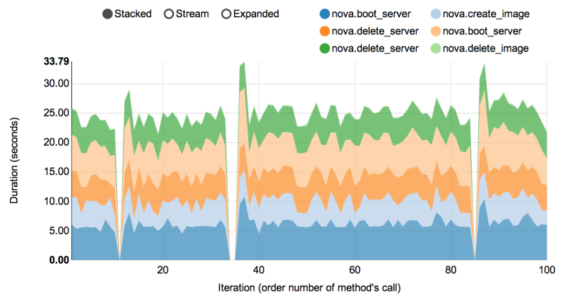
Complex scenarios
Rally measures not only the performance of the scenario as a whole, but also that of single atomic actions

Slide 9
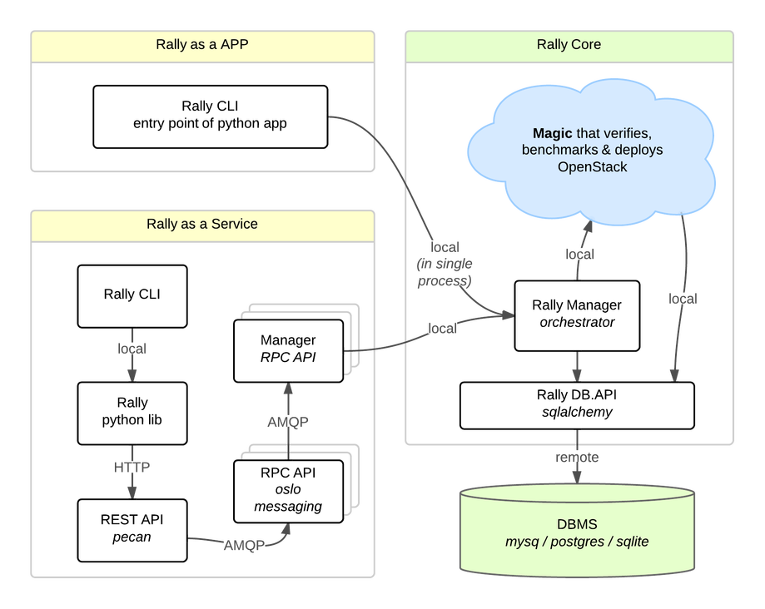
Architecture
Rally-as-a-Service
  Web UI (beta)
Rally-as-an-App
  CLI

Slide 10
Tests
Example: start and stop a VM
JSON configuration file
Start the test:
  rally task start <task_config.json>
Generate report:
  rally task report
Custom scenarios

Slide 11
Rally args
---
NovaServers.boot_and_delete_server: - Name of the test
-
args:
flavor:
name: "m1.tiny" - Flavor
image:
name: "^cirros.*-disk$" - Image
runner:
type: "constant„ - Constant load
times: 2 - Repeat
concurrency: 1 - Run in parallel
context:
users:
tenants: 1 - 1 tenant (project)
users_per_tenant: 1 - 1 user in the tenant

Slide 12
Use case
Finding a Keystone bug while testing 20 node HA cloud performance at creating 400 VMs
https://github.com/openstack/rally/blob/master/doc/user_stories/nova/boot_server.rst
4x performance increase in Keystone inside Apache using the token creation benchmark
https://github.com/openstack/rally/blob/master/doc/user_stories/keystone/authenticate.rst
More real-life examples
https://docs.openstack.org/rally/latest/overview/overview.html

Slide 13
Rally scenarios
CinderVolumes.create_and_attach_volume
GlanceImages.create_and_delete_image
NeutronNetworks.create_and_delete_networks
NeutronNetworks.create_and_delete_subnets
NovaServers.boot_and_delete_server
CinderVolumes.create_and_delete_snapshot

Slide 14
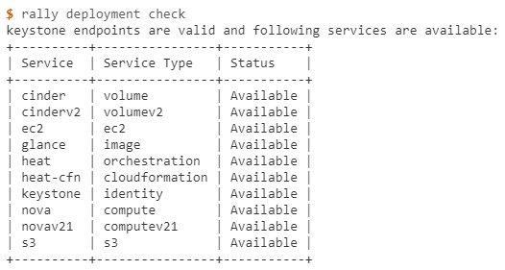
How to use it
OpenRC authentication
rally deployment create –fromenv –name=existing
Configuration file
rally deployment create –file=existing.json –name=existing
Deployment check
rally deployment check

Slide 15
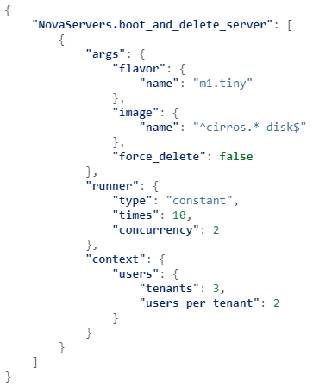
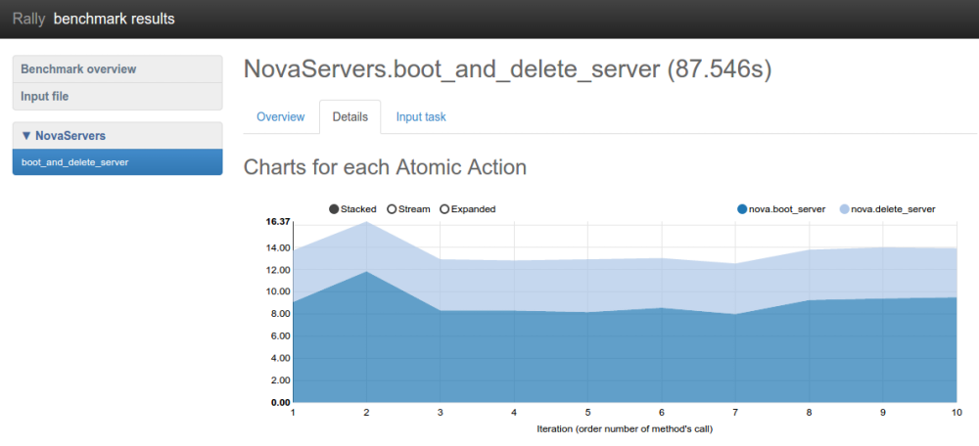
How to use it
Run a scenario
  Config file
  rally task start nova/boot-and-delete.json
Generate report
  rally task report 6fd9a19f-5cf8-4f76-ab72-2e34bb1d4996 --out output.html

Slide 16
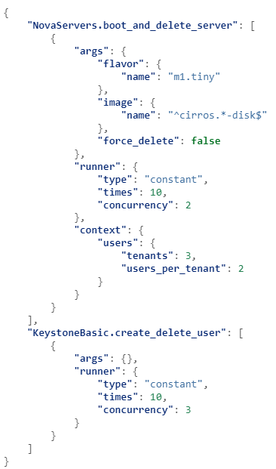
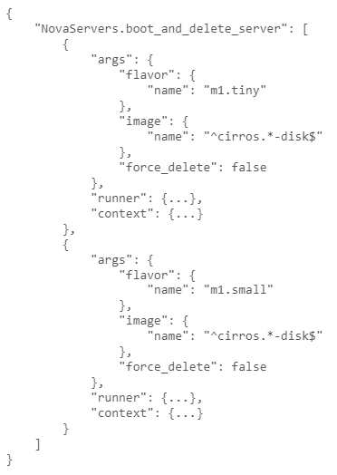
How to use it
Multiple subtasks in a single task
Multiple configurations of the same scenario

Slide 17
OpenStack Client - CLI
Unified CLI
  Compute, Identity, Image, Object storage, Block storage APIs
  https://docs.openstack.org/python-openstackclient/latest/
Individual OpenStack services:
  Compute (nova), Block storage (cinder), ...
  Bare Metal (ironic), Containers (zun), Container management (magnum), Data processing (sahara), ...
  https://docs.openstack.org/zed/language-bindings.html

Slide 18
OpenStack Client - CLI
Requirements
  Python 2.7 or later
  (pip)
Install
  Unified client
    pip install python-openstackclient
    apt install python-openstackclient
  PROJECTclient
    pip install python-PROJECTclient
    apt install python-PROJECTcleint
    PROJECT: nova, glance, ..., ceilometer, sahara

Slide 19
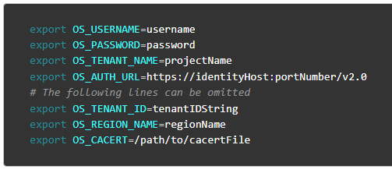
OpenStack Client - CLI
OpenRC
  Environment variables
Command List:
  https://docs.openstack.org/python-openstackclient/latest/cli/command-list.html

Slide 20
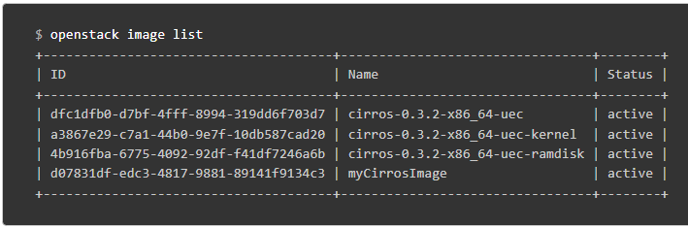
OpenStack Client - CLI
List images

Slide 21
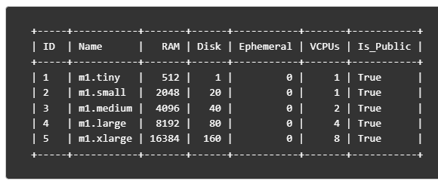
OpenStack Client - CLI
List flavors
  Openstack flavor list

Slide 22
OpenStack Client - CLI
List flavors
  Openstack flavor list

Slide 23
OpenStack Client - CLI
Start a VM
  openstack server create –image IMAGE_ID –flavor FLAVOR_ID –network NETWORK_ID –key-name KEY_NAME myserver

