Slide 1
Improving the HMM Phone Models
Tóth László
Számítógépes Algoritmusok és Mesterséges Intelligencia Tanszék

Slide 2
The problem of silences between words
In the previous lecture we saw how we can use HMMs in speech recognition. Today we discuss two further refinements to the models. One of them is the modelling of silences between words.
In continuous speech we normally do not make pauses between words, but sometimes we do (typically between phrasal units)
Eg. „I said he will be late” – „I said [sil] he will be late”
This is an issue of speaking style, both versions are correct
So the recognizers should be able to handle both cases
The mapping between the words and phones is given in the pronunciation dictionary
We could to add each word in two versions, with and without silence (sil denotes silence):
ezer E z E r
ezer E z E r sil
But HTK has a more tricky solution called the “short pause”

Slide 3
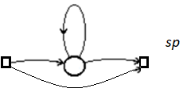
The short pause model
HTK uses a standard 3-state model to handle silence at the beginning and end of sentences (exactly the same model as for all the phones)
Any sequence generated by this model should consist of at least 3 observation vectors
To model the optional pause between words, HTK introduces a special model called the short pause
Instead of the usual 3 states, it has only 1 emitting state
And it has a transition that allows the skipping of this state
So the system can go though this model by generating 0,1,2,3… observations
This way, we can add this shot pause model to the end of each word in the pronunctiation dictionary:
ezer E z E r sp

Slide 4
Context-independent phone models
So far we assumed that we assign one (3-state left-to-right) model to each phone, so the number of models equals the number of phones (in a tzpical language, it is around 50)
These models are known as context-independent (CI) models, or they are also known as monophone models
We also talked about coarticulation, the phenomenon that the beginning of a phone gets similar to the previous phone, and the end of a phone becomes similar to the subsequent phone
That is, the beginning and end of each phone is slightly modified, and this modification depends on the neighboring phones (the context)
When using monophone models, all variants of these modifications should be handled by one model
The basic idea of context-dependent (CD) or triphone modeling is to build several models for one phone, assigning a model variant to any possible context

Slide 5
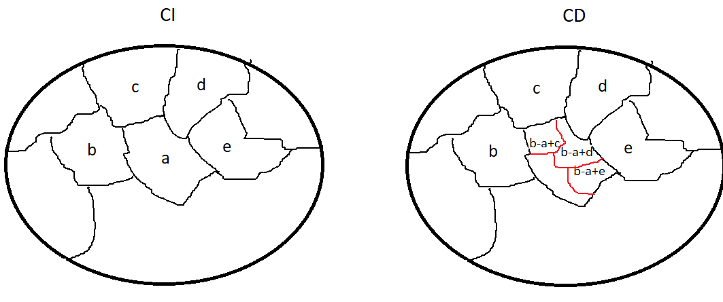
Context-dependent phone models
So far we had only one model for the phone [a]
When using CD models, we will have one model for each possible context
We will denote the previous phone by – and the subsequent phone by + We will have separate models for b-a+b, b-a+c, b-a+d, c-a+b, b-a+c, … and so on
Warning! The notation is slightly misleading: it does not mean that we model 3 phones in one; these are still the models of [a], but in different contexts
Eg. the phonetic transcript of “ezer” will be like this: … sil-E+z E-z+E z-E+r E-r+sil ...

Slide 6
Context-dependent phone models
Let’s assume that we have 50 phones
Then the number of monophone models is 50
However, the number of trifón modells is approximately 50³=125 000
What about the number of trainable parameters?
Let’s assume that we have 39 features and we use 3-state models
We use 5 Gauss-components in each stat, with a diagonal covariance matrix
Then 1 Gauss will have 39+39+1 parameters (mean, variance, weight)
1 state will have 5*(39+39+1) parameters
1 model will have 3*5*(39+39+1) parameters
Multiplying by the number of models, we get 50*3*5*(39+39+1) = 59 250 emission parameters
Compared to this, the number of state transition parameters is negligible
With CD models, we will have 125000*3*5*(39+39+1)=148 million parameters!

Slide 7
CI versus CD models
Let’s assume that we have a fixed amount of training data
If we use CI models:
Few models → lot of training examples per model
We will have enough examples for each phone even in a small training dataset
However, one model has to cover all context variants of a phone → difficult machine learning task
If we use CD models:
Each models has to describe only one context → easier machine learning task
But we have lot of models → very few examples for most of the models
For rare phone connections, it may happen that we find no training examples even in hundred hours of training data!
We won’t be able to train these models
We need some transition between monophone and triphone models
And the solution is the parameter tying of HMM models

Slide 8
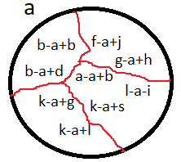
Parameter tying
Basic idea: we perform clustering over the triphones of each phone
And we fuse (“tie”) the models within each cluster
Fusing everything → monophone model
Fusing nothing → triphone
Anything between → tied triphone model
More generally:
Not only full models can be tied, but it can be generalized to the tying of certain types of parameters
For example, we can tie the parameters of the Gaussian of two states
Or you can tie only the variances, but not the means
Or you can tie the state transition probabilites of two models…
The most widespread in practice it to tie states (state tying)
We peform the clustering separately to the 1th, 2nd , and 3rd states of the triphones of each phone
The goal is to tie the Gaussian distributions, because they have lots of parameters

Slide 9
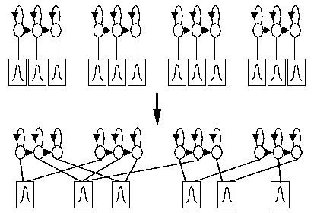
State tying
Initially, we have separate emission probabilities for each state of each triphone
Tying allows us to assign one distri- bution to more than one state at the same time
Technically: we store the parameters of the distributions in arrays, and each state has a pointer to the array of its parameters
After tying, the pointers of several states will point to the same array
After tying to states, we can also fuse their training samples!
Eg. if we have to estimate the parameters of two distributions from 100-100 examples, then after tying we estimate the parameters of 1 distribution from 200 examples
The number of parameters decreases, the number of examples per state increases

Slide 10
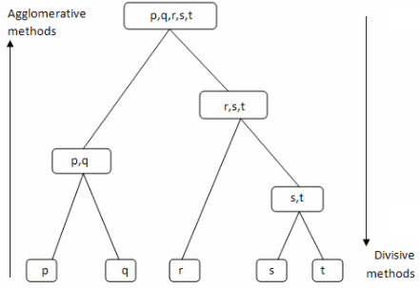
State tying by hierarchic clustering
So we perform the tying for each phone separately
And also separately for the 1-2-3 states
But even this way, there are too many possible divisions into subsets, so we will not be able to evaluate all of them
Because of this, we will perform hierarchic clustering
This can be agglomerative or divisive
We use divisive clustering: initially all the states are in one set
In each step we divide one of the subsets into two subsets
Advantages:
Easier decision in each step (which subset to divide and how)
After each step we can decide to stop or to go on with the divisions

Slide 11
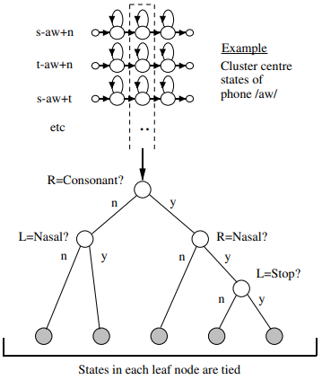
Decision tree-based state tying
How can we decide which state set should be divided further?
It can be based on phonetic knowledge (eg. p-t-k are produced similarly, so they can be kept together)
Or based on some mathematical metric (eg. The similarity of the distributions)
HTK combines the two approaches in its decision tree-based state tying method
The decision tree divides the actual states of a triphone step-by-step into smaller subsets
In each node the actual set is split into two (example: middle states of /aw/ triphones)
Phonetic questions about the left-right (L,R) neighbors (eg. Consonant? Nasal? Stop?)
The states that remain in one cluster at the leaves of the tree will be tied
We will have to specify the phonetic questions. However, the decision tree is built automatically

Slide 12
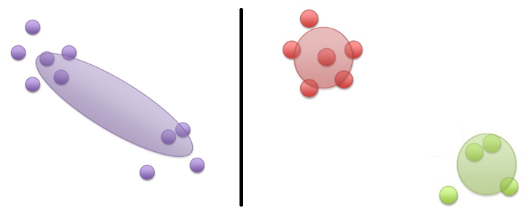
Decision tree-based state tying 2
We will have to provide a set of possible phonetic questions
Based on these, the decision tree is built by HTK
In each node it evaluates all the possible questions from the question set, and it will split the set using the most suitable question
We can specify a lot of questions, and even bad questions, it will only slow the the tree building, but does not results in poorer clustering
Evaluating the usefulness of a splitting based on the likelihood gain
We compare the fitness of all the data by one Gaussian (left), versus splitting the data in two, and describing the two sets by 1-1 Gaussians (right)
The question that gives the largest increase in model fitness (likelihood) will be selected
It can be calculated fast (fitting Gaussians on data is fast)
After we finished with the clustering, it will be possible to increase the number of Gaussian components to get the final GMM models
Stopping criteria: too few examples, or too small likelihood gain

Slide 13
Decision tree-based state tying 3
The great advantage of the state tying approach is that we can adjust the number of tied states (called senons), and so the number of the trainable parameters in the models to the actual size of the training database
1 hour of training data: monophone models (150 states)
3 hours of training data: ≈ 500-1000 senon
30 hours of training data : ≈ 1000-3000 senon
300 hours of training data : ≈ 5000-10000 senon
How to select the number of Gaussian components per state?
3 hours of training data: ≈ 4-8 gauss / senon
30 hours of training data: ≈ 8-16 gauss / senon
300 hours of training data: ≈ 32-64 gauss / senon
An interesting design issue is that when the amount of training data increases, which is better: increasing the number of senons, or the number of Gaussians?

Slide 14
Decision tree-based state tying 4
We may have triphones that did not occur in the training set at all, but they are required during testing. A further advantage of the decision tree-based tying method is that the decision tree can be used to find the closest existing model to these never seen triphones (we will used these to recognize these unseen triphones)
Its largest drawback is that it requires some sort of phonetic knowledge to create the question set
More recent speech recognizers (eg. Kaldi) have now solutions to perform the state clustering in a fully automatic manner
Using tied states is a standard method in HMM-based recognition systems, and compared to monophone modeling, it can result in 10-30% decrease in the word recognition error rate

