Slide 1
P-CFG and treebank-based methods in natural language processing
Tóth László
Számítógépes Algoritmusok és Mesterséges Intelligencia Tanszék

Slide 2
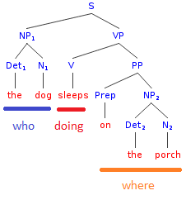
The main weaknesses of N-grams
The main critics against n-gram
It processes only a couple of previous words, and it processes all of them, although sometimes more distant words would be more important
eg.: things draw your attention away: „away” is more related to „draw” than to the two words between them
N-grams are not able to model the hierarchic structure of a sentence, just like a derivation tree in the case of grammars
Some blocks are more closely related than others eg. Noun phrase, verb phrase, object, …
But the words with closer relation do not necessarily lie side-by-side

Slide 3
P-CFG
This approach seeks to combine the advantages of formal grammars and statistical models
Let’s take a standard context-free grammar (CFG) and extend the rules with probabilities
This how we obtain the P-CFG (probabilistic CFG) language model
Similar to n-grams, a P-CFG is also able to return a probability for any word sequence w₁,…,w_{n}
How can we turn a CFG into a P-CFG?
For each rule, we map probabilities to each variant of the right side, eg.:
For a given left side, the sum of the probabilities on the right side should be1 (this guarantees that we obtain correct probability distributions)

Slide 4
Probability of a word sequence / derivation
For a given P-CFG, how can we calculate the probability of a word sequence or a derivation?
In a grammar, we obtain a word sequence from the start symbol S trough derivation (applying a sequence of rules)
eg: the derivation of yellow banana: S→AN, A→yellow, N→banana
The derivation steps can also be shown on a derivation tree:
The probability of a derivation is defined as the product of the probabilities of the applied rules
However, a word sequence my have several derivations. So we define the probability of a word sequence as the sum of the probabilities of its possible derivations

Slide 5
Questions we would like to answer
1. Given a word sequence w_{1,m} And a grammar G, what is the probability that w_{1,m} was generated by G?
This is required if we want to apply G as a language model
2. For a given word sequence w_{1,m} and grammar G, which is the most probable derivation tree t?
This is what we need if we want to analyse (“parse”) a sentence using G
3. Given a training corpus w_{1,m} how can we tune the parameters (probabilities) of G so that would assign a large probability to w_{1,m}?
This is required during the training of the model
You can observe a close analogy to HMMs!
For the HMM, the hidden variable was the state sequence, here it is the derivation tree

Slide 6
Calculating the probability of a word sequence
We will assume that the grammar is in Chomsky normal form, so all of the rules have one of the form shown below. N denotes the non-terminals, x denotes the terminals (words). The start symbol will be denoted by N^{1.}. The number of non-terminals is n.
We should calculate the sum of the probabilities of all possible derivations
However, the number of possible derivations grows exponentially with m
There is a fast calculation method which applies dynamic programming to get the result in time.
It is similar to the forward-backward algorithm of HMMs
But it calculates “inside-outside” probabilities

Slide 7
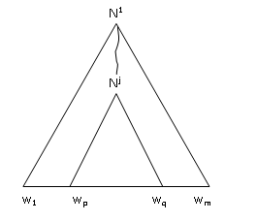
The inside-outside algorithm
Let’s consider the derivation tree of w_{1,m} , and a part of it, the derivation of a sub-sequence w_{p,q} from a non-terminal N^{j} :
We define the β inner probability as the probability that w_{pq} is derived from N^{j}
And the final result that we need is:

Slide 8
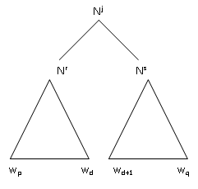
The inside-outside algorithm 2
can be calculated recursively as follows:
When p=q, that is, the sequence consists of one word:
Then there is only one way to obtain w_{pp} from N^{j} : by applying the rule. So the probability is
When p<q, so the sequence contains more than one word:
Then the first applied rule must have the shape
So the derivation subtree looks like:
Here all possible d position and all rules that have the shape are possible, so

Slide 9
Questions #2 and #3
To find the most likely derivation tree, we have to modify the previous algorithm so that it calculated the maximum instead of the sum
During the search, we should book the components that gave the largest probabi-lity, this would allow the trace back the most likely steps after the calculation
Training the model:
We assume that the rules are fixed, so we want to learn only the probabilities
The EM we used to train the HMMs can be adjusted also to P-CFGs
Practical experience with P-CFGs:
Training is relatively slow, one iteration is
Unfortunately, it gets stuck in local optima very easily
Compared to grammars created by linguists, one should use a much larger amount of non-terminals to achieve acceptable results
The rules obtained after training are not at all similar to the rules created by linguists (so the rules are not really interpretable)
Unfortunately, they behave worse than n-grams when used as language models

Slide 10
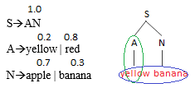
The weaknesses of P-CFG
The P-CFG is good at modelling connections between levels, but not within levels (as it is context-independent)
So a P-CFG can learn that yellow is more frequent that red, or that apple is more frequent than banana, but it is unable to learn that a yellow banana is more probable than a red banana
The n-gram is better at modelling the convext, but it is unbale to model the hierarchy
The rules learned by the P-CFG are not similar to linguistic rules
This is because during training the model was not forced to approximate “real” derivations -- actually, it did not see training examples of derivations
The treebank-based modelling approach seeks to solve the problems mentioned above

Slide 11
Treebank-based modelling
The treebank-based approaches are trained on datasets that contain real derivation trees
Of course, we will need such datasets, such as the Penn Treebank for English
There is also a similar Hungarian treebank called the Szeged Treebank
We will learn the subtrees of the derivation trees in the database
Actually, the training consists of collecting and counting all the subtrees
These collected set of subtrees will be called the treebank
To evaluate/parse a sentence, we will try to construct all the possible derivation trees of the word sequence based on the treebank
When the goal is parsing, we seek for the most probable derivation tree
When the goal is language modeling, we estimate the probability of the sentence by finding and calculating the probabilities of all its possible derivations
As we directly use the training examples for the parsing, and there is no model building or abstraction step, this approach is also known as „data-oriented parsing”

Slide 12
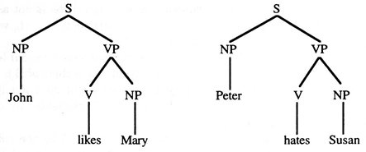
Building a treebank: example
Lets’s assume that the initial database contains only these two trees:
The treebanks can be obtained from the trees by collecting all possible subtrees
And we will also count the number of occurrences for the subtrees, because we will estimate the probabilities based on these counts!
The treebank constructed from the above two trees is shown in the next page

Slide 13
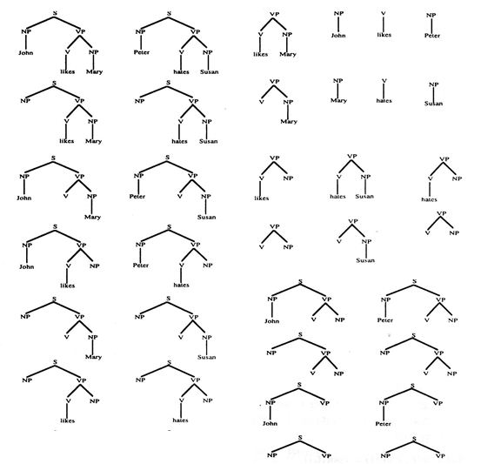
Treebank-építés: példa

Slide 14
The tree substitution grammar
How can we derive a word sequence using the treebank?
For this, we introduce the tree substitution grammar
G=<N,T,S,R,P>, where
N: a finite set of non-terminals
T: a finite set of terminals
S: start symbol
R: the treebank
P: substitution probabilities for all the trees in the treebank
The operation of G: starting from the start symbol S, we substitute the R leftmost non-terminal by a subtree from the treebank which has root R until all the leaves contain only terminals
Estimating the probability of an R→subtree substitution:
For example, let’s assume that we have only two trees with root R: T1 and T2
T1 occurred in the training data 3 times, T2 occurred 7 times
Then the probability of R→T1 substitution will be 0.3, for R→T2 it is 0.7

Slide 15
The tree substitution grammar 2
The probability of a derivation: the product of the probabilities of the substitutions applied
Probability of a word sequence: the sum of the probabilities of its possible derivations
How can we calculate
We should calculate the probability of all the possible derivations, but the number of these grows exponentially with m, so the task is NP-hard
The dynamic programming solution used in the case of P-CFGs cannot be applied here
The exist approximate solutions that can calculate the probability only approximately, with some small error, but they are in polynomial time

Slide 16
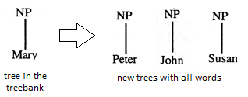
The problem of OOV words
The test dataset may contain word that were not present in the train set, so they do not occur on the leaves of the trees in the treebank
We will not be able to analyze the sentences that contain these words
Let’s assume we have a dictionary for which the system should be prepared
We assume that we have all the trees that contain only non-terminals, so the problem is only with the trees that contain at least one terminal
Base on the trees that contain at lest one terminal leaf, we create new trees
We replace the terminal leaves with all the words of the dictionary, in all possible combinations, e.g.:
But we also need probabilities for these new, artificially created trees!
For this we can news discounting methods, similar to the ones we introduced for n-grams

Slide 17
Practical usability of treebanks
The treebank-based approach was popular around 2000
(not in speech recognition, but for example, in machine translation)
In practice they were found to work much better than P-CFGs
They produced better results even when the treebank was restricted to contain only trees with heights of 1-2

