Slide 1
Morphologic analysis
Tóth László
Számítógépes Algoritmusok és Mesterséges Intelligencia Tanszék

Slide 2
Words and word forms
In a natural language the number of word stem is around 100 000
Eg, in a large Hungarian dictionary there are around 70 000 words
But in any text database we will find many more word forms
Mainly because one word may have several inflected forms (and party because we may forms compound words)
In English one word may take only a couple of forms
Have → have, has, had; hat→hats
English speech recognizers simply solve this by listing all possible word forms (that is, they define “word” as anything that may occur between two spaces)
The main European language families (german, neolatin, slavic) use significantly more word forms
But in Hungarian the situation is even worse (one noun may have about 700 inflected forms)
Similar languages are Finnish or Turkish
For these languages, listing all word forms is practically unfeasible
Can we create a language model that decomposes words into stems and suffixes?

Slide 3
The morphology of Hungarian
Morphology is the field of linguistics that studies word forms
Hungarian is so rich morphologically, because it allows to use 3 types of suffixes after each other
Pl: jó+ság+om+ért (for my good+ness)
Our goal here is to separate the stem and the 3 types of suffixes
The main problem with this is that their combination is technically not a simple concatenation
Some example for the plural sign “+k”
nő → nők (in this case, this is simple concatenation)
alma → almák (here the last vowel of the stem is modified)
ház → házak (here we insert a vowel between the stem and the suffix to ease pronunciation)
kéz → kezek (here we use a different inserted vowel, and the stem is also changed…)

Slide 4
Koskenniemi’s two-level morphology
The problems shown can be handled by Koskenniemi’s two-level morphological model (originally invented for Finnish)
Building blocks:
A set of stems and suffixes (morphemes) („ the lexicon”)
Set of rules
Lexical (upper) level: a sequence from the elements of the lexicon
Surface (lower) level: the word form created
Rules set: it defines the mapping between the 2 levels
E.g.: When the stem ends in a vowel, then no “filling” vowel is necessary
Advantages:
Easy to implement
Works in both direction, so it van be used both for analysis (decomposing a word form) and generation (generate all possible forms of a given stem)
Disdvantage: it cannot be trained, must be filled up with words manually
Implementation: using finite-state transducers (FST)

Slide 5
Word form analysis by statistical methods
The Koskenniemi model would be hard to use in a speech recognizer
For example, if we put the suffix +k in the word set, how would we handle the variants +k, +ak, +ek ? By the pronunciation dictionary?
In the output, how would we reconstruct the word form from its parts, e.g. ház +k → házak?
So, to make it simple, we return to the simple concatenation approach
We don’t bother with the conversion rules between the two levels, we simply include all possible variants in the dictionary (see the right side below:)
nő → nő, +k
alma → alma, almá+, +k
ház → ház, +ak
kéz → kez+, +ek
The “word pieces” obtained this way are not always correct morphemes in a linguistic sense (they are sometimes called “morphs”), but in a language model of a speech recognizer it makes no problem
Of course, the number of components increases (eg. instead of +k we will have +k, +ek, +ek, …), but it is not a large increase compared to the number of stems
In the output we only need concatenation (+ denotes the parts that must be fused)

Slide 6
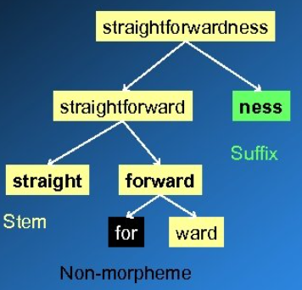
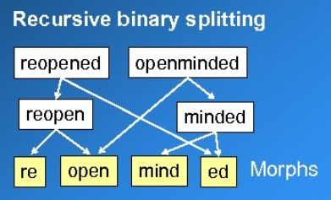
Morfessor
Morfessor is a software that can decompose words on a statistical basis
A Finnish tool, one of the oldest solutions for word decomposition
There exist other, newer tools like MORSE
It recursively splits the words in the training set into smaller parts (see image on left)
Of course, all words should be decomposed at the same time (see image on the right)
What makes a good decomposition (how can we formalize the goal)?
The obtained word pieces should cover the training dataset as much as possible
The number of word pieces should be as small as possible
We want to avoid oversplitting: the units should be as long as possible (the number of splitting steps should be as small as possible)

Slide 7
The weaknesses of Morfessor
1st problem: it is inclines to oversplit rarely seen words
We could solve this by specifying a list of known words that should not be split
The MORSE tool allows of forbids splitting based on semantical similarity (eg. It allows the decomposition locally→ local+ly, because local and locally have similar meaning, but the decomposition freshman → fresh+man is forbidden, because the meaning of freshman is not related to the meaning of neither fresh nor man)
2nd problem: it does not exploit the fact that certain components can only be stems, while other components can only be suffixes (for example, a word cannot begin with a suffix)
It has an extended version which has the categories prefix+stem+suffix
E.g. in Hungarian: el+megy+ek
Remark: how does it handle compound words like freshman?
3rd problem: When applied to Hungarian, it does no recognize letters that consist of 2 characters (like sz), it frequently cuts them into two

Slide 8
Morfessor in speech recognition
Creating a language model using Morfessor
We decompose the word forms into smaller units („morfokra”) using Morfessor
We can train an n-gram model over these units
In the speech recognizer output, we must concatenate a stems+suffixes, but we can identify these by denoting the suffixes by a special starting character like +
Advantages:
Much smaller dictionary→smaller search space, faster decoding, smaller memory requirement
Much fewer OOV words, smaller perlexity
Disadvantages:
We must train higher order n-grams (to see the stem of the previous word)
The output might contain incorrect word forms
Theoretically, the training dataset contains no such incorrect stem+suffix forms
But language model smoothing will assign small non-zero probabilities to these

Slide 9
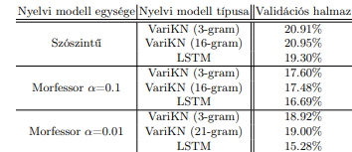
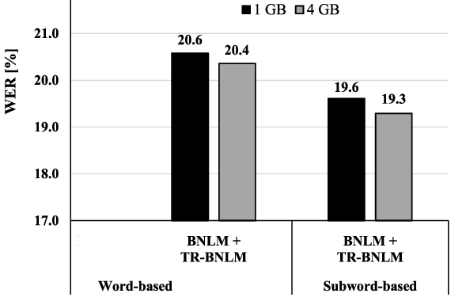
Results for Hungarian
Recognition of Broadcast news (Tamás Grósz, 2020):
OOV rates and recognition error rates for word decomposition with different “strengths” (VariKN: Kneser-Ney n-gram smoothing):
Telephone conversations (Mihajlik et al., 2019)
Word-level OOV: around 3%
Word-level model: 100 000 words; morf-model: 30 000 morfs
Language model: back-off n-gram trained on a dataset augmented using transformer neural networks
They tried two types of language models with different memory footprints (modifying the strength of smoothing)

Slide 10
„Word piece” models
End-to-end modeling would be much easier if we had fewer components (acoustic model, pronunciation dictionary, language model)
For example, can we simply drop the pronunciation dictionary?
The acoustic model could try predicting letters directly, instead of phones
However, in English the connection between letters and phones is not as simple is in most other languages (the pronunciation is strongly influenced by the context)
We must use longer word pieces, learning their pronunciation makes more sense
In „word piece” models, the length of the units we try to recognize varies between one letter and whole words
Typically used in end-to-end recognizers with no pronunciation dictionary
Trained on a LARGE database, it might work even without a language model
The word pieces are formed by algorithms that operate similarly to Morfessor
Example: a Google paper (using a train set of 12 000 hours):
State-of-the-art speech recognition with sequence-to-sequence models, 2018
Error rate: 5.8% without a language model, 5.6% with a language model

