Slide 1

The source-filter model of human speech production
Tóth László
Számítógépes Algoritmusok és Mesterséges Intelligencia Tanszék

Slide 2
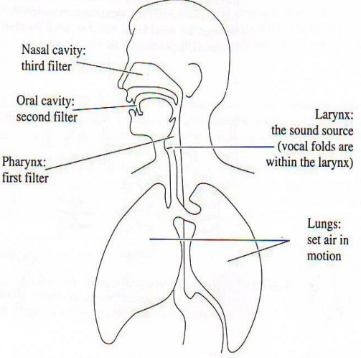
Human speech production
Human speech production consists of two main steps:
I. First step: sound generation
II. Second step: forming the sound
The first step can be modelled by a sound source, the second step is modelled by filtering, these together lead to the source-filter model of human speech production
The mains source of sounds is the air made to move by our lungs
Voiceless sounds: the air passes through the larynx freely
Voiced sounds: the air makes the vocal folds (in the larynx) resonate

Slide 3
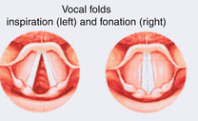
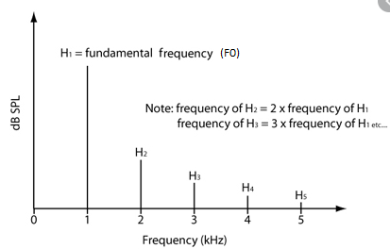
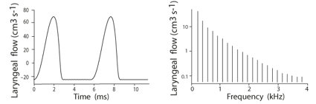
I/1. sound source: vibrating vocal cords
In the case of voiced phones, the vocal folds periodically open and close the way of the air
This results in a (quasi)periodic vibrating tone
This signal is hard to, but it looks something like below (its spectrum is in the middle, zoomed out on the right):
The signal consists of periodically repeating, spike-like impulses
Its spectruma consists of lines, that is, a base frequency and its harmonics which lie at the multiples of the base frequency
The base frequency determines the pitch we hear, and is is frequently denoted by F0
Typical voiced phones are the vowels, we can produce them continuously and with realively high energy

Slide 4
I/2. sound source: articulators
The area ranging from the larynx to the mouth is called the vocal tract. Its main part are the pharinx, oral cavity and nasal cavity.
Besides our vocal chords, we can also produce sound by our articulators along the vocal tract (most importantly by our tongue and lips)
If we narrow the way of air: we can produce noise-like sounds eg. sh, s
These can be produced continuously, but they are not as loud as vowels
If we block the way of air for a moment: plosives, eg. p, t, g, k
These are not continuous
We produce consonants by these two methods, the place and manner of the blockade determines the types of phone we hear
Nasal sounds (m, n): the air passes through our nose (as well)
The two types pf sound sources can be active at the same type, that is why most of the consonants have a voiced and unvoiced counterpart (eg. s, sh)

Slide 5
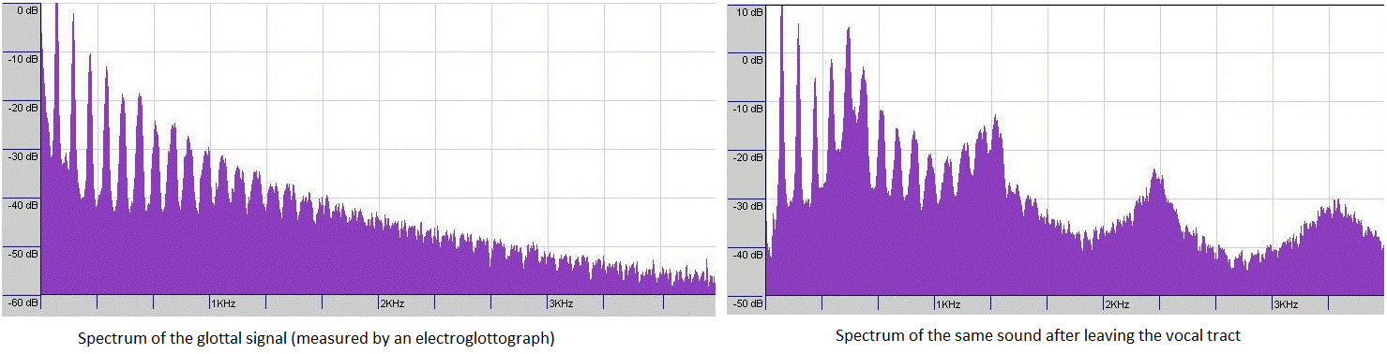
II. Forming the sound
The sound coming from the larynx (either voiced or voiceless) passes through the vocal tract
By changing the shape of the vocal tract (most importantly the oral cavity) we can modify the spectral content of the signal – we can amplify or decrease certain spectral components
spectrum of the signal passing the larynx – the same signal passing the mouth

Slide 6
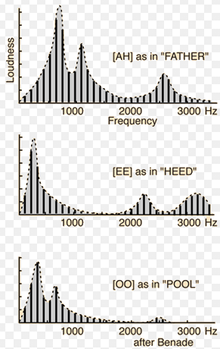
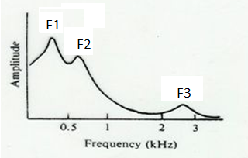
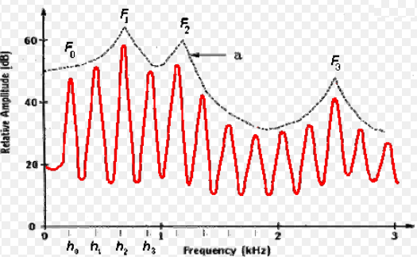
Formants
The effect of the vocal tract can be modelled by a filter
The input of the filter is the sound coming from the larynx
The transfer characteristics of the filter is relatively smooth, with a couple of peaks
The position of these peaks determines what kind of phone we hear (especially in the case of vowels)
The peaks are called the formants
The first 3-4 formants determine the phonetic quality of the phone, the higher ones are speaker-specific
Unfortunately, the formants are hard to measure exactly, the are usually defined as the peaks of the spectral envelope rather than the peaks of the spectrum, but even this definition is not precise enough

Slide 7
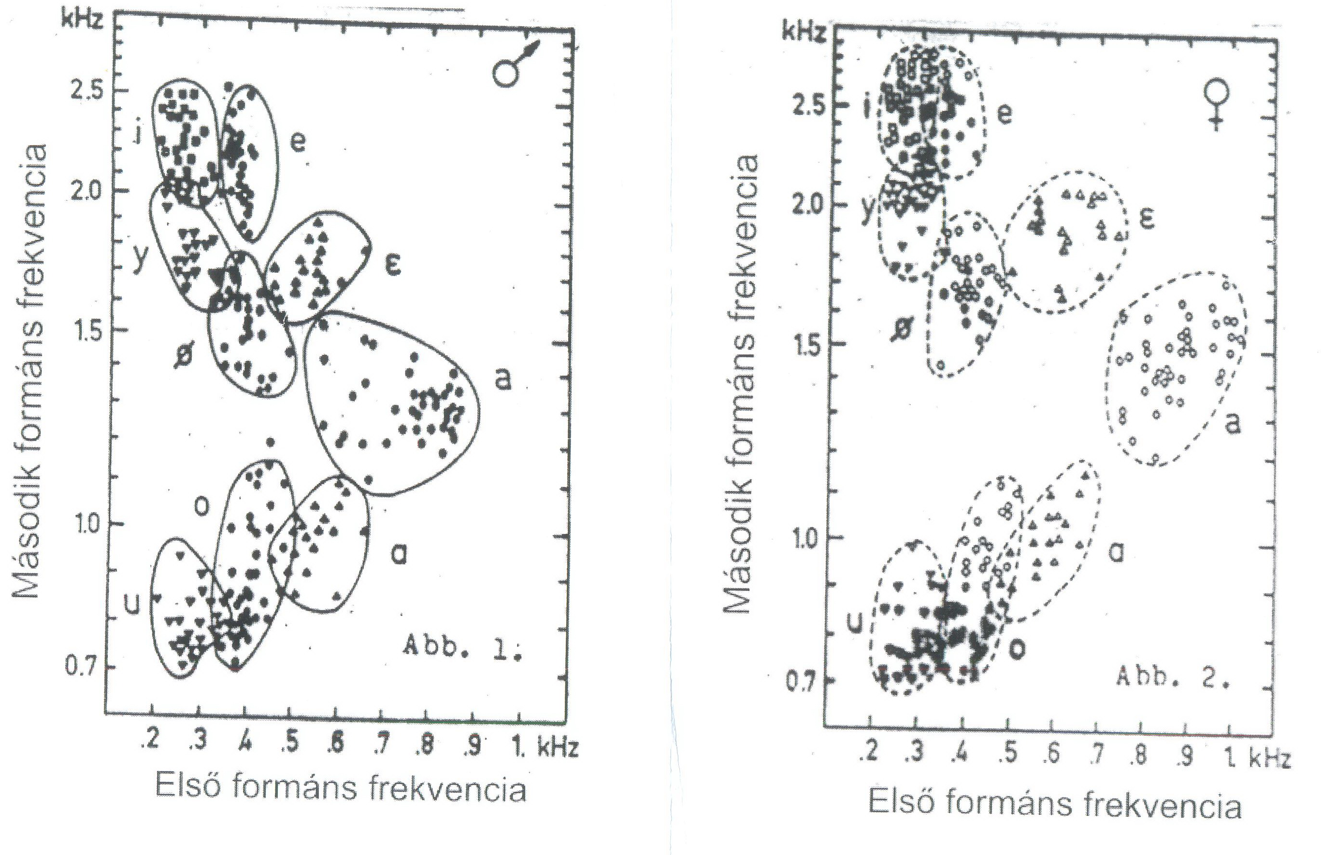
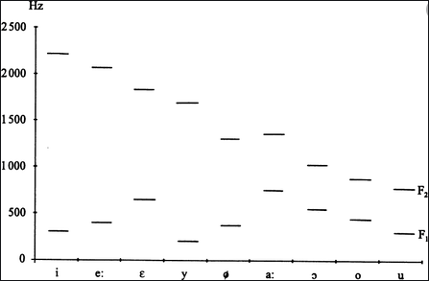
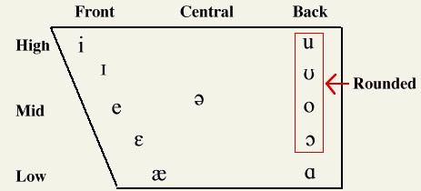
Formants for vowels
The F1-F2 formants of the Hungarian vowels (for male/female samples)
The latter type of visualization, the „vowel triangle”, for US English:

Slide 8
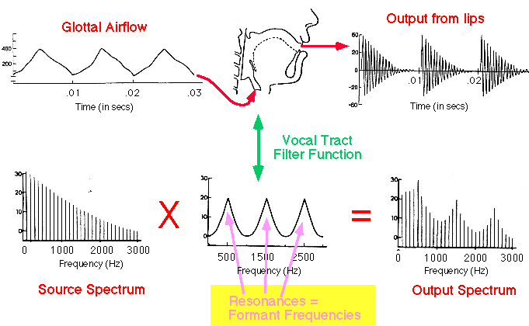
Formant synthesis
Based on the source-filter model, we can try to build a speech synthesizer, This is the so-called formant synthesizer. Eg. simulating voiced sounds (up is the time-domain signal, down is the same in spectral domain ):

Slide 9
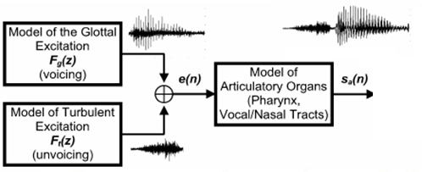
Formant synthesis 2.
If we want unvoiced sounds as well, then we need two sound sources:
To produce one steady-state sound, we need the following parameters: voiced/unvoiced decision (or ratio), F0 (for voiced sounds), formant frequencies (maybe also bandwidths), loudness
Of course, if we want to produce coninuous speech, ten we have to continuously change the parameters (eg. 100 times per second )
Remarks: decomposing the signal into an excitation and a spectral envelope is a very popular solution in speech coding (compression)

Slide 10

Formant synthesis 3.
Formant synthesis was very popular in the 70-80’s
The speech produced this way was intelligible but terribly „robotic”
Example: synthetic Hungarian vowel after implementing the simplest possible method (from an old Hungarian book on speech synthesis):
http://www.asel.udel.edu/speech/tutorials/synthesis/vowels.html
Formant synthetizers exist even today (eg. STRAIGHT), but these are mostly used for scientific purposes and not in speech synthesizers for public products
From the 90’s, speech synthtizers are built by using little pieces from human speech (these are concatenated and post-processed)
Most recently, this process is further improved by machine learning

Slide 11
Summary
The production of human speech consists of two main steps: producing an excitation signal (periodic for voiced sounds, noise-like for uncvoiced sounds), which is then passed through a filter defined by the configuration of the vocal track
As regards phonetic quality, the most important thing is the shape of the filter, which can be estimated by the spectral envelope of the speech signal – it is typically a relaitvely smooth curve with a couple of peaks known as the formants
The excitation signal, and the fine details of the spectral envelope carry information that is more related to the speaker (pitch, male or female, creaky voice, whispering,…)
This means that for speech recognition purposes we will need only a spectral image with a relatively low resolution that preserves the gross spectral envelope, but the fine details are not required

Slide 12
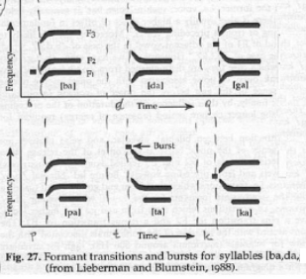
Extension
For continuant sounds (eg. vowels) the formants will tell us what phone we hear
But what happens when the given phone is not continuous, eg. for plosives?
These can be recignized from the position of the energy burst and by the formant transitions to the next phone
Further reading for those interested in the recognition of further phone types: „How to read spectrograms?” https://home.cc.umanitoba.ca/~robh/howto.html

Slide 13
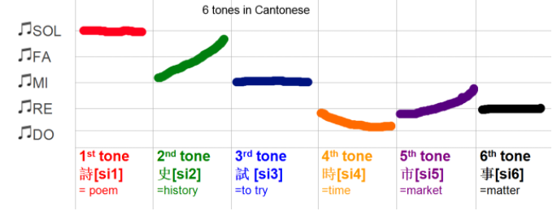
2nd Extension
We said that the pitch does not influence the phonetic identity of the sound we hear. This is true for most language, however, there are some exceptions – the so-called tonal languages, where the trajectory of the pitch within the syllable/word can influence the meaning!
The best well-known example is Chinese, there the same syllable can be pronounced with 4-6 (depending on dialect) different pitch contour, and they all have a different meaning https://www.youtube.com/watch?v=9XRXYaHOlpo

Slide 14
3rd Extension
Though for most languages the pitch does not differentiate words, but it still carries linguistic information
Prosody (intonation) is a so-called suprasegmental feature of speech, so it appears at a level that is higher than phones – at the level of phrases or sentences
The three main components of the prosody of a sentence:
Change of stress (amplitude)
Change of pitch (intonation)
Change of tempo (the duration relations of phones and pauses)
In speech recognition the prosody is not taken into consideration (ar at least, not directly), though it carries linguistic information
Eg: recognition of questions

