Slide 1
Application of Hidden Markov models for speech recognition
Tóth László
Számítógépes Algoritmusok és Mesterséges Intelligencia Tanszék

Slide 2
Introduction
The previous lecture introduced the general mathematical background of Hidden Markov Models
I also brought a lot of examples from speech recognition, so you may now guess how HMMs are applied to speech signals
Today we see how they are applied specifically to speech recognition
Obviously, the observation vectors will correspond to the spectral feature vectors
But how many states do we need, and what should they correspond to?
What should the topology (structure) of the model be?
What are the optimal models for words of phones?
When recognizing continuous speech, how can we construct words and sentences from the phones, and how can we perform the recognition?

Slide 3
Recognizing isolated words
Let’s first assume that we want to recognize only a small set of isolated words
Then we can use the same recognition scheme as that we used for DTW, simply replacing the templates by HMMs:
To each word we assign a λ model, and we train this model with the examples that belong to this words
In the recognition phase, we compare the incoming unknown sequence with each model, that is, we calculate the probability that the actual observation sequence was generated by the given model (see the 1st problem, calculating P(O|λ) )
We multiply this value by the prior probability P(λ) (see the Bayes rule we discussed earlier)
This way (apart from the P(O) constant multiplier) we obtain P(λ |O) for each λ
According to the Bayes decision rule, We should select the model with the maximal P(λ |O) as the result of the recognition

Slide 4
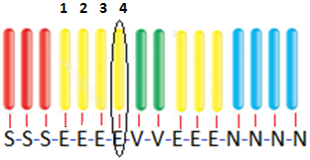
HMMs for isolated word recognition
What is the proposed model structure for words?
Examples from an old book, for short words consisting of 1-2 phones:
Topology: always goes from the left to the right
We either stay in the actual state for several steps, or move on to the right
We may allow the skipping of states to handle pronunciation variants with dropped phones
One state should model short segments with only minimal spectral changes
Simplest case: 1 state / phone
But we get better results using 2-3 states per phone
Explanation: If you exchange the order of vectors emitted in the same state, you obtain the same probability: … a_{se}b_{e}(1) a_{ee}b_{e}(2) a_{ee}b_{e}(3) a_{ee}b_{e}(4) a_{ev} …

Slide 5
Large vocabulary continuous speech recognition
What if we want to recognize whole sentences(sequences of words) built over a vocabulary of hundred thousands of words?
This is large vocabulary continuous speech recognition, LVCSR
For this, we have to change the models, the training and the recognition process
It is impossible to collect enough training samples for all possible words
We have to build our systems from smaller units, phone-level models
This increases the number of training samples per model
We will train these phone models in a special way, using embedded training
During recognition, we cannot calculate the probability of each possible sentence, and then choose the one with the largest probability
Instead of calculating P(o₁…o_{T}|λ), we just look for the q₁…q_{T} state sequence with the largest probability (see the 2nd problem of HMMs, Viterbi algorithm)
We can construct one huge model (graph) from the phone models, and the recognition task can be formulated as a search problem in this graph
Recognition is frequently called “decoding” in this context

Slide 6
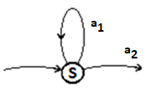
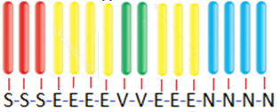
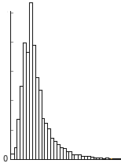
Phone models
Instead of words, we create models for shorter units, the phones
The simplest approach would be to have a one-state model for each phone
The model stays in the state for a couple of steps, then moves on (leaves the phone)
However, the „3-state left-to-right” model gives slightly better results:
Explanation #1: due to coarticulation, the beginning and end of the phone is modified by the neighboring phones, it is worth modelling the parts separately
Explanation #2: in the one-state model, the probability of generating a phone with duration t is a₂a₁^{t-1} this gives an exponential duration model (so the model will prefer shorter phones)
However, if you create a histogram of phone durations over some database, you will get figures like that shown on the left
In the 3-state model, each phone must consist of at least 3 vectors, so this slightly corrects the exponential model at the durations of 1-2

Slide 7
Embedded training
To train each phone model separately, we should collect training samples for each of them
We would have to cut our training recordings into pieces, or at least we would have to annotate the position of each phone, which would require enormous amount of manual work
Fortunately, we can do it the other way round, so instead of slicing up the sound recordings, we can also concatenate the phone models!
For each training recording (e.g. a whole sentence) we connect the corresponding phone models to get the correct model of the sentence
For example if I have a recording of the word “dog” , then I connect the phone models „d-o-g”, and train this connected model with the recording
This is called “embedded training”, because we train the phone models implicitly, embedded into a longer sequence of models
Of course, after training the models they can be taken apart again, and we can construct new words or sentences from them
This allows us to recognize words that were not present in the training database

Slide 8
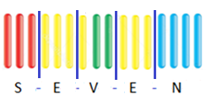
Initialization of embedded training
The training algorithm is iterative, so it requires initial parameter values
We have a sequence of observation vectors and the corresponding sequence of connected phone models, but we don’t know the actual position of the phones
Naive approach: let’s assume that each phone has the same length, and divide the recording into uniform chunks
Train the models using these chunks, this way we will get the initial values
For short recordings, especially at the beginning and end, uniform segmentation will be more or less correct; the longer the recording the larger the chance is that we get an incorrect alignment
„Flat start” initialization in HTK
It initializes all phone models with the same set of parameters
Estimating the emission distributions: it fits a Gaussian curve on ALL the training vectors
Estimating the probability of staying and moving: it uses the same values for all states
When we fit these uniform phone models to the actual training data, then we obtain a uniform division, very similar to uniform segmentation

Slide 9
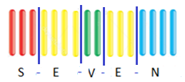
Initialization of embedded training 2
Starting from „flat start” initialization, why does the training converge?
Let’s assume that we are starting the training from uniform segmentation:
In the above example, the models of S, E, N get correct training examples, V receives some incorrect vectors, but the correct ones are still in majority
After training the models with this segmentation, we realign the models, for example by using the Viterbi algorithm
This steps is known as forced alignment, as the phone sequence is given and we want to force this to the actual observation sequence
As the model topology is „left-to-right”, and even skipping states is not allowed, the model can only play with shitfting the boundaries
In the above example, it will obtain the proper alignment
When the model topology is so restricted, and at least some models are relatively well initialized, the alignment will gradually improve during the realignment steps

Slide 10
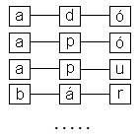
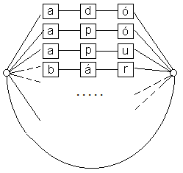
LVCSR
For isolated speech recognition, we evaluated the model of each word, and we selected the one with the largest probability
In the case of continuous speech, one word follows the other, so we have one huge model, a loop created from the words
Recognizing an observation sequence of duration T = examining all state sequences of duration T in the graph and find the one with the highest probability
This search is also known as decoding
For huge graphs this can be very slow
Without the help of the dictionary and the language model the search space increases exponentially with duration T
Dictionary (language model): during search only phone sequences that correspond to correct words (or word sequences) are taken into consideration
Statistical language model: when moving from one word to the another, the probability of the path is multiplied by the word transition probability

Slide 11
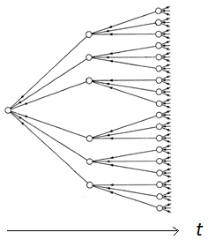
Decoding and search space reduction
The graph can also be displayed in an “unwrapped” form as a search tree (the dots correspond to word endings)
Without restrictions, the tree grows exponentially as we go ahead in time
Developing a decoder which is both fast and has a small memory requirement is technically the most complicated part of developing a speech recognition system
eg. the search tree can be dynamically extended on the front side, and dynamically decomposed on the back side during the search process
Even with these sophisticated implementations, examining all possible paths is not possible, so we have to apply search space reduction methods
The search methods and the search space reduction (pruning) methods are essentially the same as the well-known search methods (breadth-first search, depth-first search), with little modifications

Slide 12
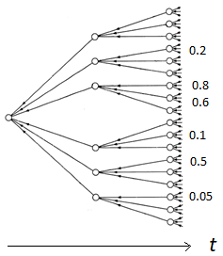
Breadth-first search
This is the more widespread solution
Here it is called „time-synchronous” search
We expand all paths in parallel, moving one step (one observation vector) ahead in time
It is basically an extension to the Viterbi algorithm, so that it can go through word boundaries
The original algorithm is extended by dynamic tree building and pruning components
Method to reduce the search space (pruning): beam search
Its parameter is the beam width (b)
Each path has a probability
Let’s denote the probability of the best path by p_{max}
We retain only those paths for which the probability p satisfies p > p_{max} –b
We might loose the best path, but it works well in practice
By tuning b, we can balance between fast and accurate operation

Slide 13
Depth-first search
We always expand the best path so far
Not really depth-first, rather „best-first” search
In speech recognition it is called „stack decoding”
The stack is an ordered list, where we store the examined path candidates
We always expand the uppermost (the most likely) one
Pruning: we limit the size of the stack
We remove the most likely path from the stack
We expand it, and put the expansions back in the stack
We re-order the stack, keeping only the k best paths
In beam pruning we prune by the probability, here by the number!
Multi-stack decoding
The probabilities of the paths with different durations are not really comparable, so this solution creates separate stacks for all possible durations
It can be improved further if we find a good heuristics to estimate the probability of the remaining path (A* search)

Slide 14
Multi-pass search
Sometimes we want to combine different search algorithms of different models
For example, we might have two quite different search algorithms
Or we might have a fast but inaccurate, and a slow but accurate model
The simplest solution to combine them is to apply multi-pass search:
First, we perform the recognition with one of the models (e.g. the fast but inaccurate model)
As the output, we return not only the best path, but the N best paths
We evaluate the second, slower but more accurate model only over the hypoteses retained by the first model (so we use the first model to reduce the hypothesis space)
The N-best paths can be stored in the form of an „N-best list”
We can also store them as a word lattice, which is harder to read for humans, but it is more dense and more efficient for further processing by computers (example on next slide)
We can also use the N-best representation when we want to post-process the output of the recognizer by some linguistic (e.g. syntactic/semantic) analyzer, which cannot be directly combined by the recognizer

Slide 15
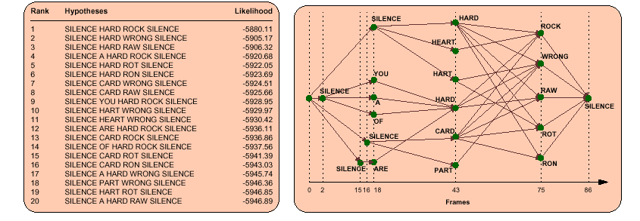
N-best list, N-best lattice

Slide 16
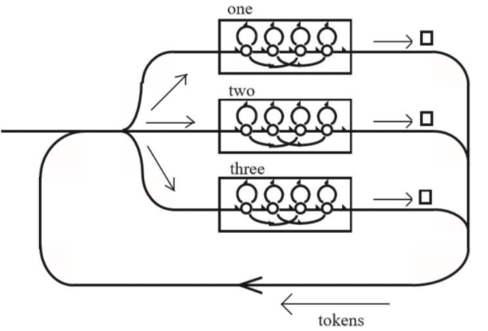
The token passing algorithm
HTK’s implementation of breadth-first search
Extends the Viterbi algorithm so that it can go through word boundaries
The tokens are little records that traverse the graph; they store the probability of the path traversed so far, the visited words and their star-end times
Rules of operation:
Each token move ahead one step in synchrony (breadth-first search)
The actual probability is multiplied by the emission probability of o_{t} and the state transition prob. (implemented as +logprob)
At forks copies of the token are created for each path (expanding paths)
When two tokens meat and they store the same word sequence, we keep only the one with maximum probability
At the end or words (□), we store the word in the token and apply the LM probability
Beam search: at each step, we can discard the low probability tokens
When we processed o₁…o_{T} , we throw all tokens that are not at word ending positions (□)
When all tokens start with the same word, we can display the word and free up memory

Slide 17
Weighted finite state transducers
An HMM is similar to an automaton, but there are important differences
The automaton is an „acceptor” model, it “swallows” the incoming symbols
The weighted finite state automata (or acceptors) (WFSA) are extensions of classic automata
It allows assigning weights (in our case, probabilities) to the state transitions
With this extension, they can represent Markov chains with them
But the HMMs also have emissions…
With a further extension to WFSAs, we obtain the weighted finite state transducers (WFST)
Besides the input symbol and the weight, there is also an output symbol assigned to each state transition (so the WFST can transform an input sequence into an output sequence)
It can be shown that any HMM can be represented by an equivalent WFST

Slide 18
WFSTs in speech recognition
In continuous speech recognition we have to combine several model components:
G: language model; it specifies how the words follow each other
L: lexicon or pronunciation dictionary; words may have several pronunciations with assigned probabilities
C: context-dependent phone models (we will have several models for the same phone, depending on the context [see next lecture])
H: the phone model HMMs
Each of the above components can be represented as a WFST
These should be embedded into each other to obtain the final large graph
We will have to perform the Viterbi search in this huge compound graph

Slide 19
WFSTs in speech recognition 2
With WFSTs our search graph is obtained as: min(det(H○C ○ L ○ G)
Where ○ denotes composition
After composition, the resulting graph should be made deterministic, this is performed by the det operation
Finally, the graph can be minimized (min), which may significantly reduce its size
There exist standard WFST libraries to perform these operations
If we use these, then we won’t have to implement all the graph construction steps for building the recognition graph
This is why (for example) the popular Kaldi speech recognizer implements its decoder via WFSTs
Recommended reading:
https://medium.com/@jonathan_hui/speech-recognition-weighted-finite-state-transducers-wfst-a4ece08a89b7

