Slide 1

Automatic screening of Alzheimer's disease using speech recognition
László Tóth
MTA-SZTE Research Group on Artificial Intelligence
University of Szeged and Hungarian Academy of Sciences
Hungary

Slide 2
Motivation and goals
Alzheimer’s disease (AD) may take years to develop
In its early stage it usually appears as a mild cognitive impairment (MCI)
It is very difficult to diagnose
Yet an early diagnosis would be important (to start the treatment as early as possible)
We seek to develop an automatic screening tool for MCI
  The goal is NOT a perfect diagnosis
  But a quick and cheap pre-filtering of the population

Slide 3

Speech is a reflection of several neuropsychological processes…
emotions
executive functions
memory
cognition
…the deterioration of these functions is also reflected in a patient’s speech

Slide 4
The 3 main questions of our research
Are there any speech-based biomarkers of MCI?
Can we extract these biomarkers automatically?
Based on the biomarkers, can we automate the healthy/MCI decision?
Fortunately, our answer is yes in all cases

Slide 5
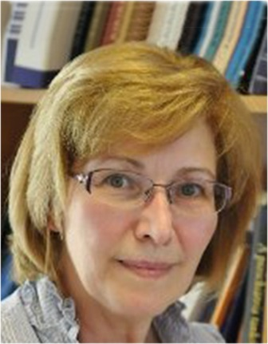
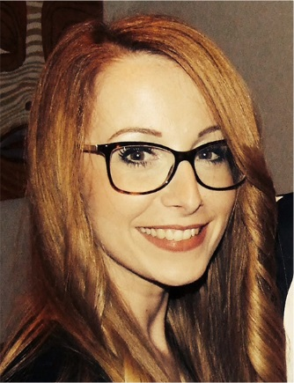
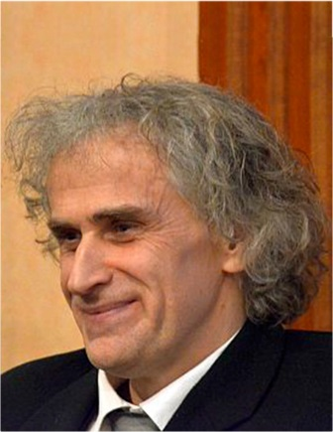

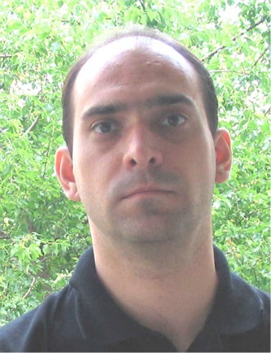
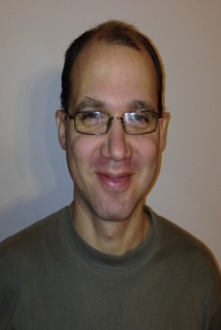
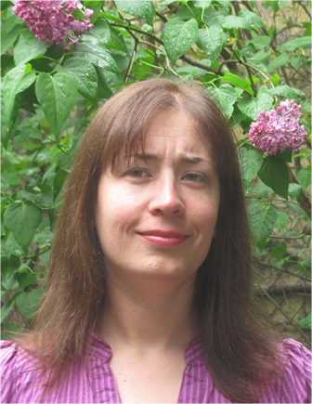
Our (interdisciplinary) team
Dept. of Psychiatry
Magdolna Pakaski M.D. Ph.D.
Greta Szatloczki Ph.D. student
Prof. Janos Kalman M.D. Ph.D.
Research Group on Artificial Intelligence
Ildiko Hoffmann Ph.D.
Laszlo Toth Ph.D.
Veronika Vincze Ph.D.
Dept. of Linguistics
Gabor Gosztolya Ph.D.

Slide 6
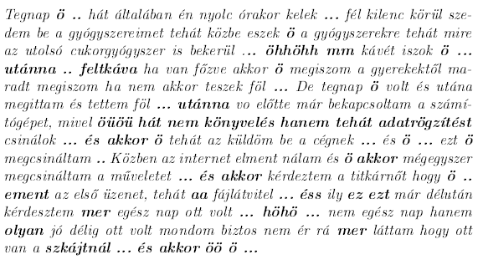
Dept of. Psychiatry: collection of speech samples in MCI
Acoustic changes: hesitations (silent or filled pauses), strechings, double starts
Linguistic changes: weasel hedge words
Emotional changes: a change in prosody

Slide 7
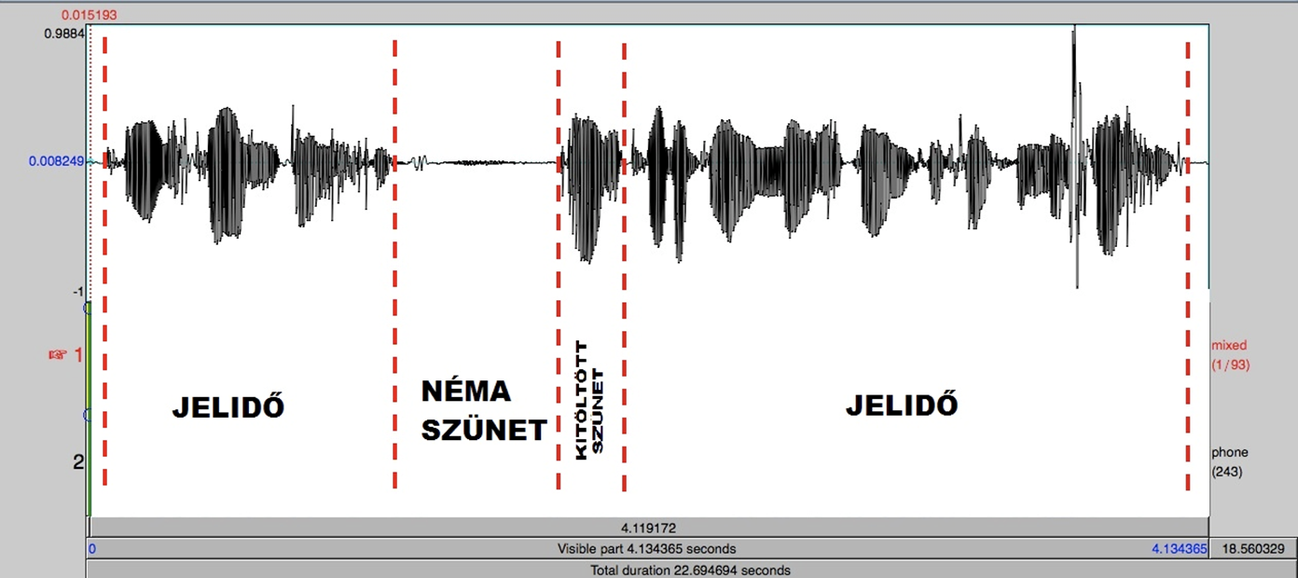
Dept of Linguistics: temporal analyis of the speech signals
Silent pause
Duration of utterance
Duration of utterance
Filled pause

Slide 8

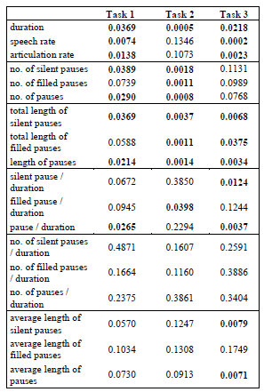
Acoustic markes that correlate with MCI
articulation rate
speech tempo
duration of filled pauses
duration of silent pauses
Speech Gap Test
hesitation rate
duration of utterance
number of silent pauses
number of filled pauses
ratio of pause and utterance
Hoffmann et al. 2016
Tóth et al. 2015

Slide 9
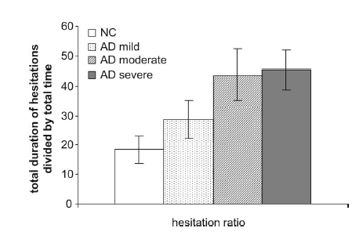
Most important marker: the hesitation ratio
Hoffmann et al. 2010
  Hesitation: pauses or ‘gaps’ in speech (either silent or filled).
„Speech-gap test” : Our new approach to MCI detection from speech

Slide 10
Research group on AI: automatic measurement of „gaps” in speech
Feature extraction using automatic speech recognition
  We use the latest deep learning technologies
  This is the so-called hybrid HMM/DNN method
  20-30% lower error rates than before (HMM only)
The recognizer is adjusted to the task
  Focus on finding the pauses, filled pauses and phone boundaries
The acoustic markers listed earlier can be calculated from the ASR output

Slide 11
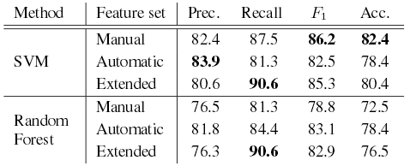
Automatic classification of patients
This is a machine learning task
Relatively few training samples (50 healthy, 50 MCI)
We used methods like SVM and Random Forest
Our classification results are around 80%
Far from perfect but…
  Remember, we want to use it only for screening!
  Suspicious subjects are forwarded to a doctor

Slide 12

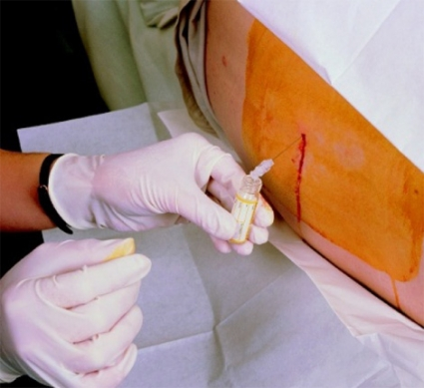
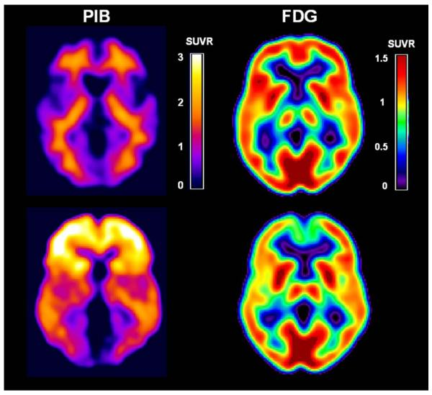
S-GAP: advantages
S-GAP
Invasive methods
Rapid
Real time
Cheap
Simple
Objective
Noninvasive
Minimal discomfort
Without side effects

Slide 13



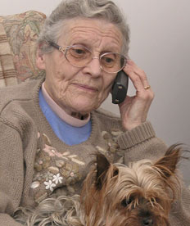
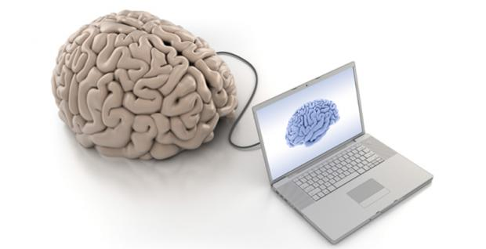
Currently we are working on …
Mobile application of the Speech Gap Analyzer Program
To capture the online performance

Slide 14
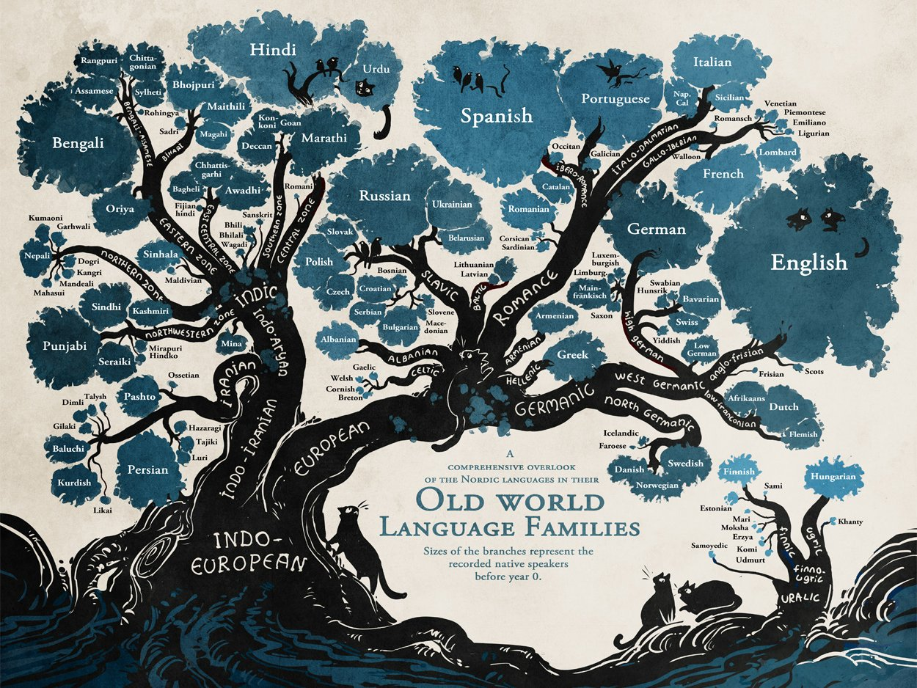

Ongoing S-GAP validation studies
Cross - linguistic approaches
We would like to collaborate with You …
We are seeking for collaborators, industrial partners, investors

Slide 15
Thank you!
Speech Gap Analyzer Programme

