Slide 1
Corpora and databases
Introduction to Computational Linguistics
10 September 2018

Slide 2
Outline
Basic concepts
Annotation
Corpus building
English corpora
Corpora developed at Szeged NLP group

Slide 3
Basic concepts
Corpus (pl. corpora): a database (collection of texts) created for specific purposes
Annotation: manual marking of relevant linguistic information on texts

Slide 4
Making use of corpora
Reference material: does a phenomenon exist?
Collecting language data: w/o introspection
Training machine learning algorithms
Testing machine learning algorithms

Slide 5
Supervised machine learning
Human
Manually annotated data
Corpora
Machine
Machine learning systems
Statistics, generalizations
Text
Automatically processed new data

Slide 6
Types of corpora
Monolingual
Multilingual – parallel corpus: same set of data in several languages
Speech corpus: recorded material
Written corpus: texts

Slide 7
Annotation
Text/document level
  An e-mail is spam/ham?
Sentence level
  Factual/uncertain information?
Token/phrase level
  Morphological analysis
  Named entities
Without annotation
  Word frequencies
  Co-occurrences (n-grams)

Slide 8
Types of annotation
manual
Semi-automatic: automatic annotation corrected manually
automatic
single: one text – one annotator
  cheap
  fast
multiple: one text – multiple annotators (independently of each other)
  time-consuming
  expensive
  inter-annotator agreement rate

Slide 9
Agreement rates
A metric to check the consistency of annotation (how similar two annotators can annotate)
  accuracy
  F-score (precision, recall)
  Kappa
Agreement rate is usually regarded as a theoretical limit for the performance of machines
May denote the difficulty of the task
Heavily depends on the task!

Slide 10
Forms of annotation
Text and annotation in the same file (mostly XML)
Text and annotation in separate files (standoff/standalone)
Advantages/disadvantages:
  Restoring the original text
  Adding new texts
  Deleting texts

Slide 11
<s id="Nepszava.24.2.1">Rövidtávú&mdash; féléves&mdash; kilátásaikat illetően a cégek egész évben októberben voltak a legoptimistábbak.
<choice>
<sic>
<w>Rövidtávú
<ana>
<humor><lemma>Rövidtávú</lemma><mscat>[X]</mscat></humor>
<msd><lemma>Rövidtávú</lemma><mscat>[X]</mscat></msd>
</ana>
<anav>
<humor><lemma>Rövidtávú</lemma><mscat>[X]</mscat></humor>
<msd><lemma>Rövidtávú</lemma><mscat>[X]</mscat></msd>
</anav>
</w>
</sic>
<corr>
<w>rövid
<ana>
<humor><lemma>rövid</lemma><mscat>[Afp-sn]</mscat></humor>
<msd><lemma>rövid</lemma><mscat>[Afp-sn]</mscat></msd>
</ana>
<anav>
<humor><lemma>rövid</lemma><mscat>[Afp-sn]</mscat></humor>
<msd><lemma>rövid</lemma><mscat>[Afp-sn]</mscat></msd>
</anav>
<anav>
<humor><lemma>rövid</lemma><mscat>[Nc-sn]</mscat></humor>
<msd><lemma>rövid</lemma><mscat>[Nc-sn]</mscat></msd>
</anav>
</w>
<w>távú
<ana>
<humor><lemma>távú</lemma><mscat>[Afp-sn]</mscat></humor>
<msd><lemma>távú</lemma><mscat>[Afp-sn]</mscat></msd>
</ana>
<anav>
<humor><lemma>távú</lemma><mscat>[Afp-sn]</mscat></humor>
<msd><lemma>távú</lemma><mscat>[Afp-sn]</mscat></msd>
</anav>
</w>
</corr>
</choice>

Slide 12
1 _ _ _ ELL ELL _ _ 0 0 ROOT ROOT
2 Japánban Japán Japán N N SubPOS=p|Num=s|Cas=2|NumP=none|PerP=none|NumPd=none SubPOS=p|Num=s|Cas=2|NumP=none|PerP=none|NumPd=none 1 1 OBL OBL
3 , , , , , _ _ 1 1 PUNCT PUNCT
4 ahol ahol ahol R R SubPOS=r|Deg=none|Num=none|Per=none SubPOS=r|Deg=none|Num=none|Per=none 9 9 TLOCY TLOCY
5 1960-ban 1960 1960 M M SubPOS=c|Num=s|Cas=2|Form=d|NumP=none|PerP=none|NumPd=none SubPOS=c|Num=s|Cas=2|Form=d|NumP=none|PerP=none|NumPd=none 9 9 OBL OBL
6 közel közel közel R R SubPOS=x|Deg=none|Num=none|Per=none SubPOS=x|Deg=none|Num=none|Per=none 7 7 MODE MODE
7 félmillió félmillió félmillió M M SubPOS=c|Num=s|Cas=n|Form=l|NumP=none|PerP=none|NumPd=none SubPOS=c|Num=s|Cas=n|Form=l|NumP=none|PerP=none|NumPd=none 8 8 ATT ATT
8 válást válás válás N N SubPOS=c|Num=s|Cas=a|NumP=none|PerP=none|NumPd=none SubPOS=c|Num=s|Cas=a|NumP=none|PerP=none|NumPd=none 9 9 OBJ OBJ
9 mondtak mond mond V V SubPOS=m|Mood=i|Tense=s|Per=3|Num=p|Def=n SubPOS=m|Mood=i|Tense=s|Per=3|Num=p|Def=n 1 1 ATT ATT
10 ki ki ki R R SubPOS=p|Deg=none|Num=none|Per=none SubPOS=p|Deg=none|Num=none|Per=none 9 9 PREVERB PREVERB
11 , , , , , _ _ 9 9 PUNCT PUNCT
12 1990-ben 1990 1990 M M SubPOS=c|Num=s|Cas=2|Form=d|NumP=none|PerP=none|NumPd=none SubPOS=c|Num=s|Cas=2|Form=d|NumP=none|PerP=none|NumPd=none 1 1 OBL OBL
13 már már már R R SubPOS=x|Deg=none|Num=none|Per=none SubPOS=x|Deg=none|Num=none|Per=none 15 15 MODE MODE
14 2,6 2,6 2,6 M M SubPOS=f|Num=s|Cas=n|Form=d|NumP=none|PerP=none|NumPd=none SubPOS=f|Num=s|Cas=n|Form=d|NumP=none|PerP=none|NumPd=none 15 15 NUM NUM
15 milliót millió millió M M SubPOS=c|Num=s|Cas=a|Form=l|NumP=none|PerP=none|NumPd=none SubPOS=c|Num=s|Cas=a|Form=l|NumP=none|PerP=none|NumPd=none 1 1 OBJ OBJ
16 . . . . . _ _ 0 0 PUNCT PUNCT

Slide 13
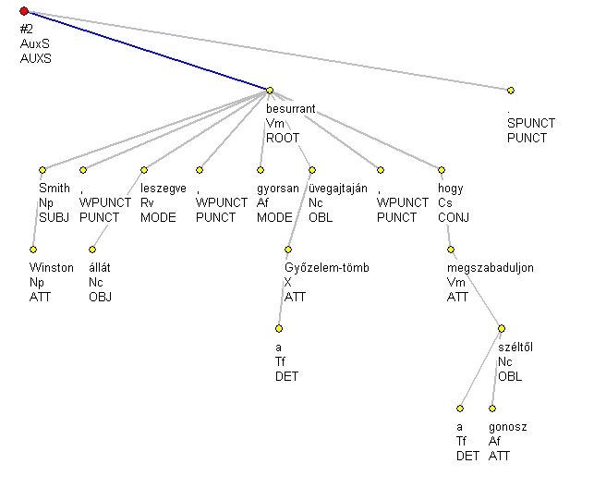

Slide 14
Shadow_Riders.txt
The Shadow Riders, known as the in the original Japanese language version, are a fictional group of villains in the Yu-Gi-Oh! GX anime series, appearing between episodes 29-49.
Composed of seven duelists and their leader of varying origins and backgrounds who each have their own agendas, the Shadow Riders serve as the main antagonists of the series' first season, intent on resurrecting the Sacred Beasts.
However, one of them returns in the fourth and final season as the true mastermind behind the mysterious attacks that take place in Duel Academy and Domino City.
Shadow_Riders.txt.annotation
NE_ORG 4 17
NE_MISC 48 56
NE_MISC 116 128
MWE_COMPOUND_NOUN 129 141
SENT_BOUND 170 175
NE_ORG 294 307
NE_MISC 394 407
NE_MISC_SB 401 407
MWE_LVC 527 537
MWE_LVC_VERB 527 531
MWE_LVC_NOUN 532 537
NE_LOC 541 553
NE_LOC 558 569
NE_LOC_SB 565 569
NE_ORG 576 589
NE_PER 626 638
NE_PER_SB 634 638
NE_PER 691 702
SENT_BOUND 794 803
MWE_COMPOUND_NOUN 814 825
MWE_COMPOUND_NOUN 855 872
NE_MISC 873 897
SENT_BOUND 994 1002

Slide 15
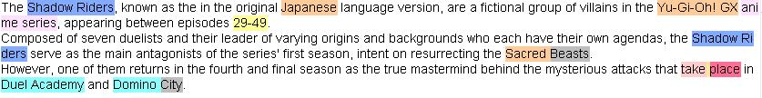
Annotation tools
Graphical user interface (GUI)
Understandable for humans
Easy-to-use
Error rate can be reduced

Slide 16
How to build corpora
Collecting and preparing texts
Manual annotation
  Multiple annotation – to check agreement rate
  Single annotation
3. Resolving differences, checking
  Disambiguation of differences in annotation
4. Final steps
  Creating the final format of the corpus, correcting technical issues, publishing the corpus

Slide 17
English corpora
British National Corpus (BNC)
  British English
  ~100M tokens
  Written and oral language
  Automatic annotation
Wall Street Journal (WSJ)
  Business English
  Some parts are manually annotated (morphology, syntax)
Reuters
  ~100M tokens
  Documents and paragraphs
Gigaword corpus
  2 billion tokens
Penn TreeBank
  5 million tokens
  POS tags
  Syntactic analysis (constituency)
Task-specific corpora: CoNLL-2003 (named entities), SemEval (semantics)…
  100-200K tokens

Slide 18
Magyar Nemzeti Szövegtár / Hungarian National Corpus(MNSZ)
187,6 million tokens
news, fiction, science, official, personal domains
Hungarian from outside Hungary
Automatic lemmatization and POS-tagging
Gigaword version (1 billion token)
http:/corpus.nytud.hu/mnsz

Slide 19
Webkorpusz
More than 1,48 billion tokens (unfiltered, or 589 million filtered tokens)
The biggest Hungarian corpus so far
18 million websites (.hu)
http://mokk.bme.hu/resources/webcorpus

Slide 20
SzegedParalell
English-Hungarian parallel corpus
Manually aligned paragraphs and sentences:
  Language books
  EU texts
  Bilingual magazines
  fiction
99,000 sentence alignment units
http://rgai.inf.u-szeged.hu/corpus_paralell

Slide 21
Szeged (Dependency) Treebank
82 000 sentences
1,5 million tokens
230 000 punctuation marks
6 domains
  Student essays
  Computer texts
  Fiction
  Legal texts
  Newspaper texts
  Short business news
Manually annotated morphological, syntactic (constituency and dependency) annotation, named entities, light verb constructions, coreference
http://rgai.inf.u-szeged.hu/SzegedTreebank

Slide 22
NE-corpora
CoNLL challenge
ORG / LOC / PER / MISC categories
~220 000 tokens (SZK business news)
~470 000 tokens (articles from HVG)
  tag-for-tag: I travelled to Barcelona.
  tag-for-meaning: Barcelona won the game.
  http://rgai.inf.u-szeged.hu/corpus_ne

Slide 23
Corpora annotated for uncertainty
BioScope (20K sentences)
  Clinical texts
  Biological abstracts
  Biological papers
  CoNLL-2010 Shared Task corpora (biological papers (18K sentences) + Wikipedia articles (20K sentences) )
Szeged Uncertainty Corpus
  reannotated CoNLL-2010 + FactBank
  Unified annotation principles
  WikiWeasel 2.0: discourse level uncertainty
  hUnCertainty: Hungarian corpus (17K sentences) + Hungarian social media texts + medical texts (under construction)
  http://rgai.u-szeged.hu/uncertainty

Slide 24
A O O
lap O O
szerint B-doxastic B-doxastic
P. O O
. O O
Márió O O
kitart B-doxastic O
amellett O O
, O O
hogy O O
egyáltalán O O
nem O O
emlékszik O O
arra O O
, O O
hogy O O
őt O O
bárki O O
is O O
üldözte O O
volna O O
. O O
Állítólag B-epistemic B-epistemic
azon O O
a O O
területen O O
, O O
ahol O O
a O O
vérengzés O O
történt O O
, O O
csak O O
a O O
gyilkos O O
kocsijának O O
a O O
keréknyomát O O
találták O O
meg O O

Slide 25
MWE-corpora
Multiword expressions
Wiki50 corpora:
  50 English Wikipedia articles (4700 sentences)
  MWEs and NEs manually annotated
LVCs in Szeged Treebank and SzegedParallel (in part)
English, German, Spanish and Hungarian LVCs in JRC-Acquis legal parallel corpus (~100K tokens for each language)
Hungarian version of the PARSEME Shared Task corpora
http://rgai.inf.u-szeged.hu/mwe

Slide 26
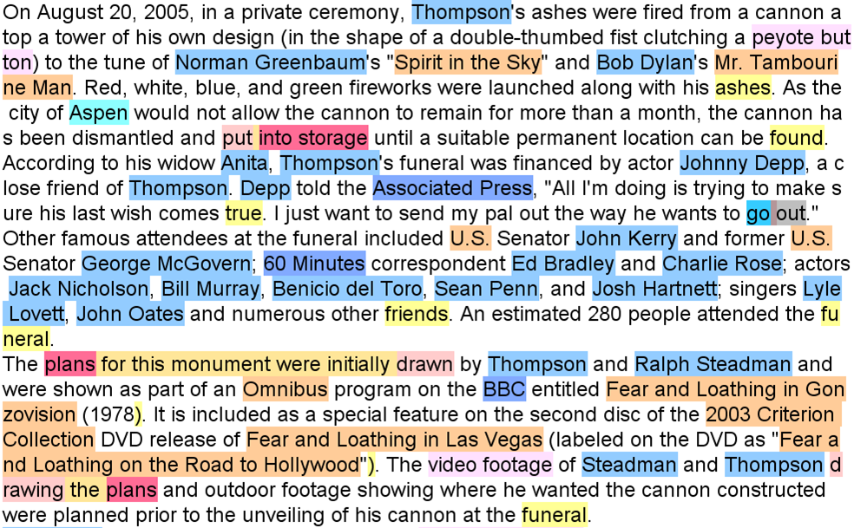
Wiki50

Slide 27
HunLearner
Students of Hungarian at intermediate and advanced level
Essays written on computer without any dictionary
1400 sentences
Morphological errors on nouns
Errors of definite/indefinite conjugation
http://rgai.inf.u-szeged.hu/hunlearner

Slide 28
1 A a Tf 2 DET T SubPOS=f
2 gyerek gyerek Nc-sn 9 SUBJ N SubPOS=c|Num=s|Cas=n|NumP=none|PerP=none|NumPd=none
3 nagyon nagyon Rx 4 MODE R SubPOS=x|Deg=none
4 okos okos Afp-sn 9 ATT A SubPOS=f|Deg=p|Num=s|Cas=n|NumP=none|PerP=none|NumPd=none
5 és és Ccsw 4 CONJ C SubPOS=c|Form=s|Coord=w
6 kedves kedves Afp-sn 5 COORD A SubPOS=f|Deg=p|Num=s|Cas=n|NumP=none|PerP=none|NumPd=none
7 és és Ccsw 6 CONJ C SubPOS=c|Form=s|Coord=w
8 jól jól Rxp 7 COORD R SubPOS=x|Deg=p
9 müködik müködik X 0 ROOT X _
10 a a Tf 11 DET T SubPOS=f
11 kapcsolatünk kapcsolatünk X 9 OBL X _ kapcsolatunk Stem: A Assimilation: 1 Matching: B Suffix number: 1
12 . . . 0 PUNCT . _

Slide 29
Personality markers and opinions
500 blogs on traveling to 5 destinations
English blogs
Positive and negative opinions on certain aspects
Text spans related to personality traits also marked
The portions were on the small side.

Slide 30
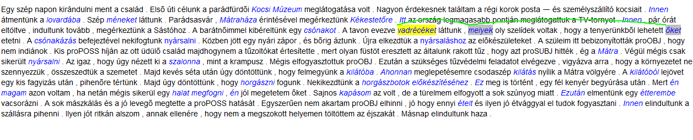
Coreference corpus
Entities referring to the same entity are linked
Szeged Treebank (in part)

Slide 31
Project work idea
Small NLP project individually or in groups
  Presentation
  Short paper (maybe article?)
Annotation tools and NLP processing tools are available
Assistance in programming (if needed)

Slide 32
Project ideas (from last years)
Create a small corpus on a topic of your choice:
  Dialectal differences
  Negation items
  Sentiment
  Coreference
Error analysis of the output of an NLP tool (parsers, machine translators, sentiment analysis):
  Comparing the output of MWEs by MT systems
  Chain translation of idioms into 10 languages, comparing the results
(Statistical) analysis of data from a corpus:
  POS distribution in literary works
  POS differences in fake and real lyrics
  Differences among language use in MA abstracts by English, Hungarian and Chinese students
More on corpus linguistics (in Hungarian): http://www.jgypk.hu/tanszek/alknyelv/?p=7700

