Slide 1
Basics of Natural Language Processing
Introduction to Computational Linguistics

Slide 2
Content
Basic notions
Computational Linguistics as a field
CL and other disciplines
Fields of CL

Slide 3
Linguistics & language
What is language? What is its purpose? What are its parts?
Communication of thoughts and feelings through a system of arbitrary signals, such as voice sounds, gestures, or written symbols.

Slide 4
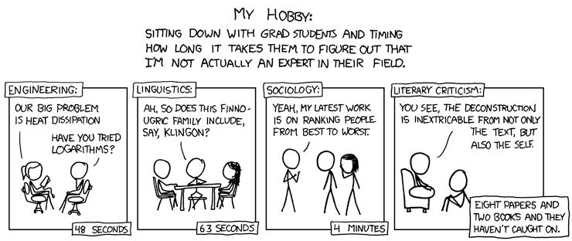
Languages
Natural languages: English, Hungarian, Russian, Hindi…
Artificial languages: Esperanto, Ido, Volapük, Sinda, Klingon…
Programming languages: C, Java, Prolog…

Slide 5
Terms
Language and speech technology:
Processing written and oral language
Generating language products
Natural language processing
Computational linguistics
Human language technology

Slide 6
Levels of language
Speech
Writing
For computer: language is primarily a written product
For human: it is primarily an oral product
~18 month old babies already use sentences (but usually cannot write!)
Almost every person can speak but there are a number of illiterate people

Slide 7
Linguistics units & CL
Sentence: segmentation
Word: tokenization
Morpheme: morphological and syntactic parsing
Phoneme: speech technology
Syllable: speech technology

Slide 8
Goals
Efficient communication between human and human / machine and human
Facilitating human work with novel technologies and services
Assisting people with disabilities (visual impairment, hearing impairment, aphasic people, people with cerebral lesion, people who cannot speak foreign languages…)

Slide 9
Interdisciplinary field
linguistics
lexicography
software technology
psychology
mathematics
informatics
physics
physiology
neurology
biology
…

Slide 10
Language technology in daily life
Spellcheckers
Search engines (Google)
Translation sites (Google Translate, webforditas)
Tagging of news/blogs
Voice dial
Directory enquiry service
Smartphone assistant (Siri, Cortana…)
…

Slide 11

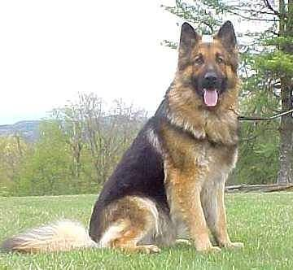



Human vs. machine
What is hard for human is easy for machine:
lg (34862 + 2896⁶) * 8966 = ?
What is hard for machine is easy for human:

Slide 12
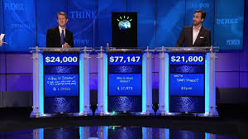
Turing test
Human and machine cannot be distinguished on the basis of their answers
Machine beats human: Watson (IBM)
http://www-03.ibm.com/innovation/us/watson/index.shtml

Slide 13
How to pass the Turing test?
Artificial intelligence
Natural language processing: understanding language
Knowledge representation: information storage
Automatized deduction: answering and deducing on the basis of stored info
Machine learning: generalization, adaptation to new circumstances
Machine vision: „seeing” and perceiving objects
Robotics: (re)moving objects

Slide 14
Problems for speech recognition
Special features for each speaker: pitch, tone, volume, speech rate… (small child vs. old person)
May be difficult for humans: geographical names pronounced by non-native speakers
[bɛdɛksɔnɪ] [lofas] [balatõfənɪ:v]
Badacsony, Lovas, Balatonfenyves

Slide 15
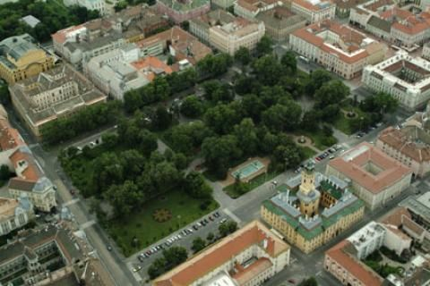

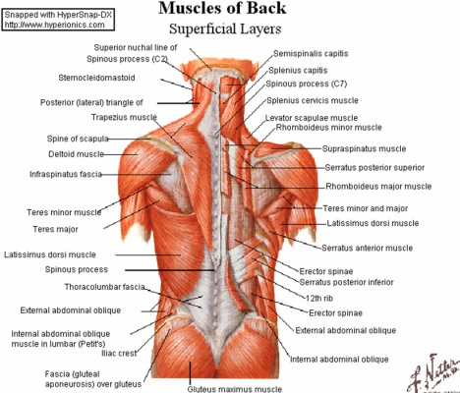

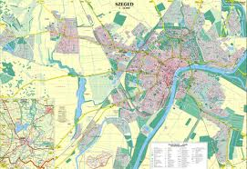

Problems with processing written texts
Ambiguities at all linguistic levels
Semantics: Az ár magas. The bar tender's punch was quite strong.
Morphology:
háttérkép
hát+térkép
háttér+kép
hát+tér+kép

Slide 16
Fields of NLP
Linguistic levels (analysis/parsing):
segmentation
morphology
syntax
semantics
Applications (e.g.):
Information retrieval/extraction
Machine translation

Slide 17
What is needed for successful parsing/applications?
A specific program or algorithm ☺
Need for training and test datasets -> manually annotated datasets (corpora)
Evaluation: compared to human performance

Slide 18
Main NLP journals and conferences
ACL
EACL
NAACL
COLING
LREC
TACL
Computational Linguistics
Language Resources and Evaluation
In Hungary: MSZNY

