Slide 1
Document classification, information retrieval, information extraction
Introduction to Computational Linguistics – 8 October 2018

Slide 2
Applications
Practical applications of parsing and linguistic analysis
„top of the iceberg”
Useful for „ordinary” people / in everyday life

Slide 3
Document classification
Automatically sorting documents into predefined groups ~ groups of books in a library
E.g. SPAM detection
Thematic grouping
Language identification
…

Slide 4
Method
Looking for those words that are characteristic of a (group of) documents
Frequent words that occur only in a few documents
Very frequent words are irrelevant -> stopwords

Slide 5
Stopwords
„unimportant” words
Are not informative from the perspective of the task
„grammar/function” words
Most frequent words
Language dependent lists
English: a, the, an, and, this, that, is, are, am, were, have, do…

Slide 6
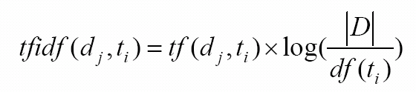
TF-IDF
Term Frequency-Inverted Document Frequency:
tf: frequency of term
df: number of documents with the term t
|D|: number of documents

Slide 7
TF-IDF
The more the given term occurs in a document, the more important it is (tf)
The more document contains the given term, the less informative it is in classifying the documents

Slide 8
Clustering
Forming groups of documents
Similar documents form a group
Predefined groups
Groups created by the system

Slide 9
Information retrieval
IR
Collecting documents that are relevant for the given search / query
Search engines (Google, Yahoo!, Bing)

Slide 10
Basic task in IR
There is a corpus (collection of documents, internet…)
The user is looking for documents most relevant to his need for information
He formulates a query
Output: a ranked list of documents that are relevant for the query

Slide 11
Word-document matrix

Slide 12
Features of an IR system
Speed of indexing (not importnatn for the user)
Speeding of query processing
Scope of the query language (what can be asked and what not?)
Precision (recall, F-score?)

Slide 13
Search
Search engines:
Google
Yahoo
…
What is needed/would be needed:
All-words WSD (bank)
Lemmatization (HU: foci, focinak, focival etc.)
Uncertainty and negation detection

Slide 14
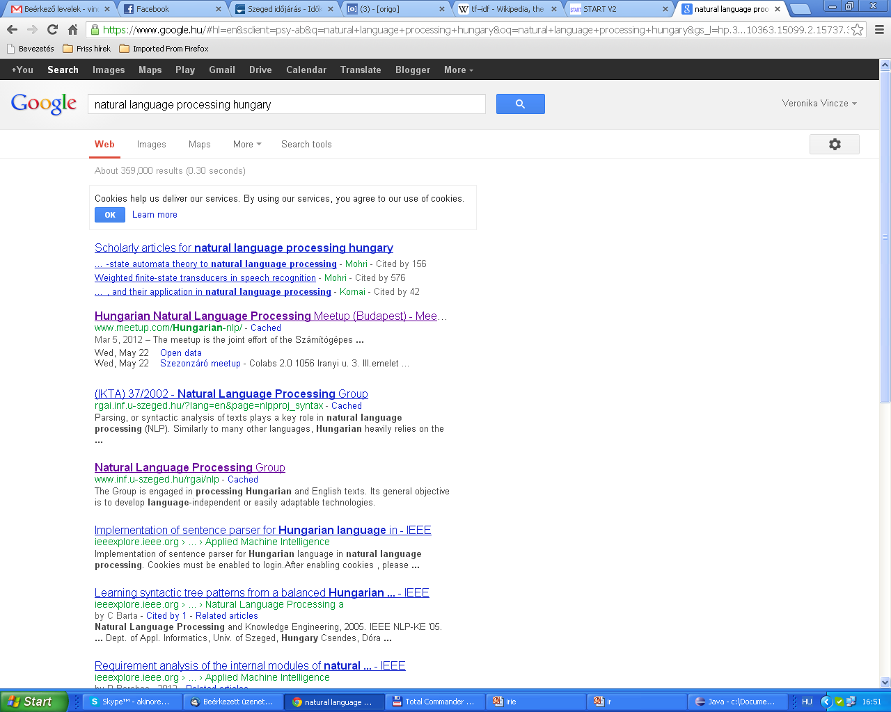

Slide 15
Information extraction (IE)
gaining structured information from unstructured text
several fields of application
Named entity recognition
Biomedical IE
Keyphrase extraction
Opinion mining
Social web mining

Slide 16
IE vs. IR
More difficult task (unstruuctured input)
Current systems are able to extract only information of a certain type
Domain specificity
Slow and less precise systems
Results are easier to process both for humans and machines

Slide 17
Named Entity Recognition
Named entities (NEs): proper names & identifiers
Recognition + classification
Special treatment needed: George Bush - ? Georg Busch
Mainly domain- and language-independent task (but see exceptional cases)

Slide 18
Recognition/classification
Recognition can be done with simple features
List-based approach: Dictionaries help a lot but cannot be totally relied on
Classification is a harder task

Slide 19
Categories
Person names (PER)
Locations (LOC)
Organizations (ORG)
Other (MISC)
In many cases, categories need to be extended/added

Slide 20
Categories - 2
Different classes might be relevant for different tasks
Medical texts: name of the patient, name of the doctor, city name, hospital name…
Legal texts: lawyer, judge, prosecutor, suspect, witness…
Hierarchy of categories (all are PERS in legal texts)

Slide 21
Problematic cases
Proper name -> common name
Kleenex – kleenex
Hoover - hoover
Common name -> proper name
They call their dog Rock.
Metaphor, metonymy
Barcelona won the game.

Slide 22
Interlingual differences
Days, months, feasts:
Monday, June, Christmas
hétfő, június, karácsony
Nationalities
Hungarian, Spanish – magyar, spanyol
Scientific nomenclature
Canis lupus
May be separate NE categories

Slide 23
Formal features
Starts with a captial letter (?)
PDA, Ft, eBay, 4 Non Blondes
Die Tränen greiser Kinderschar ich zieh sie auf ein weißes Haar werf in die Luft die nasse Kette und wünsch mir, dass ich eine Mutter hätte

Slide 24
NE spans
Where are the borders of an NE?
Additional items
Aunt Grace
Széchenyi Square
Appalache mountain
New York state
Articles
The Hunger Games – I have seen the/The Hunger Games.
The Beatles – This is a Beatles hit.
Los Angelesből az Offspring, Glasgowból a Snow Patrol, Düsseldorfból a Die Toten Hosen és a világ számos pontjáról további zenekarok jelezték a napokban, hogy elfogadják a Sziget szervezők meghívását.

Slide 25
Identifiers
Regular expressions (patterns)
Hungarian registration plates: 3 letters + - + 3 digits
Phone numbers: 9 digits
Easy task for computational applications

Slide 26
Features for automatic NER
Orthographic features
Frequency information
Contextual information
Phrase level information
Dictionaries
NEs in training dataset

Slide 27
Approaches
Token-based: each word is analyzed separately and classified as NE / non-NE
Sequence-based: each sequence (a sentence) is analyzed at once and the most probable sequence label is assigned to it

Slide 28
Biomedical & clinical IE
Biological patents, publications and clinical documents contain a lot of information hidden in the text
Processing of such documents is costly and time-consuming
Automatic IE tools help to extract relevant information

Slide 29
Biomedical & clinical IE 2.
Target information: biological entities (genes, proteins etc.) and relations among them
Biomedical event extraction
Disambiguating and normalizing gene names (several names for 1 gene, 1 name for several genes in the literature)
Anonymization of clinical documents (data protection)

Slide 30
Biomedical text mining
IE systems for several tasks:
protein-protein interaction
determining the smoking status of a patient
automatic coding of radiological finds using ICD codes
identifying obesity and co-morbidities in finds

Slide 31

Keyphrase extraction
assigning phrases to documents which summarize them and semantically represent their content
application fields:
Scientific papers
Newspaper articles
Product reviews

Slide 32
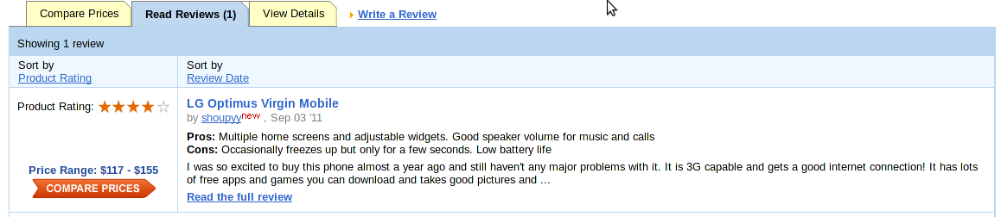
Opinion mining
Classifying documents as describing positive/negative feelings towards something (product, political party, celebrity, service, location, etc.)
Opinion (changes) on a specific entity can be monitored automatically
Can be used in marketing, opinion polls etc.
Our system has been applied to:
Product reviews
Internet forums

Slide 33
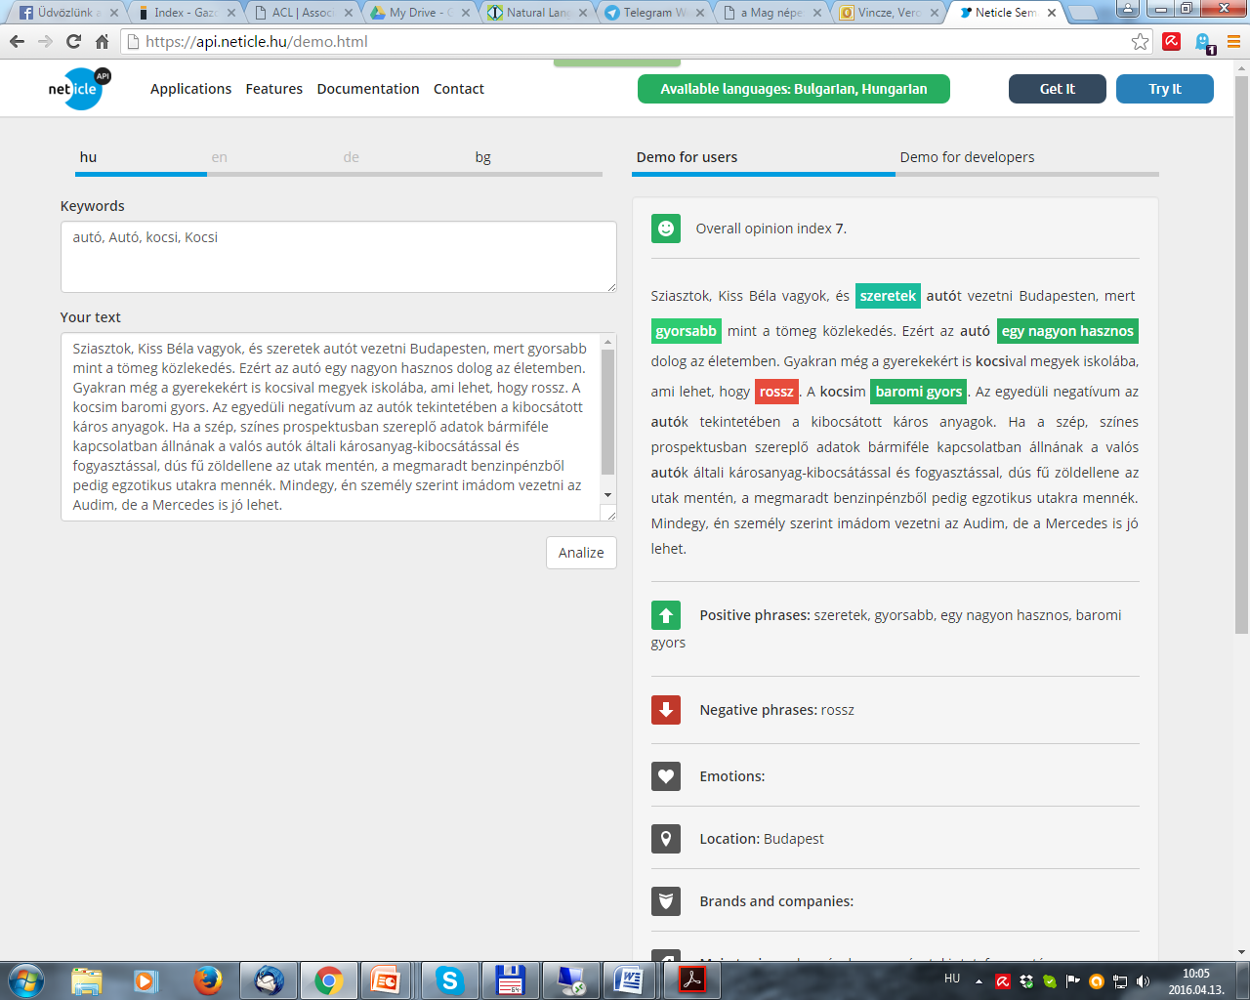

Slide 34
Scientific social web mining
Finding patterns in a network of researchers
Collecting information from homepages of researchers (co-authors, affiliation, colleagues, cooperations, etc.)
Social information like researchers with the same fields of interest, cooperative partners, etc. can be extracted

Slide 35
Social web mining
Several people may share their full name (Anne Hathaway: Shakespeare’s wife or actress?)
A name can have several variants (Bill Clinton – William Jefferson Clinton - Clinton)
Homepages with the same owner’s name may belong to different people
Disambiguation is necessary
Our group developed a solution for disambiguating homepages by making use of features like address, affiliation, degrees, birthday, attended schools, etc.
Only relevant homepages are offered for the user

