Slide 1
Morphology and POS-tagging
Introduction to Computational Linguistics – 17 September 2018

Slide 2
Introduction
Morphological analysis of words
Lemmatization
POS-tagging

Slide 3
Morphological analysis
Aim: assign to each word its morphological analysis (part-of-speech and other morphological features) and their lemmata (lemmatization)
Word vs. word form
Hungarian vs. English
Base form of the word
Number of possible word forms
Number of possible analysis / codes (EN 36 vs. HU ~1000)
Can all the word forms be stored?

Slide 4
EN vs. HU
Morphology does not match
Morphology vs. syntax
Csinálhattátok Vois2p---y
V | csinál | do
o | hat | can
i | - | -
s | t | PAST
2p | tok | you
y | á | it
 | csinálhattátok | you could do it

Slide 5
Morphological analyzer
Lexicon: stems and affixes
Rules: correspondence among representations of word forms and linguistic units
Can ALL words occur in the lexicon?

Slide 6
Unknown words
Intensive growth of vocabulary
Not all of the words can be listed
List of suffixes does not change
Are there possible suffixes at the end of the word?
If so, it is cut and the rest is given as lemma
Morphological analysis is assigned on the basis of affixes
Can it be created from two existing words? (egérpad)

Slide 7
Unknown words
Unknown words can be:
Compounds
Named entities
Derivations
fémkapunk
félmillió
csokinyúl
NATO-hoz
Methods for analysis (Zsibrita et al. 2010):
Segmentation into two or more analyzable parts
Expert rules to filter impossible combinations (*V+N)
Analysis of the last part goes to the whole word
Substitution for hyphenated words (pre-defined patterns for each morphological class)

Slide 8
félmillió
fél | N | half
 | ADJ | half
 | NUM | half
 | V | be afraid
millió | NUM | million
fél+millió
Mc-snl
Expert rules:
NUM + NUM
* non-NUM + NUM

Slide 9
fémkapunk
fém | N | metal
kap | V | get
kapu | N | gate
unk | S | 1Pl (verb)
nk | S | 1PlPoss (noun)
fém+kap+unk
Vmip1p---n
fém+kapu+nk
Nc-sn---p1
Expert rules:
N + N
N-nonNOM + V
* N-NOM + V

Slide 10
csokinyúl
csoki | N | chocolate
nyúl | N | rabbit
 | V | stretch
kinyúl | V | stretch out
csoki+nyúl
Vmip3s---n
Nc-sn
cso+kinyúl (?)
Vmip3s---n
Expert rules:
N + N
N-nonNOM + V
* N-NOM + V

Slide 11
NATO-hoz
NATO | ? | NATO
hoz | V | bring
 | S | to
NATO-hoz
NATO: V
Vmip3s---n
NATO-hoz (kalaphoz)
NATO: N
Np-st
Ordering of rules:
substitution
segmentation
Expert rules:
N + - + S
N-nonNOM + - + V
* N-NOM + - + V
V + - + V
Substitution:
NATO- -> kalap ‘hat’

Slide 12
Lemmatization
Lemmatization (i.e. dividing the word form into its root and affixes) is not a trivial task in morphologically rich languages such as Hungarian
common nouns: relying on a good dictionary
NEs: cannot be listed
Problem: the NE ends in an apparent suffix

Slide 13
Lemmatization of NEs
each ending that seems to be a possible suffix is cut off the NE in step-by-step fashion
Citroenben
Citroenben (lemma)
Citroen + ben ‘in (a) Citroen’
Citroenb + en ‘on (a) Citroenb’
Citroenbe + n ‘on (a) Citroenbe’
Each possible lemma undergoes a Google and a Yahoo search – the most frequent one is chosen (Farkas et al. 2008)

Slide 14
Tagsets
Formalized/computerized morphological information
Difference in granularity
Difference in size
Language-specific?

Slide 15
Universal morphology
Universal Dependencies:
international project (unfunded!)
45 languages (v2.0)
goal: to develop a „universal", i.e. a language-independent morphological and syntactic representation
multilingual morphological and syntactic parsing
studies on linguistic typology and contrastive linguistics
http://universaldependencies.org/

Slide 16
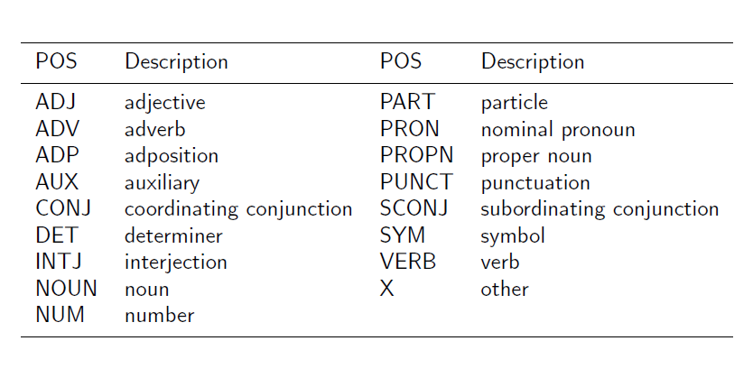
POS-tags

Slide 17
POS-tagging
POS-tagging – POS-tagger
To choose the correct POS tag and morphological analysis from all the possible codes
In English, words are highly ambiguous:
The soldier decided to desert in the desert.
This was a good time to present the present.
When shot at, the dove dove into the bushes.
I did not object to the object.
The insurance was invalid for the invalid.
To help with planting, the farmer taught his sow to sow.

Slide 18
What part-of-speech is missing?
"Climate ----- is real. It is ----- right now; we needed to go ----- the tip of South ----- to find snow. ... It is the ----- urgent threat facing our entire species," ----- said. "We need to ----- leaders around ----- world who speak for ----- people, for humanity, the voices who have ----- drowned out by the politics of greed. Do ----- take this planet for granted. ... I ----- not take this night for granted. Thank -----."

Slide 19
"Climate change is real. It is happening right now; we needed to go to the tip of South America to find snow. ... It is the most urgent threat facing our entire species," he said. "We need to support leaders around the world who speak for indigenous people, for humanity, the voices who have been drowned out by the politics of greed. Do not take this planet for granted. ... I do not take this night for granted. Thank you."

Slide 20
Automata in morphology

Slide 24
Morphological analysis – exercise
-val/-vel suffix in Hungarian
Data:
Ház – házzal – zal ‘(with) house’
Kéz – kézzel – zel ‘(with) hand’
Fa – fával – val ‘(with) tree’
Eke – ekével – vel ‘(with) plough’
Sün – sünnel – nel ‘(with) hegdehog’
Csoport – csoporttal – tal ‘(with) group’
Kapu – kapuval – val ‘(with) gate’
Peti – Petivel – vel ‘(with) Pete’

Slide 25
Steps
Clustering data
Generalizations
Rule formation
Ordering the rules

Slide 26
1. Clustering data
Does v in the suffix change?
Ház – házzal
Kéz – kézzel
Sün – sünnel
Csoport – csoporttal
Fa – fával
Eke – ekével
Kapu – kapuval
Peti – Petivel

Slide 27
1. Clustering data
What vowel is there in the suffix?
Ház – házzal
Fa – fával
Csoport – csoporttal
Kapu – kapuval
őz – őzzel
Eke – ekével
Sün – sünnel
Peti – Petivel

Slide 28
2. Generalizations
Does the v in the suffix change?
After V it does not
After C it does
What vowel is in the suffix?
After á, a, o, u: a
After e, i, ü, ő: e
Lengthening: at the end of the word: a, e -> á, é

Slide 29
Rules
Default value:
Describes most of the cases
It is easier to formulate divergences from the default than the default ☺
Default: val
C at the end of the word
v -> C
Last V is e, ő, ü or i
val -> vel
V at the end of the word is e or a
e# ->é#
a# -> á#

Slide 30
Ordering the rules
kéz + val eke + val
3 rules, 6 possible ordering
C-rule
kéz + zal eke + val
2. V-rule
kéz + zel eke + vel
3. lengthening
kéz + zel eké + vel
V-rule
kéz + vel eke + vel
2. C-rule
kéz + zel eke + vel
3. lengthening
kéz + zel eké + vel

Slide 31
Ordering the rules
kéz + val eke + val
C-rule
kéz + zal eke + val
2. lengthening
kéz + zal eké + vel
3. V-rule
kéz + zel eké + vel
V-rule
kéz + vel eke + vel
2. lengthening
kéz + vel eké + vel
3. C-rule
kéz + zel eké + vel

Slide 32
Ordering the rules
kéz + val eke + val
lengthening
kéz + val eké + val
2. C-rule
kéz + zal eké + val
3. V-rule
kéz + zel eké + val
lengthening
kéz + val eké + val
2. V-rule
kéz + vel eké + val
3. C-rule
kéz + zel eké + val

Slide 33
Ordering the rules
The order of C-rule and V-rule does not matter
Lengthening not first

