Slide 1
Pragmatics
Introduction to Computational Linguistics

Slide 2
Introduction
Pragmatics: Language in use
Language in interaction
Communication
Dialogue
Linguistic forms in context
Semantics vs. Pragmatics: original vs. Intended meaning

Slide 3
Topics
Speech acts and implicatures
Dialogue systems
Non-literal meanings: irony, sarcasm
Deception detection

Slide 4
Speech acts
Acting by language
What is the expected reaction?
Literal vs. intended meaning
Requests /orders:
Can you pass me the salt?
Would you mind closing the door?
Orders:
Can you please shut up?

Slide 5
Conventionalized implicatures
Certain forms of politeness have implicatures
Generally known by the community of speakers
If taken literally, humorous / strange effects
Could you pass me the salt?
Yes, I could but I don’t want to.

Slide 6
Dialogue acts
A dialogue act is a stretch of communicative activity of a dialogue participant
Has a certain communicative function and a semantic content
May have certain functional dependence relations, rhetorical relations, and feedback dependence relations

Slide 7
An example
Do you know what time it is?
Asking for time (the speaker does not know what time it is)
Reproach for being late (the speaker does know)
Common ground: shared knowledge of the dialogue participants
Nonverbal behaviour also helps in interpreting dialogue acts

Slide 8
Assistant talk
Siri, Cortana, Bixby…
Basic instructions: „Open Facebook”; „Close all apps”; „Call Mum”
Interpersonal questions: „Who is you best friend?”-„We are friends, right?”; „How are you?” – „Never better”
Advanced level: „Tell me a joke.” – it does!
If unable to get what the speaker wants: „This is what I found on the web.”

Slide 9
Annotating discourse
lack of well-developed and generally accepted theoretical accounts of pragmatic phenomena -> only a few resources
Discourse connectives
Turns
Speech acts
Coreference relations
Textlink: towards a unified annotation scheme of discourse phenomena (http://textlinkcost.wixsite.com/textlink)

Slide 10
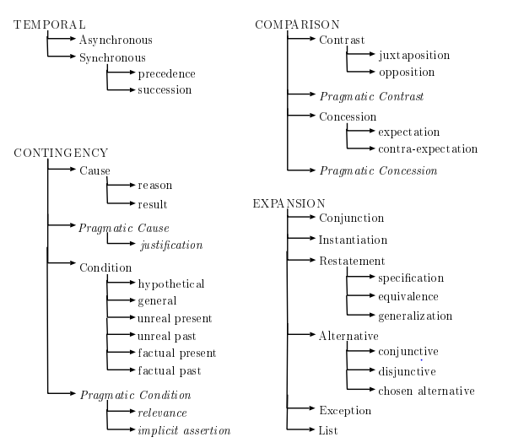
Corpora for discourse annotation
PENN Discourse Treebank: discourse relations added to syntactic trees
Connectives (coordinative, subordinative, multiple…)
Pragmatic functions

Slide 11
ONTONotes
English, Chinese, and Arabic texts
Syntax and predicate argument structure
Word sense linked to an ontology
Coreference relations: semantic-pragmatic relations among NPs

Slide 12
A sample
My Heart is in <COREF ID="95" TYPE="IDENT">Macau</COREF> :<COREF ID="96" TYPE="IDENT">" Local Portuguese " Carlos Marreiros</COREF>-LRB- Jackie Chen / tr. * by Brent Heinrich -RRB-Around the time of the <COREF ID="95" TYPE="IDENT">Macau</COREF> handover , questions that *T*-1 were hot in the Western media were , What is " Macaense *T*-2 " ?And what is <COREF ID="111" TYPE="IDENT">native <COREF ID="95" TYPE="IDENT">Macau</COREF> culture</COREF> *T*-1 ?<COREF ID="114" TYPE="IDENT">This</COREF> is <COREF ID="96" TYPE="IDENT">Carlos Marreiros 's</COREF> story .<COREF ID="114" TYPE="IDENT">The story</COREF> began during the era of great sailing ships .Four hundred years ago , a Portuguese trading vessel dropped anchor off the island of Macau , *-9 intent on * doing business with imperial China .That one brief rest stop destined <COREF ID="95" TYPE="IDENT">Macau</COREF> to become a cultural montage that *T*-1 includes Chinese , Indian , Malay , Portuguese and other European influences .

Slide 13
Non-literal meaning
In language, an utterance can mean just the opposite of its semantic content in context
Is it a false utterance? Not necessarily
Poetic language
Irony: Great. Another rainy day. How wonderful.
Sarcasm: Children really brighten up a household - they never turn the lights off.

Slide 14
Irony vs. sarcasm
Sarcasm is defined as the hostile false words the speaker is aware of when uttering out
Irony could be the false words the speaker may be aware of, or may be not aware of
Sarcasm is one type of irony that is aggressive

Slide 15
Irony/sarcasm detection
Irony in tweets: quite popular topic in NLP
#sarcasm
#irony
Speaker’s intention is clear
Wang (2013): 500-500 tweets investigated

Slide 16
Examples
Worrying about weight gain while happily eating 5 slices of pizza and a doughnut. #irony food is my love.
This play is amazingly good. #sarcasm
really have fantasssstic friends.. #sarcasm
Boyfriend of the year award. #sarcasm
you always find a way to ruin my night! #thankyou #sarcasm
I ordered 6 new pairs of shoes...this saving money thing is going pretty good for me #Sarcasm
Oh! there's water coming out of the smoke alarm. :) cool! #sarcasm #irony

Slide 17
Irony / sarcasm vs. sentiment

Slide 18
SemEval 2018 Task 3
Irony detection in English tweets
With removing the ironic tag (#irony, #sarcasm and #not), can the system predict whether it is an ironic tweet or not?
I just love when you test my patience!! #not
Had no sleep and have got school now #not happy
Best results around 70% accuracy

Slide 19
Deception detection
To intentionally cause another person to have or continue to have a false belief that is truly believed to be false by the causer
Aim: to identify deceptive content
Applications: forensic linguistics, border control, lie detector, media analysis…
Elections: who can you trust?
Fake news and media: what is reliable?

Slide 20
Linguistic cues for deception
Self-references: 1Sg references offers a link between the reality and the speaker - deceivers reduce the use of self-references
Negative words: Emotions such as guilt, shame and fear increase the use of negative words
Cognitive complexity: fewer exclusive words such as except, but, without and exclude + increase in action verbs (e.g. go, lead, walk)

Slide 21
Fake news
Hoax: news on the web (social media) that are deceptive
Aim: making profit from naive people
Satirical news: false but aiming a humorous effect on the reader
Many people believe these („what is in the news must be true”)

Slide 22
Fake vs. real news
English: Onion, Daily Mash etc.
Hungarian: hírcsárda etc.
Satirical or humorous pieces of news
Aim to entertain people
See examples:
Rubin et al. 2016
Vincze 2018

Slide 23
An English fake news
A 32-YEAR-OLD man hopes he reaches the fabled cut-off point where you stop listening to new music soon, because he has had enough of it.
Nathan Muir knows that after a certain age men simply stop bothering with any new music, preferring to repeatedly listen to the tunes of their youth, and he has told friends he is ready for it as soon as possible.
He said: “It can’t quite have arrived yet, because when I hear about a hot new band I still feel duty-bound to check them out. Even though they’re always shit.
“And when I go on about how much better Queens of the Stone Age are than anything around today, there’s still a nagging sense of perspective. I don’t have the rock-solid certainty you see in comments on YouTube.
“It’d be nice to never have to bother again, because I keep doing things like listening to the new Arctic Monkeys, so it’s doing me harm.
“It definitely needs to be over before I have kids. A father can’t be open-minded about music. What would they despise?”
Muir also asked at what age he would begin to believe a suit jacket and jeans was a stylish sartorial choice ideal for flirting with younger women, because he is basically ready now.

Slide 24
A Hungarian fake news
Zuckerberg megvette Magyarországot
Fasza kis startupnak tűnik -kommentálta országunkat Budapest romkocsmáit látogatva a Facebook vezére. Magyarország ezentúl Facebook appként működik tovább.
Lapunknak sikerült kiderítenie a váratlanul Budapesten feltűnő Mark Zuckerberg látogatásának célját. Ez pedig nem más, mint Magyarország akvizíciója, amivel a Facebook portfolióját szeretné szélesíteni a világ egyik legbefolyásosabb embere. „Ha fényképezni akarok ott az Instagram, a térképi infók végett pedig meglesz a Waze. Most pedig veszek egy országot. LOL” - indokolta a vásárlást a Facebook vezetője.
Elemzők szerint a vételre a kutyája beszélhette rá, aki szintén magyar származású és puli. Úgy tudjuk, hogy Magyarország Magyarország ezentúl Facebook appként működik tovább. A jelenlegi vezetést valószínűleg lecserélik és hipszter dizájnerekkel, programozókkal, egy kávéautomatával és Széles Gáborral töltik fel az igaztatótanácsot. „Yeah, Gábor is lots of fun. Különösen tetszik a perpetuum mobile alapú golfpálya koncepciója. Zseniális. Nekem jó ideje ő a háttérképem‘” - mondta el Zuckerberg munkatársunknak, aki kutyaeledelnek álcázva jutott a közelébe.
Hogy pontosan mi lehet a célja az országunkkal az egyelőre nem ismert, de valószínűleg hamarosan mobilra is optimalizálják, megjelennek rajta reklámok és bárki örökbe fogadhat rajta kidobott kismacskákat.

Slide 25
Automatic distinction
Features (EN): absurdity, humor, grammar (morphology and syntax), punctuation etc.
Features (HU): morphology, syntax, semantics, pragmatics
Results: EN – 87 F-score, HU – 80 F-score
Next step: deliberately deceptive websites vs. „real” websites

