Slide 1
Semantics
Introduction to Computational Linguistics – 24 September 2018

Slide 2
Introduction
Semantics: meaning in language
How to define meaning?
  May change in time / space (gay)
  Regional differences (van/truck)
Meaning of words: lexical semantics
Meaning of sentences: predicate logic
Meaning of texts: Boolean logic

Slide 3
Formal semantics in linguistics
Boolean logic
  p v q
  ¬p
Meaning of words
  Dog ‘dog’
  Bark ‘bark’
(First order) predicate calculus
  ¬∃x(dog(x) & bark(x) & bite(x))
  Is the meaning really given?

Slide 4
Semantic change
Narrowing: Change from superordinate level to subordinate level - skyline
Widening: specific brand names being used for the general product - Kleenex
Metaphor: Change based on similarity of thing. For example, broadcast originally meant "to cast seeds out"; with the advent of radio and television, the word was extended to indicate the transmission of audio and video signals

Slide 5
Semantic change
Metonymy: Change based on nearness in space or time - jaw "cheek" → "mandible".
Synecdoche: Change based on whole-part relation - capital cities
Hyperbole: Change from weaker to stronger meaning - kill "torment" → "slaughter"
Meiosis: Change from stronger to weaker meaning, - astound "strike with thunder" → "surprise strongly"
Degeneration: knave "boy" → "servant" → "deceitful or despicable man"
Elevation: knight "boy" → "nobleman"

Slide 6
Computational semantics
Analysis of content?
To get the meaning of the text is still to be done…
To get the meaning of words is easier → word sense disambiguation

Slide 7
Ambiguities
Syntax and morphology may not suffice
Lexical ambiguities
bank
bark
fly
pen
Humans can do that quite easily
For machines, it can be more problematic

Slide 8
WSD
Word sense disambiguation: Giving the meaning of a word, based on a predefined set of meanings
  Meanings are collected from a dictionary
  For machine learning, annotated samples are needed
Word sense discrimination: Clustering different uses of the word without predefining the possible meanings
  No need for annotated labels

Slide 9
WSD
Types
  All words
  WSD for all words in a running text
  Lexical sample
  WSD for certain words in a running text
  Fine grained WSD (at least 6-8 meanings)
  Coarse grained WSD (at most 3-4 meanings)

Slide 10
JÁR (movement in space, in time, abstract motion)
BELONGING TOGETHER
REPETITIVE MOVEMENT
OTHER
occurring together
22
○--○
consequence
23, 24, 25
○○
approaching
15, 16, 18, 19
|
step by step
1, 33

regular
3, 4, 6, 31
________

functioning
10, 11, 13, 17, 20

state
7, 14, 29
idioms
26, 28
verbs with prefixes*
many-to-one
32
one-to-one
8, 27, 30
back and forth
2, 12
||
||
stage by stage
5, 9, 21


Slide 11
(dis)advantages
All words
  Very few resources available
  Very complex patterns
  No efficient solutions yet
  In practice, this would be ideal
Lexical sample
  Available resources, easy to create for new words
  Less complex patterns
  There are some useful solutions
  In practice, it is less applicable

Slide 12
Uncertainty
In IE systems uncertain and negated information must not be confused with factual information:
But CNN understands from Israeli sources that the military believes there may have been a number of Hamas rocket launchers in the area of the zoo, and that the zoo might have suffered collateral damage in strikes targeting those rocket launchers.

Slide 13
Uncertainty detection
Identification and disambiguation of uncertainty cues (linguistic markers of uncertainty) within the text
In May, there may be heavy storms.
According to the purpose of the application, uncertain texts spans must be deleted or treated separately
Work mostly done for English (Farkas et al. 2010, Morante and Sporleder 2012)

Slide 14
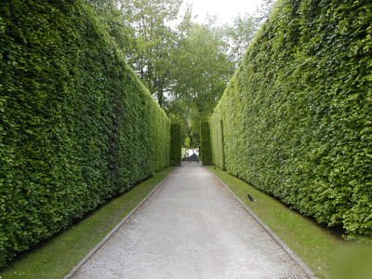

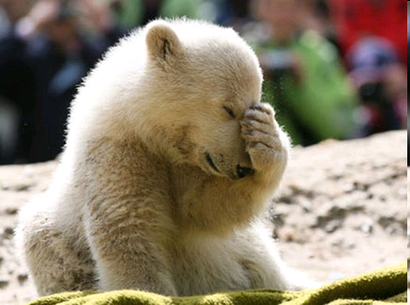
What is uncertainty?
Uncertainty
Hedge
Speculation
Factuality
Polarity
Weasel
Uncertain
Speculative
Probable
Possible
Doubtful

Slide 15

Corpora
BioScope (Vincze et al. 2008)
FactBank (Saurí and Pustejovsky 2009)
WikiWeasel (Farkas et al. 2010)
MPQA (Wiebe, Wilson, and Cardie 2005)
Biological papers (Medlock & Briscoe 2007)
PubMed-abstracts (Settles, Craven, and Friedland 2008)
Genia Event (Kim, Ohta, and Tsujii 2008)
10K biological sentences (Shatkay et al. 2008)
E. Coli (Thompson et al. 2008).
Genia Pathway (Nawaz, Thompson, and Ananiadou 2010)
112 journal papers (Rubin, Liddy, and Kando 2005; Rubin 2010)
Medical discharge summaries (Uzuner, Zhang, and Sibanda 2009)

Slide 16
Types of uncertainty
Semantic uncertainty: no truth value can be assigned to the proposition (see Szarvas et al. 2012 for details)
It remains to be determined whether therapeutic targeting of IL-1 will substantially affect IL-17 in RA.
Discourse-level uncertainty: the proposition can be assigned a truth value, the uncertainty is related to the lack of source or reference point
Some scientists report that this results in a better taste than that of other diet colas.

Slide 17
Semantic uncertainty
Epistemic: the truth value cannot be determined
It may be raining.
Doxastic: related to beliefs
He believes that the Earth is flat.
Investigation: something is under examination
We examined the role of NF-kappa B in protein activation.
Condition: conditionals
If it rains, we’ll stay in.

Slide 18
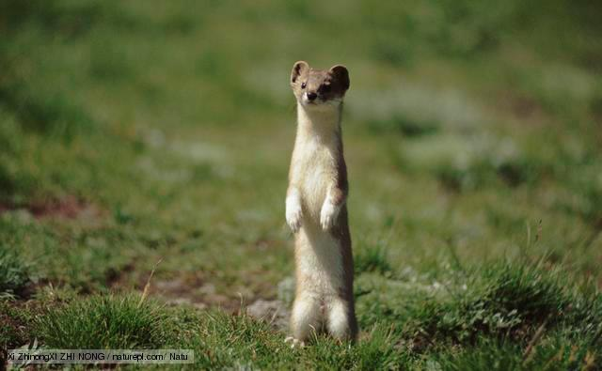
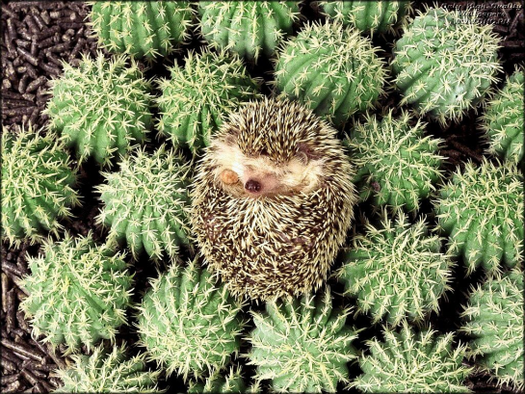
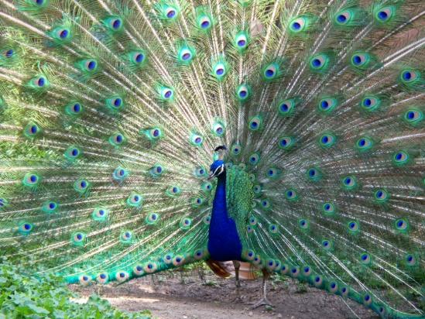
Discourse-level uncertainty
Weasel: lack of source or underspecified arguments
Some note that the number of deaths during confrontations with police is relatively proportional for a city the size of Cincinnati.
Hedge: blurred qualities / quantities
Magdalene Asylums were a generally accepted social institution until well into the second half of the 20th century.
Peacock: subjective / unjustifiable terms
The main source of their inspiration was native Georgia, with its rich and complex history and culture, its breathtaking landscapes and its courageous and hardworking people.

Slide 19
Uncertainty detection
For English: machine learnign systems all over the world (in Szeged, too) – semantic uncertainty
Discourse-level uncertainty: some rare approaches (in Szeged, too)
For Hungarian: uncertainty detectors created for both types

Slide 20
Compositionality
The meaning of a complex expression is determined by the meanings of its constituent expressions and the rules used to combine them
red car
drink some water
Not all phrases are compositional…

Slide 21
Multiword expressions (MWE)
Lexical units that contain more than one token
They exhibit syntactic, semantic, statistical or pragmatic idisyncracies
They are not (fully) compositional

Slide 22
Types of MWEs
Noun compounds: high school
Adjectival compounds: Roman Catholic
Verb-particle constructions: put off
Idioms and proverbs: to be in seventh heaven
Light verb constructions: to give a lecture
Other types: drink and drive, c’est la vie

Slide 23
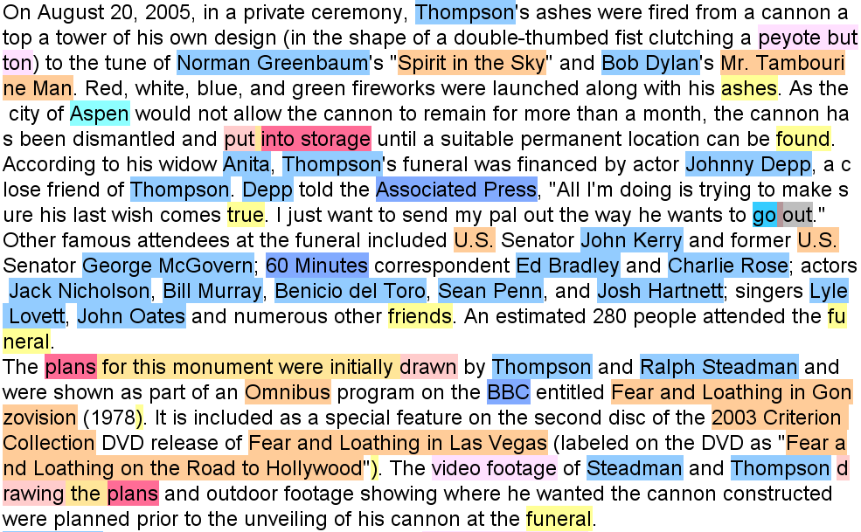

Slide 24
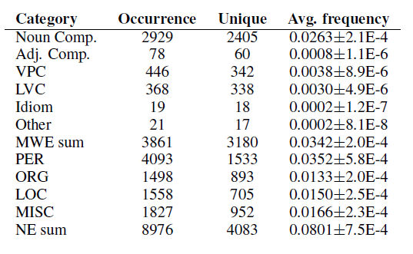
Frequency of categories

Slide 25
MWEs in computational linguistics
Special treatment: racing car – versenyautó (MT), to have a lecture - *having – lecture (IE)
They need to be identified in context (give a ring, tevékenységet folytat)
Annotated corpora (Wiki50, corpora for LVC, PARSEME shared task…)

Slide 26
MWEs in applications
1 MWE is 1 unit
Special rules:
  IE: the noun contains the meaning in LVCs
  For non-compositional items, none of the parts can be literally used - lexicons
In MT, MWEs have a crucial rule (fűbe harap (to bite into grass) – to kick the bucket)

