Slide 1
Speech technology
Introduction to Computational Linguistics – 17 September 2018

Slide 2
Introduction
Linguistic fields:
phonetics
phonology
NLP fields:
Speech recognition
Speech synthesis

Slide 3
Phonetic transcription
IPA (International Phonetic Alphabet)
Language independent
For all sounds in all languages
Latin, Greek and invented symbols

Slide 4
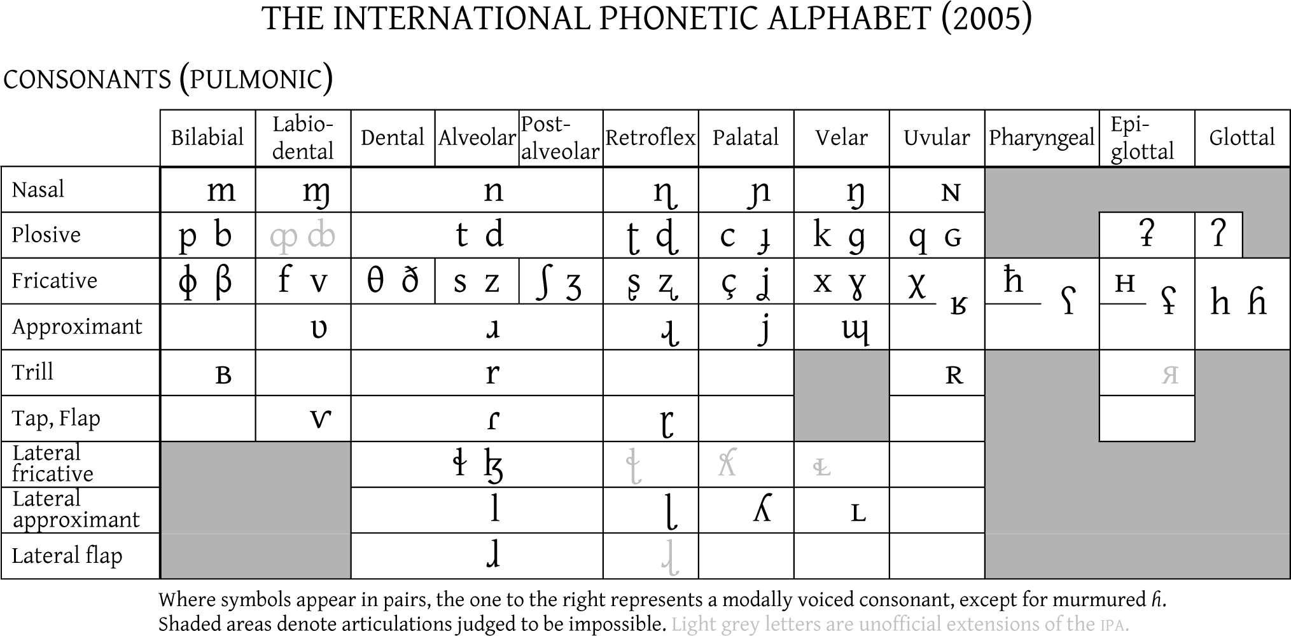
Consonants (C)

Slide 5
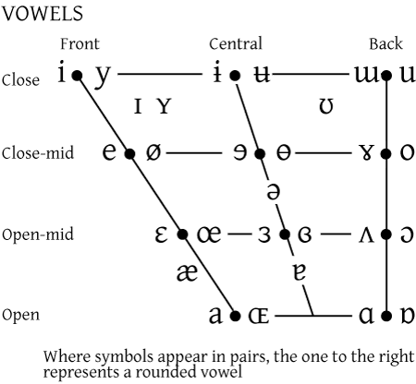
Vowels (V)

Slide 6
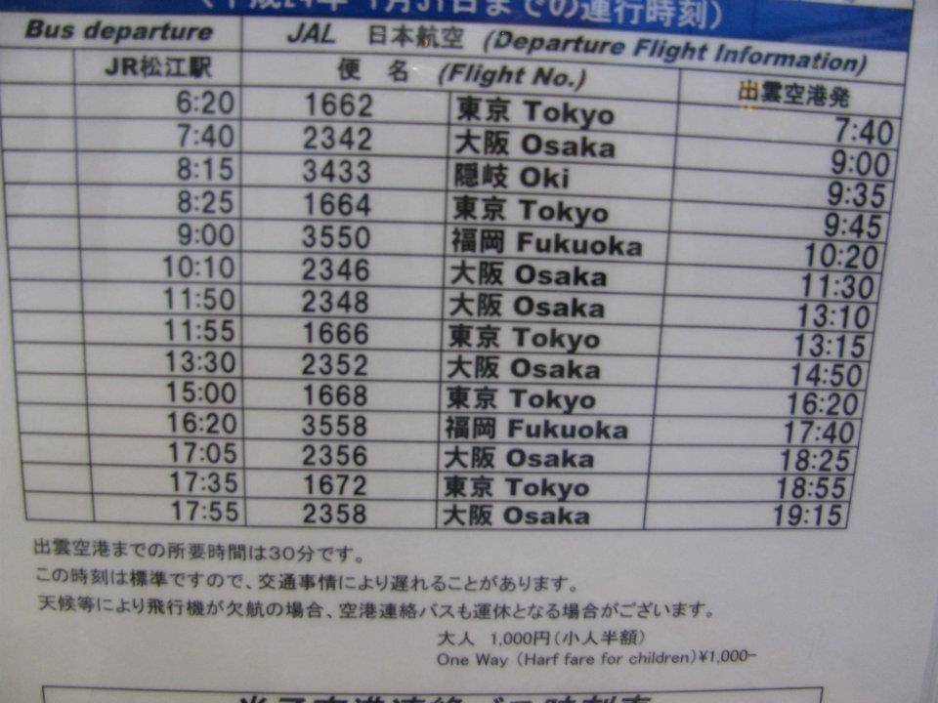
Phoneme - allophone
Japanese: [l] and [r] – 2 allophones, 1 phone – English „words” („pratfrom”, „Restaulant”, „harf fare”)

Slide 7
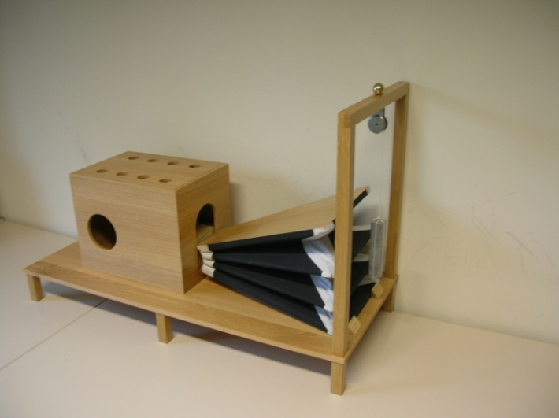
Speech technology
Speech synthesis (text2speech)
Speech recognition (speech2text)
Well before NLP:
Speech machine by Farkas Kempelen (1770)

Slide 8
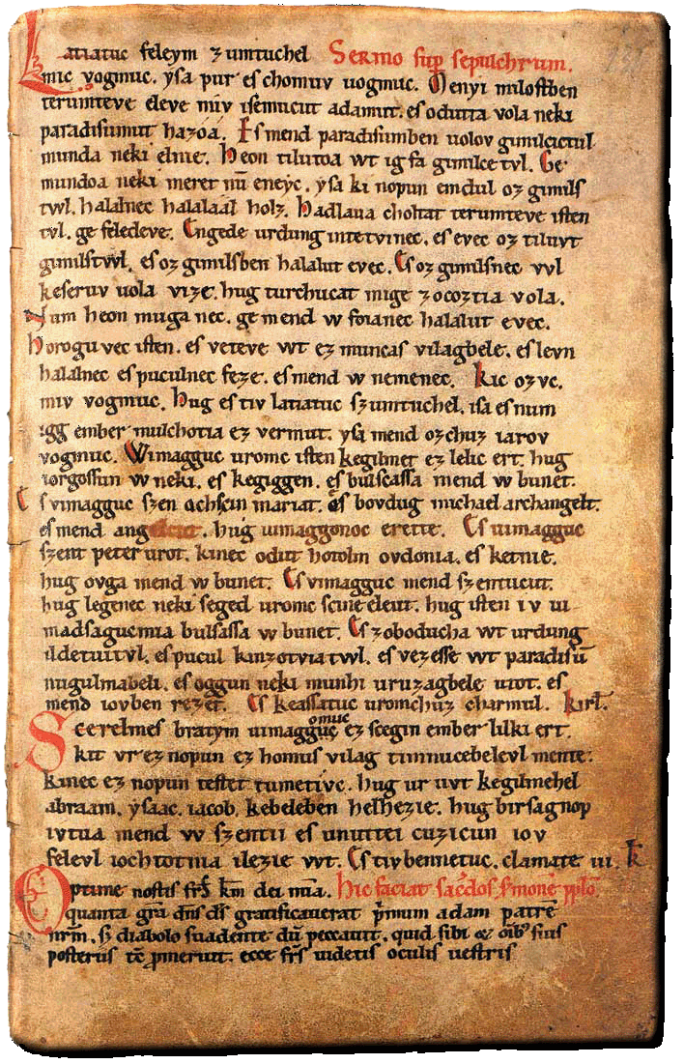
Text2speech
Exercises
Funeral Sermon
Finland Män
Orthography and pronunciation may be very distinct

Slide 9
Text2speech – give it a try
A: Conas mar a bhí an scoil inniu? B: Maith go leor. A: An raibh an obair bhaile a rinne tú don rang Mata ceart go leor? B: Bhí. A: Agus an ndeachaigh sibh go dtí an linn snámha san iarnóin? B: Chuaigh. A: An raibh Manus ar ais ar scoil inniu? B: Ní raibh. A: In ainm Dé, a Shéamais, labhair liom! Tá tú chomh tostach! B: Ach tá mé tuirseach agus bréan den scoil. A: Maith go leor, mar sin. Ní chuirfidh mé níos mó ceisteanna ort. B: Go raibh maith agat.

Slide 10
Speech2text – give it a try
Listen to the file: sample.mp3
Try to write what you listen to ☺
http://www.rte.ie/easyirish/aonad3.html
[bɛdɛksɔnɪ] [lofas] [balatõfənɪ:v]
Badacsony, Lovas, Balatonfenyves
https://www.youtube.com/watch?v=zzE3dIkCDoc
Smartphone: Siri, Cortana

Slide 11
A: Ith do dhinnéar, a Chaoimhín. B: Ach níl ocras ar bith orm. A: Agus ith thusa do chuid glasraí, a Shorcha. C: Ní maith liom glasraí – is fuath liom iad. B’fhearr liom sceallóga. A: A Chaoimhín, tabhair dom an t-im, le do thoil. Go raibh maith agat. Agus an bainne. Maith an buachaill. C: An féidir liomsa gloine oráiste a bheith agam? A: Is féidir – má itheann tú do ghlasraí i dtosach. C: Ach ní maith liom brocailí ná cairéid. Tá drochbhlas orthu. A: Tá siad an-mhaith agat. Ith suas iad agus ansin is féidir leat gloine dheas oráiste a bheith agat. C: Níl sin féaráilte!

Slide 12
Speech synthesis
From text to speech = reading aloud a text
Hard to solve
Domain specific solutions exist
No universal solution yet

Slide 13
Characters -> sound
Normalization:
Australia-based website AirlineRatings.com has named Air New Zealand the 2016 Airline of the Year in its prestigious Airline Excellence Awards. The "industry trendsetter" was praised for its award-winning inflight innovations, operational safety and environmental leadership.
australia based website airline ratings dot com has named air new zealand the two thousand sixteen airline of the year in its prestigious airline excellence awards the industry trendsetter was praised for its award winning inflight innovations operational safety and environmental leadership
Unnecessary characters removed
Language identification
Resolution of abbreviations, numbers…

Slide 14
Techniques: formant sythesis
Machine generated waves
Very mechanical/artificial
Not in real-world applications
Only for research purposes

Slide 15
Techniques: concatenation
Waves cut from human speech are concatenated
Sound-based: it might work but bad quality
Phonological context: sound combinations (dyads/triads) ~ syllables
Popular now in the world

Slide 16
Techniques: pattern selection
Corpus-based: wave + text + normalized transcript + phonetic transcript
In the database: full sentences recorded with different speakers with different prosody
The most similar sentence should be selected to the one to be read aloud
It works fairly well:
Bigger units, less gaps
Prosody is more natural

Slide 17
Speech synthetizers
Domain-specific modules:
weather forecasts
schedules
name and address lists
news
numbers…

Slide 18
Speech recognition
To write down what was told
+ speaker recognition, emotion recognition…
Feature extraction: separating speech and noise
Pattern matching: features matched to statistical patterns (collections of sounds, words, speakers…)

Slide 19
Pattern matching
Timing: where does the actual sentence/word start/end?
Stress patterns
Similar to transcribing a foreign language
Classification: which stored element is the most similar – probability model

Slide 20
Language dependent models
Language model: weighs the word candidates of the given language based on the already known words
Pronunciation model: matching words and sounds
Coarticulation model: dyads and triads
Acoustic model: sound with its acoustic features

Slide 21
ASR applications
Command and keyword recognition
Command: after a beep you can tell a given command
Voice dialing
Keyword recognition: find a keyword in spontaneous speech

Slide 22
Dictation systems
Very restricted vocabulary
Large vocabulary-based ASR (LVCSR)
Clinical domain (radiology)
Legal domain
Fairly good accuracy
General purpose ASR:
https://dictation.io/

Slide 23
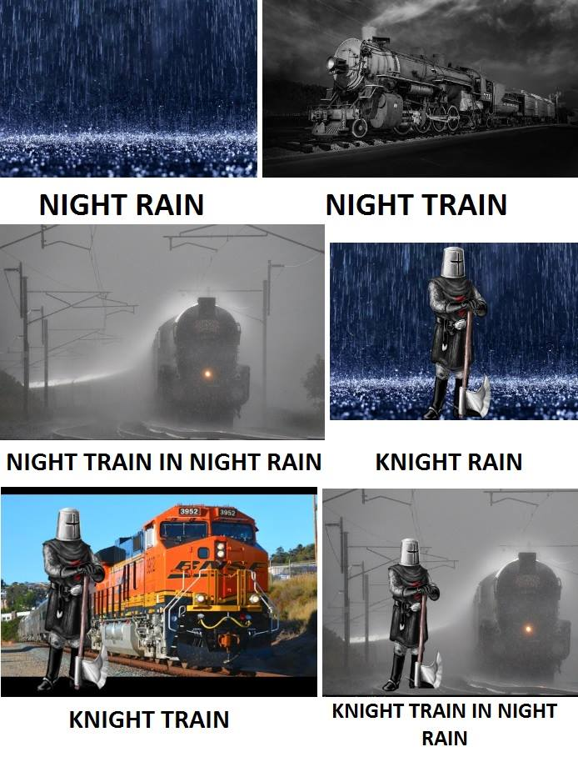
Challenges
Homophony (peer, pear)
Homography (lead)
Rare in Hungarian (but: foglyuk – fogjuk, gombjuk – gomblyuk)
Different speakers: pitch, volume, speech rate…
Letter combinations:
Nyílászáró
Egészség
Összsúly
Bokszzsák
Dzsesszzene
Mishap
Knighthood

Slide 24
Solutions?
Morphology: compounds, morpheme boundaries
n-grams (neighboring elements):
I lead vs. lead poisoning

Slide 25
Misheard lyrics ☺
http://www.youtube.com/watch?v=tnlveKfDuyk
http://www.youtube.com/watch?v=Kd2KjK3Mn5A
http://www.youtube.com/watch?v=rESL1uihJeg

