Slide 1
Syntax and parsing
Introduction to Computational Linguistics – 24 September 2018

Slide 2
Introduction
Syntax: detecting grammatical relations among words (subject-verb, noun-preposition etc.) -- in an automatic way
Building on tokenization and POS-tagging
Parsing – parser

Slide 3
Syntactic units
Phrases: elements that belong together
  Noun phrases (NP): I, the yellow house, Steve’s dog…
  Phrases fulfill grammatical roles (subject, object…)
Predicate-argument relation
  Not only verbs may be predicates (adjectives (jealous of sy), nouns denoting events (war against sy/sg)…)

Slide 4
Syntax in applications
Syntactic parsing is usually a preprocessing step for other higher-order applications
It is essential to parse sentences for a deeper linguistic analysis of texts
Effective syntactic analysis is needed for information extraction:
Germany lost the war against France.
France won the war against Germany.
Winner: France Loser: Germany

Slide 5
Syntax in applications
Machine translation
Tegnap az irodában Péter öt levelet írt.
TEMP LOC SUBJ OBJ VERB
Peter wrote five letters in the office yesterday.
SUBJ VERB OBJ LOC TEMP

Slide 6
Computational syntax
Rule-based parsing
  Experts manually define rules
Statistical parsing
  Big datasets (treebanks)
  Parsers
  Parsing is based on rules automatically collected from treebanks

Slide 7
Statistical parsing
Technologies developed for English
Constituency grammar
Dependency grammar
Fixed word order vs. free word order
Morphologically rich languages

Slide 8
Syntactic trees
Root
Leaf/leaves
Nodes
Edges
Labels
Peter went to the garden.

Slide 9
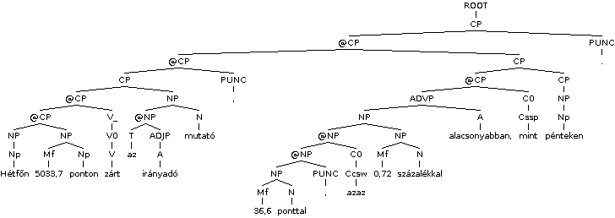
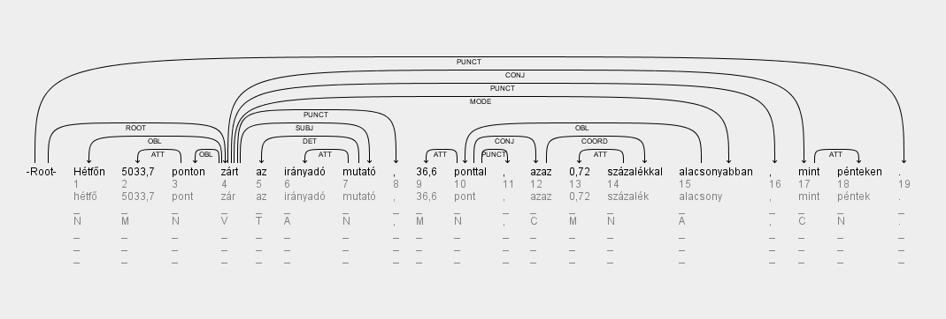

Slide 10
Dependency vs. constituency
Each node denotes a word in dependency trees -> no artificial nodes (CP, I’…)
Constituency grammars usually function well for fixed word order languages
What determines syntactic roles?
  Position in the tree (constituency)
  Dependecy relations (labeled edges) (dependency)

Slide 11
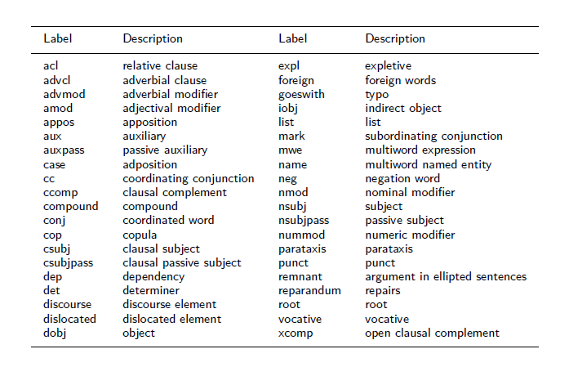
Universal Dependencies

Slide 12
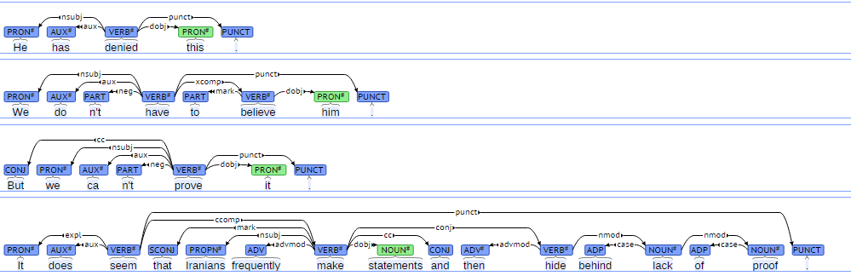
Samples

Slide 13
Parsing as search
Given a sentence, try to find the parse trees and select the best one
Constraints in search:
  The start symbol is the root of the tree (S)
  Words of the input are on the leaves of the tree

Slide 14
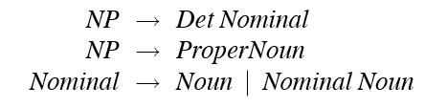
Constituency parsing
Terminals: words
Non-terminals: constituents
Rules: one non-terminal on the left handside

Slide 15
Top-down parsing
Goal-oriented
Starting from S
Finds matches for the left handside of the rules

Slide 16
Bottom-up parsing
Data-driven approach
Starts from the input words
Finds matches for the right handside of the rules

Slide 17
Comparison
Top-down:
  Only correct trees are created (ending in S)
  Many trees do not match the input
Bottom-up:
  Only trees that match the input are produced
  Many incorrect trees are created

Slide 18
Dependency parsing
Transition based
  Adding a new edge in each step
  Classification problem:
    units: word bigrams
    features: words, POS, morphology
    action: adding a new edge or nothing
Graph based
  Finding the best graph

Slide 19
Ambiguity
morphological:
szemét – szem+é+t
structural:
One morning I shot an elephant in my pajamas.
  Who wears my pajamas?
lexical:
He went to the bank.
  To the river or to the financial institute?
semantic:
Every man loves a woman.
  The same woman for everybody or different?

Slide 20
Syntactic ambiguity
PP-attachment:
I saw the girl with the telescope.
  Who has the telescope?
coordination:
(Blonde (girls and boys) were playing in the yard.
(Blonde girls) and (boys) were playing in the yard.
Resolution of ambiguity: selecting the best possible analysis for the sentence
Local ambiguity: a part of the sentence is ambiguous (it has more than one possible analysis) but the sentence itself is not ambiguous (the boy’s dog – where to attach „the”?)

Slide 21
Ambiguity
Time flies like an arrow.
VB VBZ VB DT NN
NN NNS IN VB
NNP NN
RB
CC

Slide 22
Time flies like an arrow.
Time moves in a way an arrow would.
Certain flying insects, "time flies," enjoy an arrow.
Magazine Time moves in a way an arrow would.
The publishing company of Time moves in a way an arrow would.
Measure the speed of flies like you would measure that of an arrow.
Measure the speed of flies like an arrow would.
Measure the speed of flies that look like an arrow.

Slide 23
Time flies like an arrow.
Az időlegyek szeretnek egy nyilat.
Úgy repül az idő, mint egy nyílvessző.
A Time magazin úgy száll, mint egy nyílvessző.
Az idő úgy menekül, mint egy nyílvessző.
A Time magazin kiadója úgy száll, mint egy nyílvessző.
Mérd a legyek sebességét úgy, mint egy nyílét.
Mérd a legyek sebességét úgy, mint egy nyíl.
Mérd meg nyílsebesen a legyek sebességét.
Mérd meg azoknak a legyeknek a sebességét, amelyek egy nyílra hasonlítanak.

Slide 24
Agreement
Morphosyntactic features of two or more phrases agree
Often denotes syntactic connection
SUBJ (Per, Num) -> V (Per, Num)
The boy runs – The boys run
SUBJ (Per, Num) -> PRED (Num)
  I became a teacher – we became teachers
Numeral – NOUN (Num)
An apple – two apples

Slide 25
Agreement - HUN
OBJ (Def) -> V (Def)
  Látom a gyereket. (I can see the kid.)
  Látok egy gyereket. (I can see a kid.)
Possessor (Num, Per) -> Possessed (NumP, PerP)
  az én könyvem (my book)
  a te könyved (your book)
  az ő könyve (his book)
Exception:
  az ő könyvük - * az ők könyvük (their book)
  a fiúk könyve - * a fiúk könyvük (the boys’ book)

Slide 26
Agreement - HUN
Noun (Cas) -> DET (Cas)
  Ez a lány – ezzel a lánnyal (this girl – with this girl)
DAT (Num, Per) -> INF (Num, Per)
  A fiúnak nem szabad futnia. - A fiúknak nem szabad futniuk. (The boy is not allowed to run – The boys are not allowed to run)

Slide 27
Evaluation of syntactic parsing
Constituency
  Constituents are compared (with our without labels)
  The order of parents of each leaf is compared
Dependency
  For each word
  Parent and/or label is compared

Slide 28
Evaluation metrics
precision
recall
F-score
LAS (labeled accuracy score): parent and label
ULA (unlabeled accuracy score): only parent
Possible reasons for parsing errors:
  Incorrect POS tagging
  Error in the training data
  ambiguity

Slide 29
Specifications for the term paper
please follow the template (template_angol (2).docx)
write 2-3 pages at least (references included)
please follow the sections found in the template (Introduction, Methodology, Results, Conclusions)

Slide 30
Quiz 1
https://forms.gle/QEJwkMGr3AvnABmC9
Please fill in until 19 October

