Slide 1
Binary Tomography
17th Summer School on Image Processing
Debrecen, Hungary 2009

Slide 2
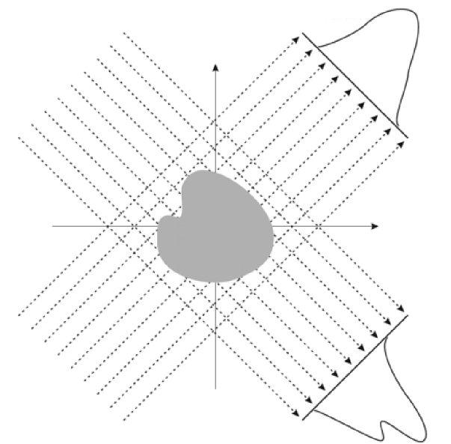
Introduction
Basic idea
Computerized tomography
Discrete tomography
Binary tomography
Applications

Slide 3
Problem description
Projections
Reconstruction

Slide 4
Known algorithms
Simulated annealing
Linear relaxation
Branch and bound
SPG based method
Maximum flow problem
Neural networks
Convex-concave regularization
...

Slide 5
Our solutions
Simple solution
Star section algorithm for 2 and 4 projections
Evolutionary algorithm for 2D and 3D objects
Modified Kaczmarz algorithm

Slide 6
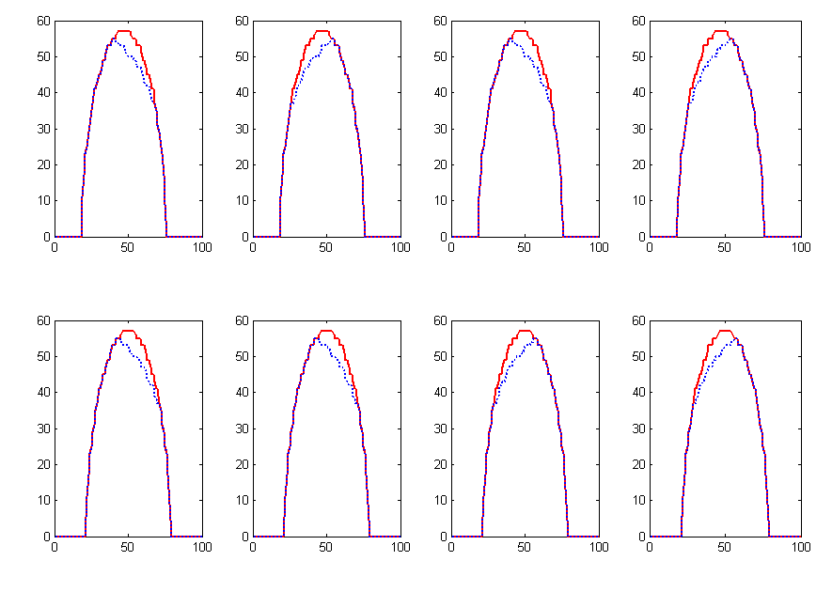
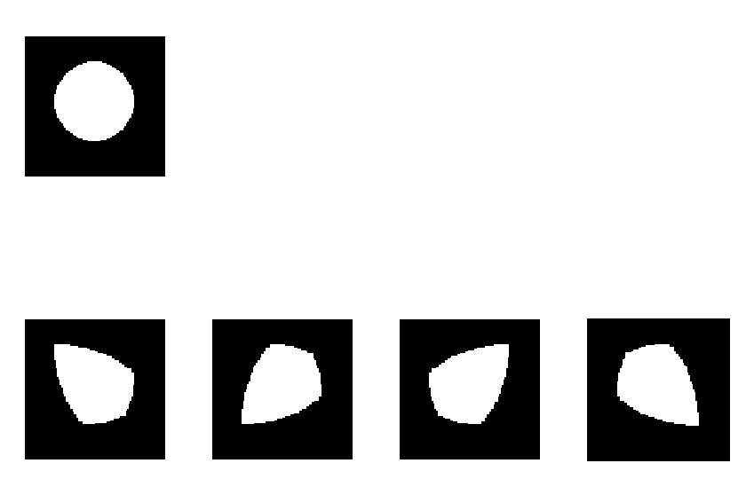
Simple solution
Greedy algorithm
Orginal image
Reconstructions

Slide 7
Star section algorithm
Maximum value of projections
Cross shape growing

Slide 8
2 projections - results

Slide 9
2 projections - results

Slide 10
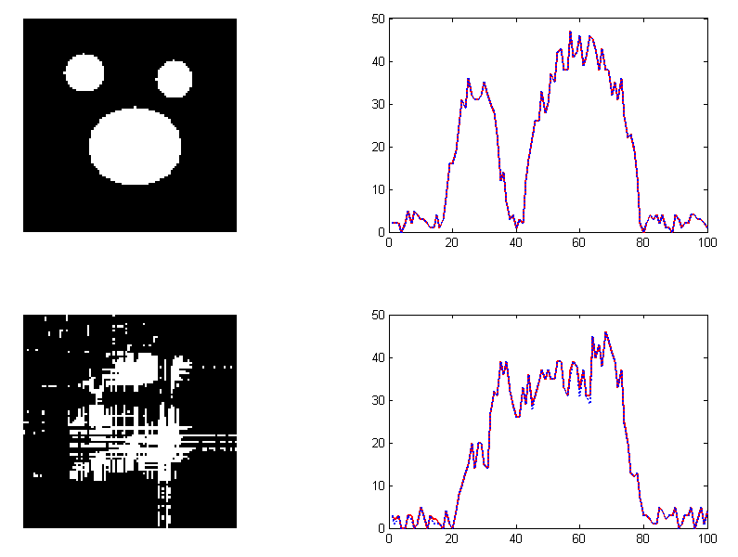
2 projections - results

Slide 11
4 projections - results

Slide 12
4 projections - results

Slide 13
4 projections - results

Slide 14
4 projections - results

Slide 15
Evolutionary algorithm for 2D
Population
Mutation
Crossover
Fitness
Prototype based representation of shapes

Slide 16
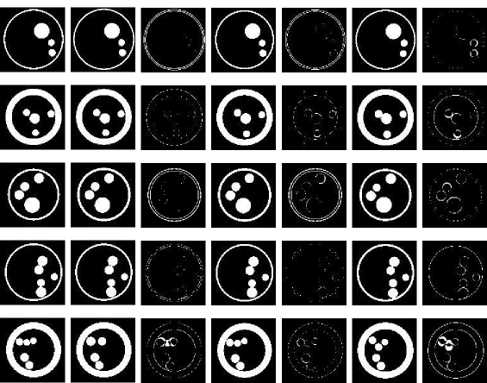
2D results
10% noise
25% noise
Noisless

Slide 17
2D results

Slide 18
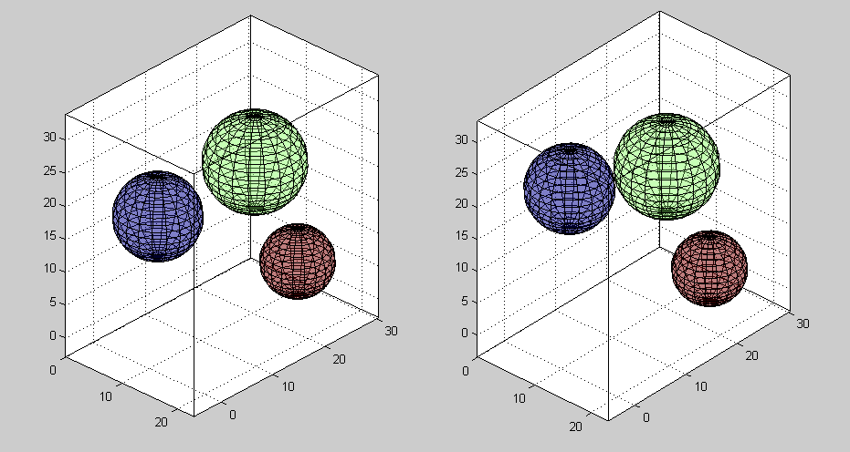
Evolutionary algorithm for 3D

Slide 19
Modified Kaczmarz algorithm
Linear system
r(i) is chosen from the set {1,2,...,m} at random, with probability proportional to

Slide 20
Results

Slide 21
Results

Slide 22
Results

Slide 23
Results

Slide 24
Summary

Slide 25
The avenue of future researches
Star section algorithm
Using circular directed growing instead of sectional
3D implementation
Evolutionary algorithm
Automatic parameter adjustment
Applying algorithm to other shapes
Randomize Kaczmarz algorithm
Improving boundary reconstruction method

Slide 26
A - team

Slide 27
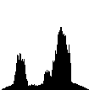
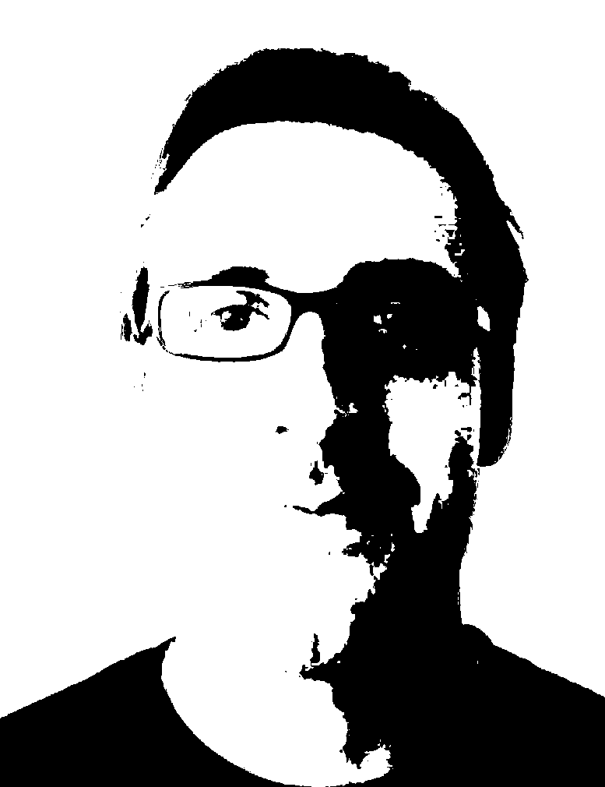
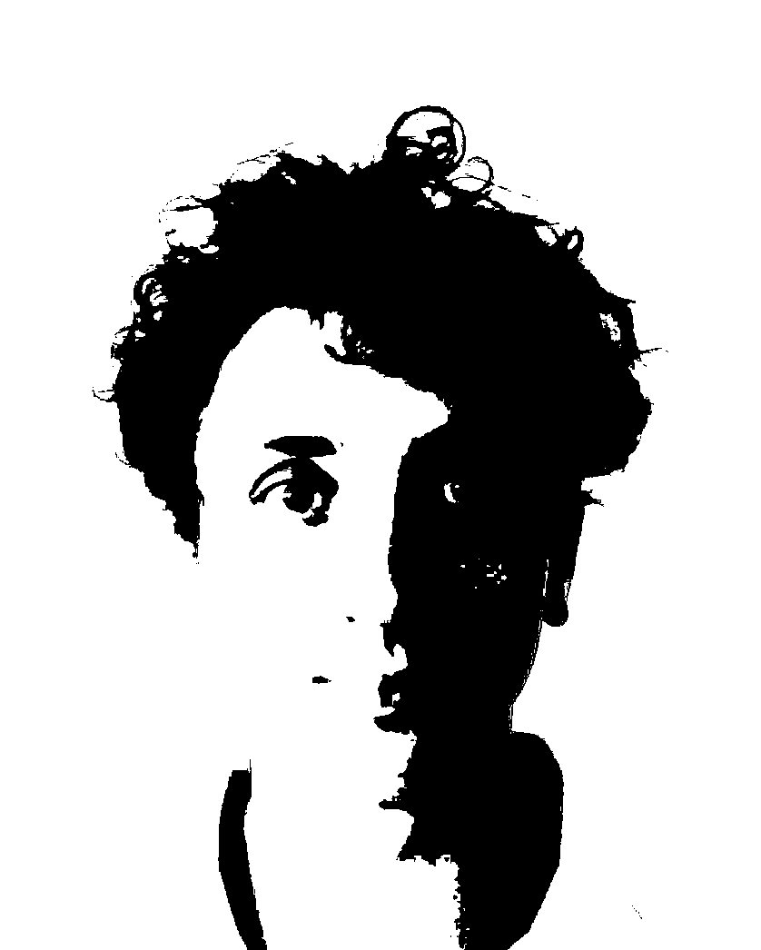
Thank You for Your Patiance

